Slide 1
PRIVATE EQUITY & SEC REGULATIONS Josh Cantwell & Joe Carney, Esq.

Slide 2

THE ELEPHANT IN THE ROOM!
Because no one talks about real truth about private money and the securities laws!
Once you understand the law and the rules you can use them to your advantage, be more professional and raise money in compliance with the law!
Once you offer to take someone’s money and offer them a ROI this is an offer of a “security”.
Both the offer and the sale of a “security” are regulated by state and federal agencies.
These slides are summaries and are not a substitute for working with your own attorneys, financial and tax advisors.
Why Am I Passionate About Real Estate and Private Money?

Slide 3
SEC REGULATIONS
SEC INVESTIGATIONS
People demonstrating compliance with proper documents and activity do not worry regulators; but no such thing as “finders fees” which are commissions payable only to registered broker dealers (These worry SEC)
PRIVATE PLACEMENT
An offer to raise private money
without any form of “general solicitation”

Slide 4
DID YOU KNOW?
Public Companies Use Private Placements Also To Raise Money
2010
More Than $1 Trillion Dollars Was Raised By Private Companies And Public Companies
More Money Was Raised From Private Placements Than I.P.O.'s
Under Private Placements You Don't Generally Give Up Control Unless You Plan It That Way

Slide 5
3 THINGS TO CONSIDER
1
Are you going to be making offers to everyone or just accredited investors? (Y or N)
2
Are you going to be operating just within your state or across state lines? (Y or N)
3
Are you going to be raising money from just people you already know or do you want to solicit the general population (strangers)? (Y or N)

Slide 6
ACCREDITED INVESTORS
$1M Net Worth
Income Based
Cannot include value of home you are living in; can include all other assets and property; entities including Trusts have special rules; all owners accredited or $5 million net worth
Single - $200,000 +
Past 2 years and the current year of annual gross income
Married - $300,000+
Past 2 years and the current year of annual gross income
Asset Based
Income Based

Slide 7
ACCREDITED INVESTORS
UNACCREDITED
ACCREDITED
SEC policy/reasoning on “Accredited vs. Non- Accredited”
SEC takes more time and money to protect UNACCREDITED (UA)
The UA don't have the sophistication, assistance of professionals or money to protect themselves
Protect the little guy
SEC takes less time and money to protect ACCREDITED
Accredited have their own resources to protect themselves

Slide 8
“IN STATE” OR NATIONWIDE OFFERINGS
Intrastate vs. Interstate
Intra State Offerings – Section 3(a)(11) and/or Rule 147; Rule 147 is a safe harbor with more restricted guidelines than Section3(a)(11); look easier but it’s COMPLEX ; both applicable only to ISSUERS (NOT RESALES)
Offers NOT Just Sales are Covered
Rule 147: The Intra-state Offering Exemption Safe Harbor
Rule 147, adopted under Section 3(a)(11) of the Securities Act, grants an exemption from registration to issuers conducting an intra-state offering that satisfy the following conditions:
The issuer must be organized and doing business in the state where the securities are offered and sold.
General advertising and general solicitation to market the securities are allowed only within the state and there is no limit on the amount of securities that may be sold.(no internet)

Slide 9
“IN STATE” OR NATIONWIDE OFFERINGS
Intrastate vs. Interstate
Resales are permitted to in-state residents. Resales by non-affiliates to out-of-state residents are only permitted beginning nine months after the last sale of securities by the issuer. The exemption is destroyed if offers or sales are made to out-of-state residents.
The in-state requirements of Rule 147 put significant constraints not only on the type of investors that companies may approach but also on the method of communication with those investors. As a result, Rule 147 may be of limited benefit to companies seeking to raise capital. It should also be noted that Rule 147's requirements are absolute and that there is no "reasonable basis to believe" standard as in Regulation D
You may still fall back on Section 3(a)(11)

Slide 10
“IN STATE” OR NATIONWIDE OFFERINGS
Intrastate vs. Interstate
Where Is Your Primary Residence; Other Indicators - Driver's License And Registered To Vote
That's Your Home State ; Entity Investors if formed to invest must have all owners in that State
"Intrastate" Offering
Rule 147 lays out what state an issuer is viewed to be In; Look At Rule
80 cents of each dollar raised must be used in that state
"Interstate" Offering (Substantial Regulation /Registration use Section 4(a)(2) and Regulation D/Rule 506
You in Home State, Investors in another state
Crossing State Lines (Cities close to state borders are problematic places for intrastate offerings )
Investing In 2 Or More States At Same Time (Having More Than 20 Cents of What you Raised Used In Other States = Interstate Offering)

Slide 11
PRIOR EXISTING RELATIONSHIP VS. GENERAL SOLICITATION
Prior Existing Relationship vs. General Solicitation
Prior Existing Relationship = Defined At Federal Level
It is a substantive, pre-existing relationship between the investors and the company.
It is a matter of substance and does not relate to the time of a relationship or the context. SEC says this is a fact specific determination.
Impersonal, non-selective means of communications indicate General Solicitation.

Slide 12
PRIOR EXISTING RELATIONSHIP VS. GENERAL SOLICITATION
Prior Existing Relationship vs. General Solicitation
What is a substantive relationship? It is one in which the issuer (or a person acting on its behalf) has sufficient information to evaluate, and does in fact evaluate a prospective offerees financial circumstances and sophistication, in determining his or her status as an accredited or sophisticated investor. Self certification by an investor is alone not sufficient to create a substantive relationship. (CDI 256.31)
In the absence of a prior business relationship or duty to an offeree, it is difficult for an issuer to establish a pre-existing substantive relationship when contemplating an offering, especially when contemplating or engaged in an offering over the internet. Issuers have to consider not only whether they have sufficient information about the particular offerees, but also whether they in fact use that information appropriately to evaluate the financial circumstances and sophistication of the prospective offerees prior to commencing the offering. (CDI 256.32)

Slide 13
FEDERAL LEVEL: EXEMPTION FROM REGISTRATION UNDER REG “D” OFFERING
FEDERAL LEVEL: CLAIMING EXEMPTION UNDER REG D
REG “D” Exemption to Securities Act Registration Requirements
Securities Act of 1933, passed in 1933
Securities and Exchange Commission created in 1934, under the Securities Exchange Act of 1934
Both securities acts arose in the ashes of the Great Depression of the 1920s and documented abuses in the sales of stock. Basically, the 1933 Act deals with the new issuance of securities; and the 1934 Act deals with trading of securities and broker dealers.
1933 Act – SECTION 5: Each and every sale of securities, no matter how small, de minimus or private must either be registered with the SEC or have an exemption from registration; exemptions were set up to deal with typical situations

Slide 14
FEDERAL LEVEL: EXEMPTION FROM REGISTRATION UNDER REG “D” OFFERING
FEDERAL LEVEL: CLAIMING EXEMPTION UNDER REG D
Dual Regulation - In ADDITION to the federal securities laws, the state securities laws must also be complied with UNLESS THEY ARE PREMPTED. (PARTIAL PREMPTION IN REG D FROM STATE NOTICE AND REGISTRATION BUT STATE ANTI FRAUD LAW CONTINUES TO APPLY)
Online offerings popular in the 1990s and shut down because of rampant fraud (old Rule 504) (Shut down was accomplished by just withdrawing the preemption of state law so that all online offerings had to fully register or be exempt on a state basis.
Online offerings are PUBLIC OFFERINGS.
Claiming Reg D Rule 506 is EASY (Form ID; Form D; all filed electronically with SEC; Hard copy to relevant states with fee)

Slide 15
FEDERAL LEVEL: EXEMPTION FROM REGISTRATION REG “D” OFFERING
FEDERAL LEVEL: EXEMPTION FROM REGISTRATION – REG “D”
FORMS D are visible on the SEC Web Site via EDGAR
http://en.wikipedia.org/wiki/EDGAR
“Electronic Data Gathering, Analysis and Retrieval system performs automated collection, validation, acceptance and forwarding submissions by companies who are required by law to file forms with S.E.C.”
“Freely available to the public via the internet.”

Slide 16
FEDERAL LEVEL: EXEMPTION FROM REGISTRATION REG “D” OFFERING
FEDERAL LEVEL: EXEMPTION FROM REGISTRATION – REG “D”
www.sec.gov/edgar.shtml
Public Companies filed stock registrations; 10-Ks; 10-Q; Proxies; Annual Reports and substantial information to provide the investing public and investment professionals with full, fair and adequate public information about those companies; available at no cost.
Form D is just a claim of exemption; no offering document is filed. (Some states might have a rule stating a copy be provided. E.g. Massachusetts)

Slide 17
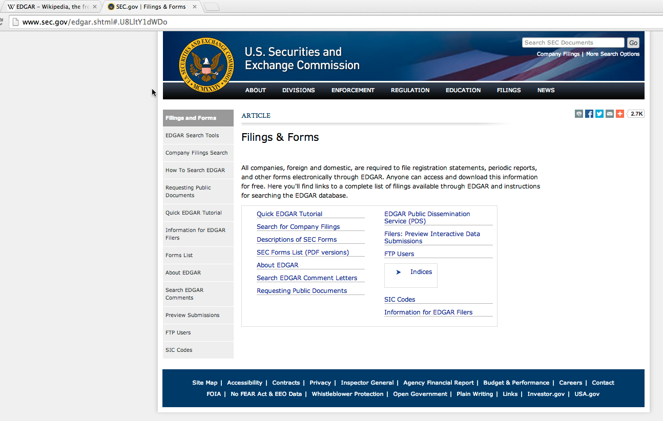

Slide 18
FEDERAL LEVEL: EXEMPTIONS FROM REGISTRATION REG “D” OFFERING
EXAMPLES OF REG D OFFERINGS
504
505
506 (b)
506 (c)

Slide 19
FEDERAL LEVEL: EXEMPTIONS FROM REGISTRATION REG “D” OFFERING
REG D 504 FEDERAL FILING – NOT A SAFE HARBOR
Raise Up to $1M
Online Filing of Form D with SEC
No Fee
FULL STATE REGISTRATION OR EXEMPTION REQUIRED -- NO PREMPTION

Slide 20
FEDERAL LEVEL: EXEMPTIONS FROM REGISTRATION REG “D” OFFERING
REG D 504 FEDERAL FILING – NOT A SAFE HARBOR
MOST Rule 504 offerings now need a full registration for each state in which there will be OFFERS OR SALES. This is a very complex, expensive and time consuming process. Your offering is reviewed and commented on by the State Securities staffs. You need to get an order of effectiveness to initiate the offer and sale. There are many “substantive” regulatory” requirements, e.g. “BLUE SKY” if they don’t like how much you pay yourself, you don’t go effective; if they don’t like x,y,z you need to change it to go effective. The Blue Sky laws protect small investors.
Rules are under Section 3(b) of the 1933 Act – Not a safe harbor – if you go outside of the Rules you have created potential civil liabilities and the rights of investor to get their money back – you lose your risk transfer you sought.

Slide 21
FEDERAL LEVEL: EXEMPTION FROM REGISTRATION REG “D” OFFERING
REG D Rule 505 FEDERAL CLAIM OF EXEMPTON (NOT A SAFE HARBOR)
$5M Limit
Federal filing claims the federal, but not state, exemptions from registration
Like Rule 504, you need to perfect either state registration or a state claim of exemption
Online Filing Form D with SEC: but you must file a registration in each state or find a state exemption, this is a very complex aspect
Up to an unlimited number of accredited investors and up to 35 non accredited investors

Slide 22
FEDERAL LEVEL: EXEMPTION FROM REGISTRATION REG “D” OFFERING
REG D Rule 505 FEDERAL CLAIM OF EXEMPTON (NOT A SAFE HARBOR)
As compared to Rule 506(b) the Investors (alone or with their purchaser representatives) need not be sophisticated. This can be a good situation for company employees where there is not the same level of sophistication as with a private placement. Rules are under Section 3(b) of the 1933 Act – Not a safe harbor – if you go outside of the Rules you have created potential civil liabilities and the rights of investor to get their money back – you lose your risk transfer you sought.

Slide 23
FEDERAL LEVEL: EXEMPTION FROM REGISTRATION REG “D” OFFERING
REG D 506 (b) FEDERAL FILING = THIS IS WHAT JOSH DID= SAFE HARBOR TO SECTION 4 (a)(2), WHICH IS ALSO A SELF EFFECTUATING FEDERAL EXEMPTION FROM REGISTRATION AND IS BROADER THAN RULE 506(b). This is the main and the best known and developed Private Placement Exemption.
506 (b)
Allows You To Get Money From Accredited (Unlimited) And Non Accredited (Max 35) (Unaccredited - Sophisticated)
NO LIMIT TO AMOUNT YOU CAN RAISE

Slide 24
FEDERAL LEVEL: EXEMPTION FROM REGISTRATION REG “D” OFFERING
REG D 506 (b) FEDERAL CLAIM OF EXEMPTION= THIS IS WHAT JOSH DID
506 (b)
Well developed and well known exemption used by public and private companies
Unlimited raise (may be pragmatically limited by number of investors)
FORM D – Very few questions; federally no Fee (states have fees)
Questionnaire to fill out
Update with amendment but most of the time does not need updated or amended- Can cover up to 12 months

Slide 25
FEDERAL LEVEL: EXEMPTION FROM REGISTRATION REG “D” OFFERING
REG D 506 (b) FEDERAL CLAIM OF EXEMPTION= THIS IS WHAT JOSH DID
No Waiting Period
Within hours / minutes you get confirmation "ACCEPTED”
YOU Can never say “Approved”
Venture Funds; Hedge Funds; etc. use Rule 506(b) to form pools of money (other laws apply to funds depending)
Form D when filed with a state caused the preemption of its state Blue Sky laws registration provisions, but not the State’s Anti-Fraud Laws; with only the short Q & A Notice filing; its easy to enter and do business in various states

Slide 26
FEDERAL LEVEL: EXEMPTION FROM REGISTRATION REG “D” OFFERING
REG D 506 (b) FEDERAL CLAIM OF EXEMPTION= THIS IS WHAT JOSH DID
Crisscross State Lines
NO 80/20 Rule, raise it in any state and crisscross as often as you like; Apply the money in a different state; File Form D in each state where a sale is made within 15 days
Used extensively by private businesses

Slide 27
FEDERAL LEVEL: EXEMPTON FROM REGISTRATION A.K.A. REG “D” OFFERING
REG D 506 (b) FEDERAL FILING
506 (b)
Investor Questionnaire to fill out (Investor must be sophisticated or have help rendering the investor sophisticated)
No general solicitation allowed ; This means no soliciting strangers; No internet; No country club membership lists; you must have a prior substantive existing relationship to offer them a deal
It’s perfect if you know a lot of people or you can network well
CANNOT take out a CRAIGSLIST AD saying “Get 12%”
Cannot Say “10% Guaranteed”

Slide 28
FEDERAL LEVEL: EXEMPTON FROM REGISTRATION A.K.A. REG “D” OFFERING
REG D 506 (b) FEDERAL FILING
How do you deal with new persons? New Persons – You don’t have Prior Substantive Existing Relationship (PSER); You must develop PSER before you make an offer for someone to invest in your ROI Offering
Consider use of prior closed offerings can facilitate creating PSER, use for investor to teach issuer about his sophistication and via this and learning investors other investments you can create PSER
Can't put offer on website (visible to the world) (some exceptions if you have highly qualified technology; but typically not worth it.)
Keep it password protected (still a significant risk) Or Take Off Web All Together

Slide 29
FEDERAL LEVEL: CLAIM OF EXEMPTION FROM REGISTRATION A.K.A. REG “D” OFFERING
REG D 506 (b) FEDERAL CLAIM OF EXEMPTON FROM REGISTRATION
506(b) You Can Say "Come Learn About Private Mortgage Lending" | We Can Give Examples
“Is It Possible To Make More Than The Bank?” YES | Your loans are high risk however (mitigated by study of real estate market; mortgages; and other factors; but still high risk)
But Banks They Have FDIC Insurance | We Haven't Done It But Here's The Kinds Of Deals They Offered
NEVER KNOCK The Other Companies | Focus on Learning Investors History of Investing; Risk Tolerance; Sophistication when
Here's Our Options | Until a substantive relationship is established the SEC Prohibits Me To Make You An Offer; but I can show you a prior closed deal that you can NOT invest in; this way you learn about how we do business and I the borrower learn about you the investor
Invite To Webinar Or Seminar | Don't Give The R.O.I.
Tell You About Company And Its History No Offer of a Current Deal – Tell about a closed done deal; learn about the attendees.

Slide 30
FEDERAL LEVEL: CLAIM OF EXEMPTION FROM REGISTRATION A.K.A. REG “D” OFFERING
REG D 506 (b) FEDERAL EXEMPTION FROM REGISTRATION (SAFE HARBOR)
506 (b)
Specific Offering – But you design the terms; use Form 1-A , Model B as disclosure guideline * Google it*
Note
Interest rate
Minimum or max amount
Investing in particular property or properties

Slide 31
FEDERAL LEVEL: CLAIM OF EXEMPTION FROM REGISTRATION A.K.A. REG “D” OFFERING
REG D 506 (b) FEDERAL EXEMPTION FROM REGISTRATION (SAFE HARBOR)
You can't say I will give you (X)
You can say “This is what others have done"
Tell the lender about the SEC
You have a prior substantive existing relationship with your lenders
Your lenders were NOT located with general solicitation of any type

Slide 32
FEDERAL LEVEL: CLAIM OF EXEMPTION FROM REGISTRATION A.K.A. REG “D” OFFERING
REG D 506 (b) FEDERAL FILING
506 (b)
506(b) Filing Form D with the State will preempt state law registration or exemption requirements;
States maintain their anti fraud protections
Overcomes State Registration and Sometimes onerous state private placement law and rules which are much more onerous than a single filing; Registration is like a mini going public process; claims of exemptions on a state level often have an initial filing; updates every 6 months; a closing filing; a use of proceeds filing; audits by the state a few years later on use of proceeds and if proceeds used differently than disclosed a risk of enforcement action; all of these kinds of issues are preempted by a Regulation Rule 506(b) filing.

Slide 33
FEDERAL LEVEL: CLAIM OF EXEMPTION FROM REGISTRATION A.K.A. REG “D” OFFERING
REG D 506 (b) FEDERAL FILING
.
States can have certain dollar thresholds and limits; such that bigger dollar offerings or those to more than x number of people, e.g. 10, require more complex filings. Regulation D, Rule 506(b) allows freedom of action without the time, cost and effort to make these many filings.
Full, Fair and Adequate Disclosure is always required and always enforceable by a state, e.g. the anti fraud state laws are never preempted.

Slide 34
FEDERAL LEVEL: CLAIM OF EXEMPTION FROM REGISTRATION A.K.A. REG “D” OFFERING
REG D 506 (b) FEDERAL CLAIM OF EXEMPTION FROM REGISTRATION
506 (b)
Private Notes Are Most Popular
Some people believe Notes are not Securities. This is not correct. Notes are securities as are other forms of evidence of indebtedness. The only classes of notes which are not securities are those that are purely commercial in nature such as those issued by borrowers to a bank. That commercial interpretation for a note is a very narrow and limited interpretation which is a matter of case law, its not statutory. It will not apply to any private company small investor situations. Any time you have an obligation of a borrower, e.g. your newly formed company which is borrowing investor money and it has to be successful to pay the investor back, the investor is now dependent on your efforts for the return of his or her principal and return and these are all of the elements of a security, an investment of money where your return is dependent on the efforts of others.

Slide 35
FEDERAL LEVEL: CLAIM OF EXEMPTION FROM REGISTRATION A.K.A. REG “D” OFFERING
REG D 506 (b) FEDERAL CLAIM OF EXEMPTION FROM REGISTRATION
.
Equity Sharing In House, Condo Is Another Option, and is a security
OR
Equity Sharing In Your Company, is a security
If You Give Up Too Much Equity You May Give Up Control
An option to acquire a security is a security
The title of any instrument or document is not controlling the economic reality of the relationship controls the legal outcome.

Slide 36
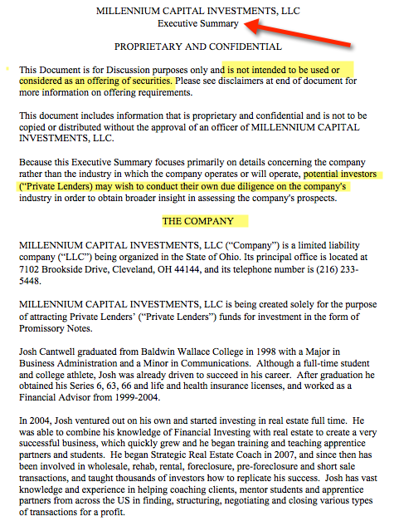
EXECUTIVE SUMMARY
Left Side: Executive Summary
Section 1: Confidential
Section 2: The Company
Section 3: Risks
Section 4: Management
Section 5: Company Operations
Section 6: Use of Funds
Section 7: Financial Information
Section 8: Securities Counsel
Section 9: Litigation
Section 10: Disclaimers

Slide 37
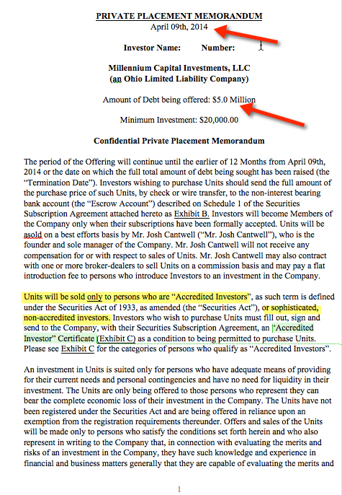
PRIVATE PLACEMENT MEMORANDUM
Left Side:
Private Placement Memorandum
(Only If I’ve Established A Prior Existing Relationship)

Slide 38
FEDERAL LEVEL: CLAIM OF EXEMPTION FROM REGISTRATION A.K.A. REG “D” OFFERING
REG D 506 (c) (PART OF JOBS ACT) FEDERAL CLAIM OF EXEMPTION FROM REGISTRATION FOR OFFERINGS THAT INCLUDE GENERAL SOLICITATION
THIS is Considered in Popular Articles to Become THE Most Popular IN THE FUTURE
In Our Opinion - This Will Be Huge; But there is limited experience
Similarities to 506(b)
Still Unlimited Money
Unlimited Investors (Must Be Accredited)

Slide 39
FEDERAL LEVEL: CLAIM OF EXEMPTION FROM REGISTRATION A.K.A. REG “D” OFFERING
REG D 506 (c) (PART OF JOBS ACT) FEDERAL CLAIM OF EXEMPTION FROM REGISTRATION FOR OFFERINGS THAT INCLUDE GENERAL SOLICITATION
General Solicitation IS NOW ALLOWED
The BAD NEWS: DISCLAIMER & “THE RUB”
You Can Only Accept Money From Accredited Investors (estimated as maximum of 10% of all investors)
The GOOD NEWS
You Can Make A Specific Offering On DAY 1
Take Money On DAY 1

Slide 40
FEDERAL LEVEL: CLAIM OF EXEMPTION FROM A.K.A. REG “D” OFFERING
REG D 506 (c) (PART OF JOBS ACT) CLAIM OF EXEMPTION FROM FEDERAL REGISTRATION
THIS WILL Become THE Most Popular
SEC Requires
Private Documents From the Investor to Prove They are Accredited
Tax Returns
Bank Statement
Provided By Investor Through Financial Advisor (Lawyer, Accountant Or Banker)
Income
Assets / Net worth

Slide 41
FEDERAL LEVEL: CLAIM OF EXEMPTION FROM A.K.A. REG “D” OFFERING
REG D 506 (c) (PART OF JOBS ACT) CLAIM OF EXEMPTION FROM FEDERAL REGISTRATION
If You Want To Take Money From ACCREDITED INVESTORS YOU CAN ADVERTISE
YES
Billboards, Flyers, Websites, Commercials
We Will Be Focused On Experiential (Golf Outings & Steak Dinners) And Digital/Online Marketing
CAUTIONS FOR ALL SITUATIONS
Financial statements what are needed do you have them; if you don’t, have you met full fair and adequate disclosure, or have you omitted material information (negligent misrepresentation or fraud risks)
Commissions; Finders Fees; either can only be paid to fully registered broker dealers; all other situations create substantial risks.

Slide 42
FEDERAL LEVEL: CLAIM OF EXEMPTION FROM REGISTRATION A.K.A. REG “D” OFFERING
REG D 506 (c) (PART OF JOBS ACT) CLAIM OF EXEMPTION FROM FEDERAL REGISTRATION
When You File Form D Federally Its A Free Open Database
Its A Form Of Public Communication
Josh has gotten at least 6-8 calls from various vendors asking about his filings
Completely Legal, In Fact Required (as is filing with each state where there are purchasers)
Can We Connect With Your Client
States Typically Don't Have A Open, Digital Database, or if they do its not easily accessible
IS (XYZ) Company Listed With You??

Slide 43
FEDERAL LEVEL: CLAIM OF EXEMPTION FROM REGISTRATION A.K.A. REG “D” OFFERING
REG D 506 (c) (PART OF JOBS ACT) CLAIM OF EXEMPTION FROM FEDERAL REGISTRATION
The Companies Who File Their Forms D with the SEC and all required states Have Brought Themselves To The Attention To The SEC and the States And That’s Good
Its The Many Thousands Of Others Who Don't File Form D, who don’t claim another state or federal exemption or who don’t register or should and don't that SEC and the STATES are more likely to pursue
RULE 506(c) limitations : ONLY ACCREDITED INVESTORS ; ONE NON ACCREDITED INVESTOR OR INSUFFICIENT EXAMINATION CAN CREATE RECISSION RIGHTS TO ALL INVESTORS; YES RISK OF HAVING TO GIVE BACK ALL THE MONEY WITH INTEREST; NO PROBLEM FOR SUCCESSFUL DEALS: HUGE PROBLEM FOR UNSUCCESSFUL ONES: RISK TO INDIVIDUALS WHO RUN OR CONTROL

Slide 44
FEDERAL LEVEL: CLAIM OF EXEMPTION FROM REGISTRATION A.K.A. REG “D” OFFERING
REG D 506 (c) (PART OF JOBS ACT) CLAIM OF EXEMPTION FROM FEDERAL REGISTRATION
RULE 506(c) IS NOT A SAFE HARBOR. IT’S A CLIFF. Go beyond it and you have fallen off. There is no statute which is broader than the Rule. In 506(b), section 4(a)(2) is broader than the Rule; if you go outside the rule you can try to rely on the statute; no possibility of this in Rule 506(c) offerings.

Slide 45
CROWD FUNDING: (POOLING) / PART OF JOBS ACT
CROWD FUNDING “ORIGINALLY and OTHER TYPES “ (SOME PART OF JOBS ACT)
WORDS: Crowdfunding by “Kickstarter and others” You are getting donations and can’t provide securities - just products; t-shirts; emails; events;
Originally Could Not Get A Return on Investing (Donations Only)
Regulation A and Regulation A+; Regulation A is a form of modified SEC registration called “qualification” and is up to $5 million ; Regulation A + is up to $50 million and now is active;

Slide 46
CROWD FUNDING: (POOLING) / PART OF JOBS ACT
CROWD FUNDING “ORIGINALLY and OTHER TYPES “ (SOME PART OF JOBS ACT)
Future Crowdfunding to NON ACCREDITED INVESTORS (General Solicitation and ability to accept any investor)
Will Not Do Raise Yourself
Advantage
Disadvantage
Must use an approved Funding Portal – FINRA TO BE INVOLVED: anticipate heavily examination of offerings; high likelihood of fraud by others in this space despite regulation; this is what happened in the 1990s with Rule 504 before it was shut down.

Slide 47
CROWD FUNDING: (POOLING) / PART OF JOBS ACT
CROWD FUNDING “ORIGINALLY and OTHER TYPES “ (SOME PART OF JOBS ACT)
These rules proposed but not adopted
INTRA STATE CROWDFUNDING to NON ACCREDITED INVESTORS (General Solicitation and ability to accept any investor) ; Because its intrastate SEC not really involved; States are adopting new sets of rules; Each state will be different; Actually Rule 147; Section 3(a)(11) allowed intrastate crowdfunding since 1933 if done properly but little used for that purpose

Slide 48
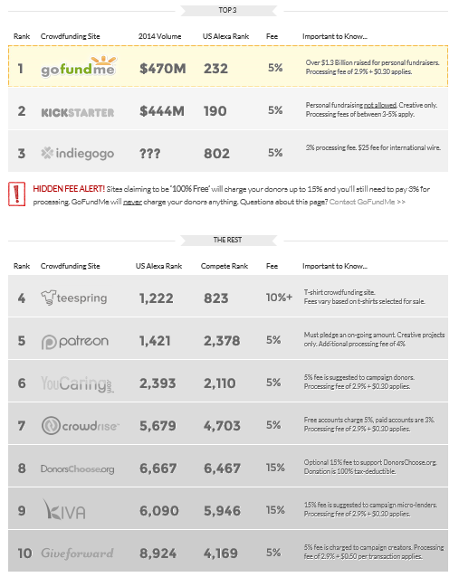
TOP CROWD FUNDING WEBSITES WWW.CROWDFUNDING.COM

Slide 49
CROWD FUNDING: (POOLING) / PART OF JOBS ACT
What Are The Latest Updates On Crowdfunding For Real Estate Investors?
Reg A Plus

Slide 50
MISC. FUNDING QUESTIONS ANSWERED
Family and Friends Across State Borders
International Investors
Dodd Frank
Safe Act
Jobs Act

Slide 51
FAMILY ACROSS STATE BORDERS
FAMILY ACROSS STATE BORDERS
Raising from family in PA and do deals in Nebraska
Set up Company In Nebraska
Have AUNT become co-owner of company
Have her buy 1 unit / 1 share of the LLC
Have aunt start a business (LLC) in your state, aunt deposits money into her business and lends from her business

Slide 52
FAMILY ACROSS STATE BORDERS
FAMILY ACROSS STATE BORDERS
ALL IRA’s (anything of a retirement nature) as if her money was in PA
Special IRA Restrictions need to be understood and followed; risk of loss of tax exemption
Have them set up a LLC in your state / sell them a unit of your company and have them lend to that company; economic reality means this must be real and not a device to avoid regulation or law

Slide 53
INTERNATIONAL INVESTORS
INTERNATIONAL INVESTORS
Legal in all the offerings
Legal for you to accept money into your company (but international laws may apply)
Buy property with your company
You can accept the money
Money laundering issues; FINCEN; Foreign Corrupt Practices Act; others these are real issues; not really as simple as it might seem.

Slide 54
INTERNATIONAL INVESTORS
REG “S”
Living in another country
Physically in another country
4 countries that are forbidden
ONLY SELL to INTERNATIONAL investors
Only take money from people in other countries
Must make investors in writing that they cannot sell their investment for 12 months
Its up to the lender/ investor to follow their own countries laws; but if you are offering the securities while you have Reg S SEC exemption you may have to file or obtain rights or permissions in their countries; If you accept international money US DEPARTMENT OF COMMERCE FILINGS: FIRPTA (IRS) ISSUES (Foreign ownership of US Real Estate)
Our SEC attorney’s can only speak to US LAW

Slide 55
DODD FRANK / SAFE ACT
DODD FRANK REGULATES “PERSONS” DOING MORTGAGE LENDING
SAFE ACT under Dodd Frank (just for home loans)
Dodd Frank Legislation was going after unlicensed mortgage brokers and bankers
In a company there's no limit
You can do 4 owner finance deals a year IN YOUR OWN NAME
HUSBAND / WIFE
Counts as one person
Plus same sex marriage states
Every other family relationship is considered 1 person

Slide 56
226 Units
96 – 40 2/1’s + 56 1/1’s
GP 60% LP 40%
96 Lorain LLC and its bank account
64 – 48 2/1’s + 16 1/1’s
GP 60% LP 40% LLC and its bank account
64 mayberry LLC
66 – 66 1/1’s – LOI 100% CASH PURCHASE
GP 60% LP 40% LLC
66 Triskett LLC and its bank account

Slide 57
226 Units
Collectively – 88 2/1’s and 138 1/1’s
3 Separate Closings
3 Separate Books / UW’s
“226 Holdings LLC” - $$
1% Managing Member
1 PPM
$5M

