Slide 1
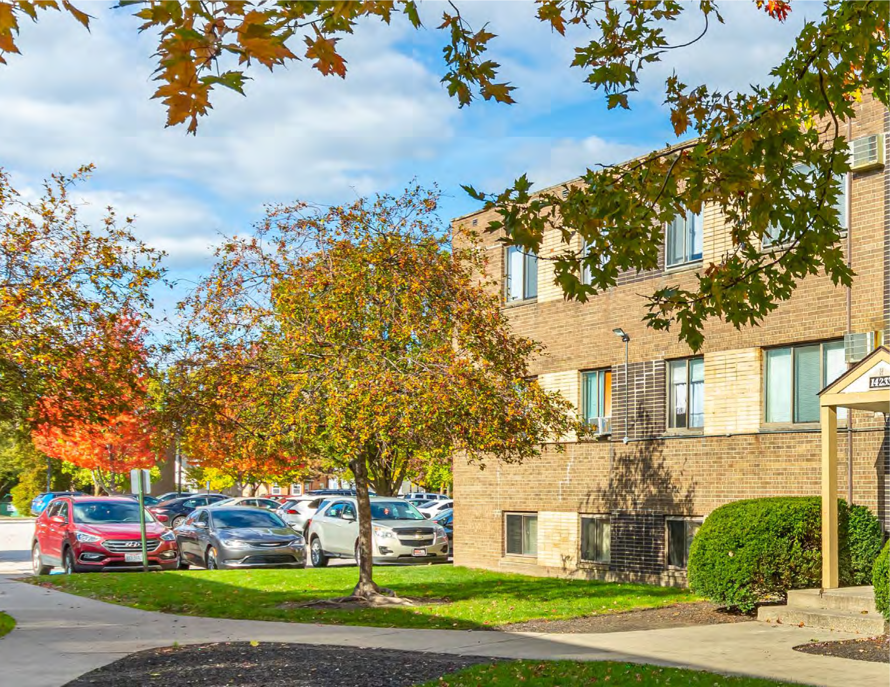
JOSH CANTWELL Chief Executive Officer
GLENN LYTLE Chief Strategy Officer
TYLER BRUMMETT Chief Operating Officer
“296 Triskett” Value Add Apartment Opportunity

Slide 2
Freeland Ventures : Meeting Agenda
Real Estate Private Equity
Introduction to Freeland Ventures
BIOs / Operator information and credentials
Introduction to Mgmt Team and current project overview
Investment Overview for “296 Triskett” Portfolio
Overview of the properties
Discuss financials and stabilization plan
Explain the investment opportunity
Next Steps

Slide 3
Operations Overview
PROJECT & PROPERTY MANAGEMENT
Freeland Ventures: Josh Cantwell, Glenn Lytle, Tyler Brummett
Experience: 34 Years Combined
Residential & commercial experience in private lending, large rental portfolios, renovation and property management.
Joint ownership in 2,700+ apartment units & $200M+ of assets.
In 2021: Freeland Bought 1,372 New Units and Sold 1,332 Units for a profit
Completed 17 Full Funded Syndications just like “296 Triskett”

Slide 4
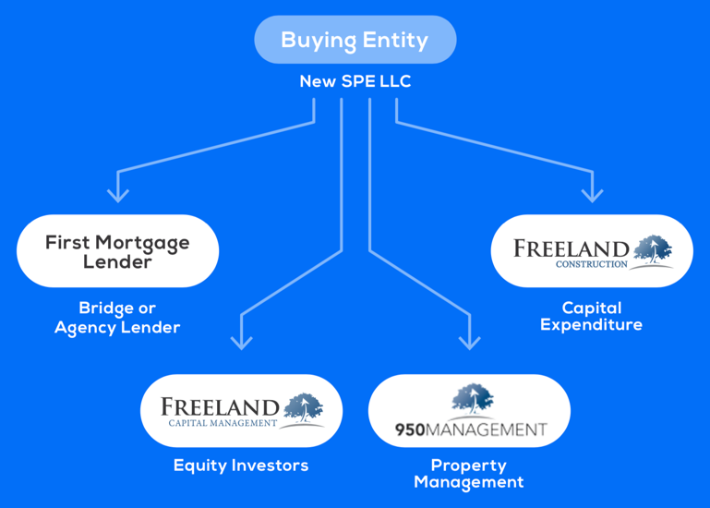

Slide 5
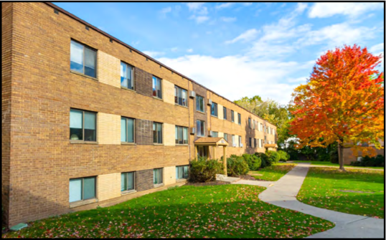
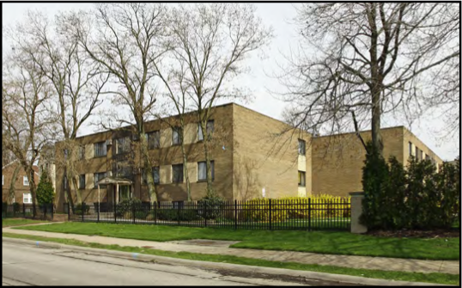
506(B) Investment Opportunity: Accredited and Non Accredited (But Sophisticated) Investors with Prior Existing Relationship with Josh Cantwell, Glenn Lytle, Tyler Brummett, Freeland Ventures and /or Strategic Real Estate Coach

Slide 6
Interested In Investing?
Text Josh Now to Secure Your Spot
To secure units:
Josh Cantwell
Phone: 216-233-5448

Slide 7
Freeland Portfolio (Partial) In Cleveland Market within 15 minute drive to “296 Triskett”

Slide 8




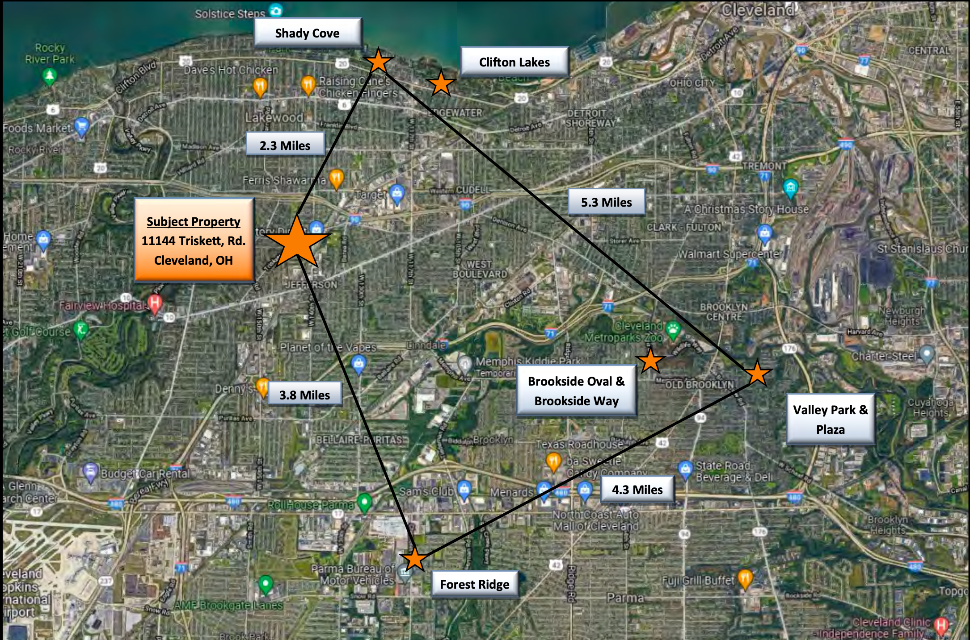

Slide 9
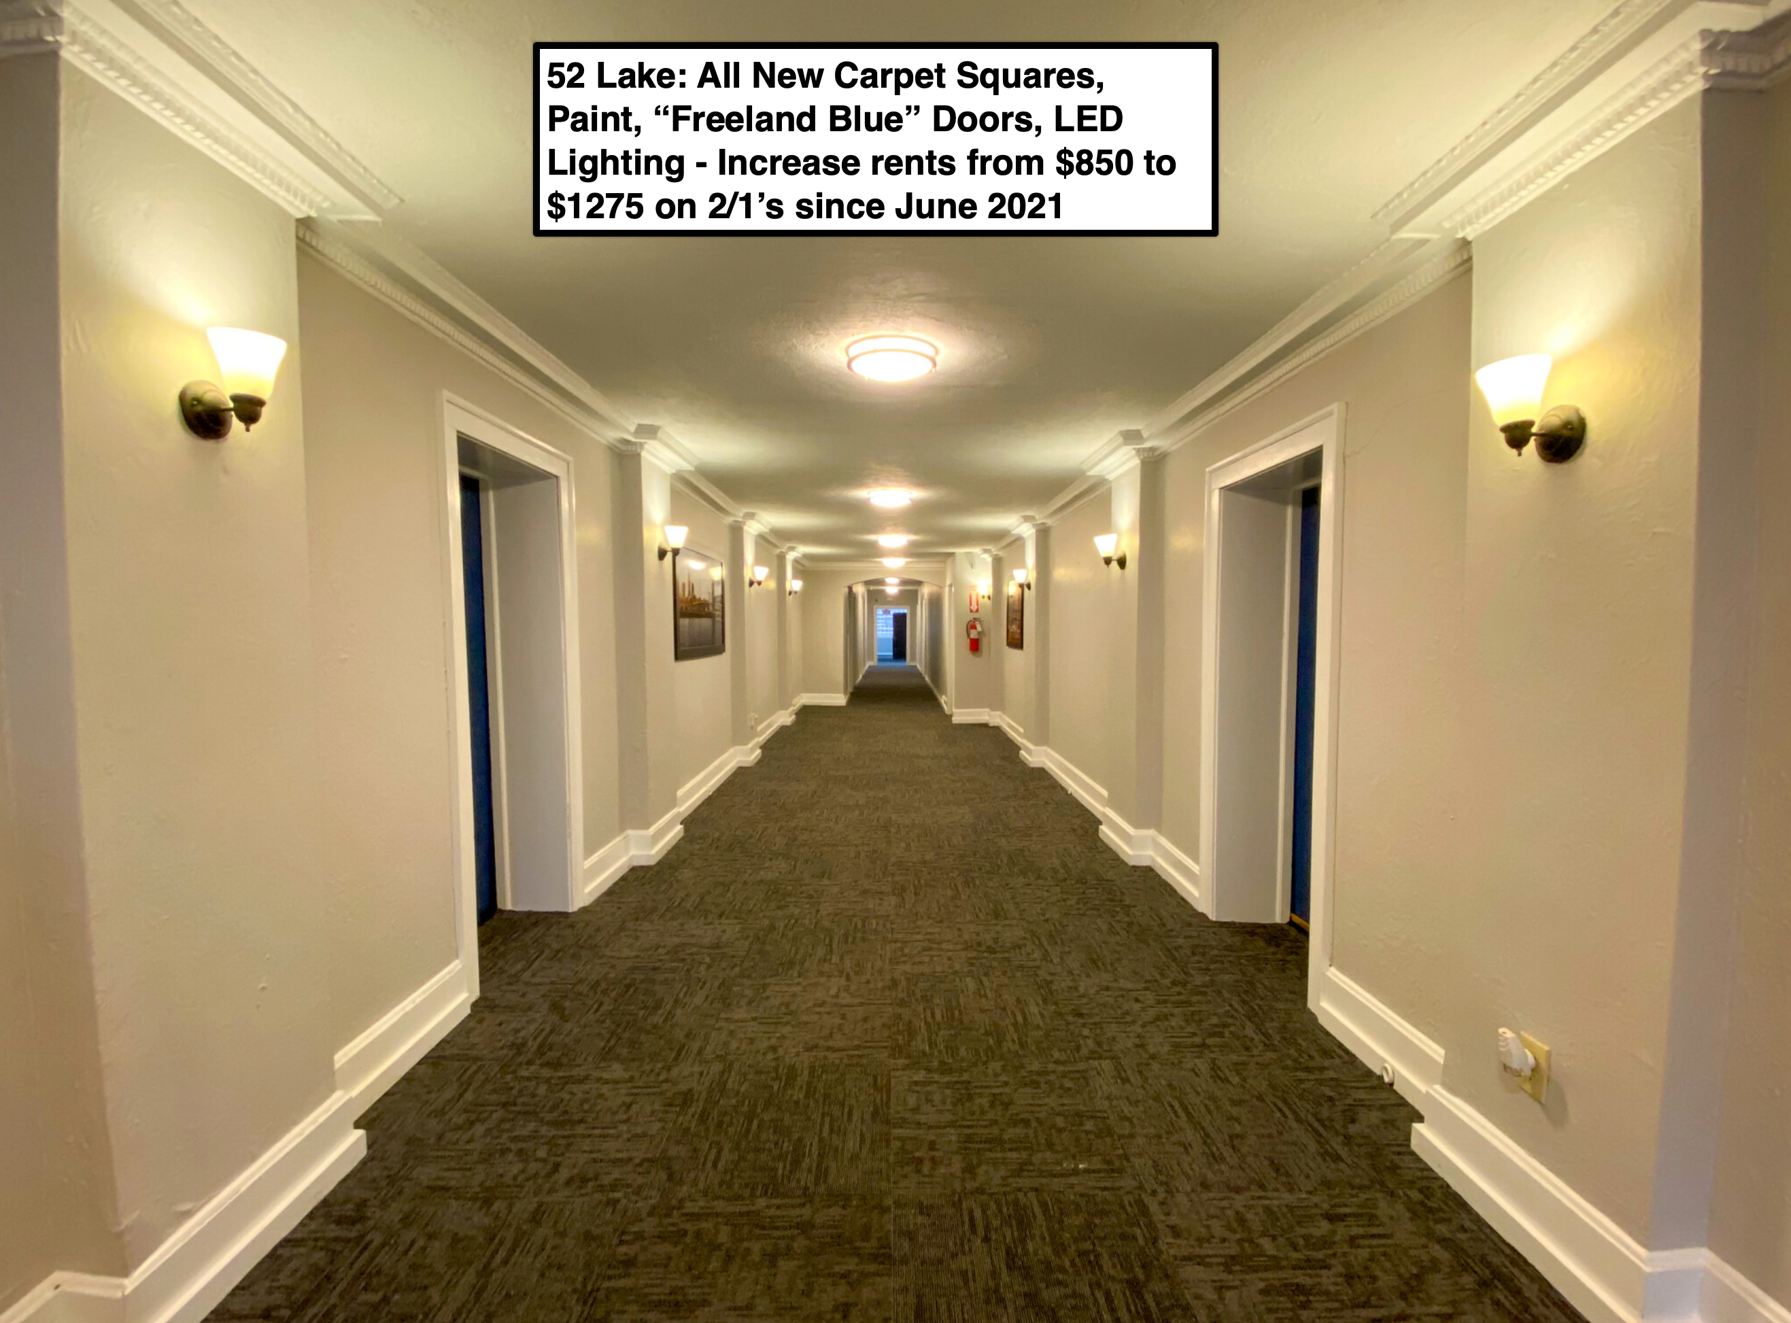
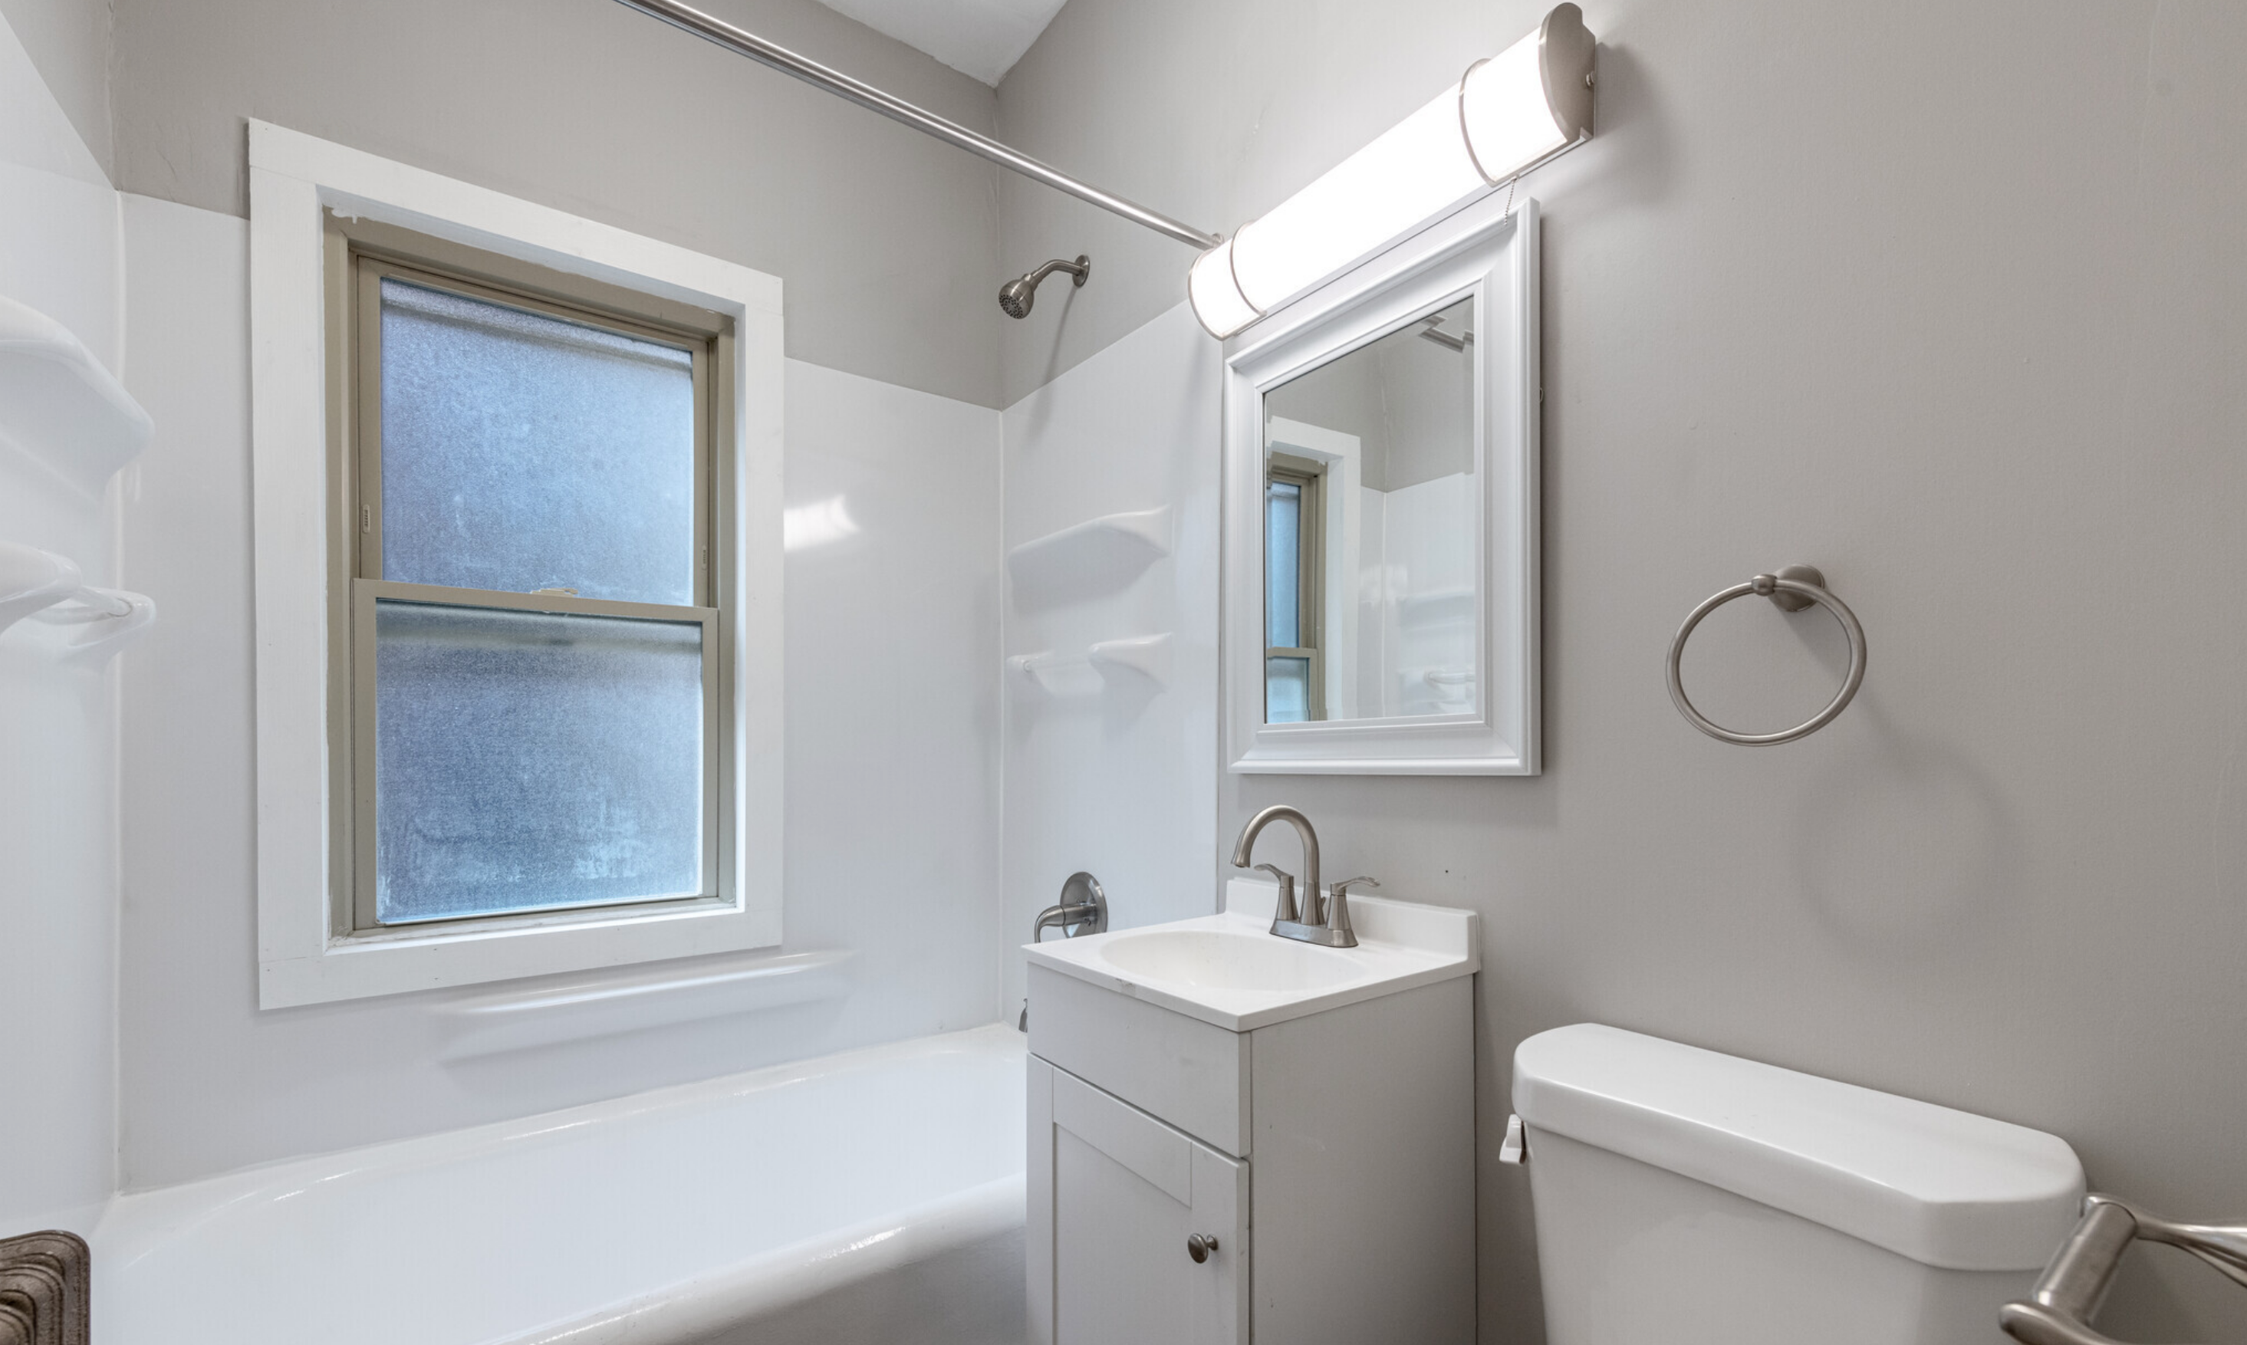
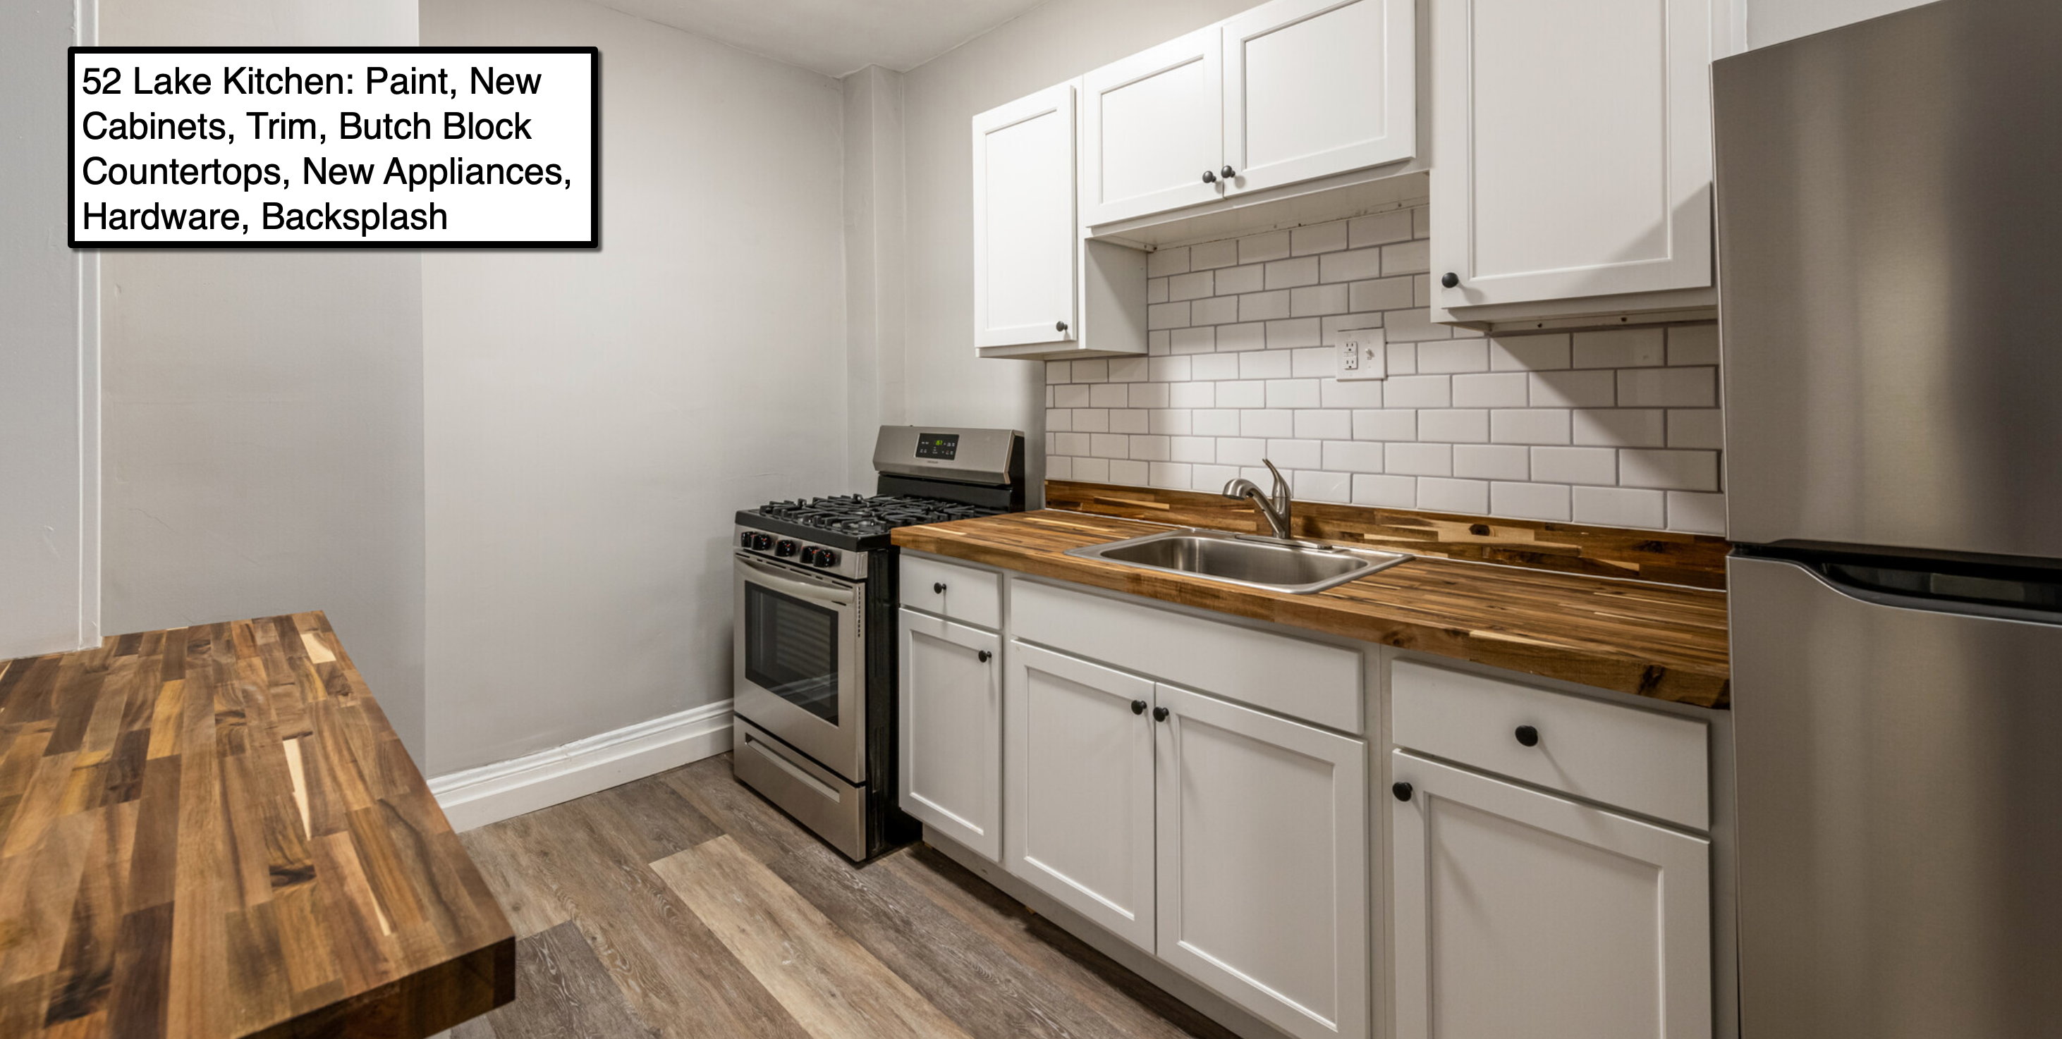
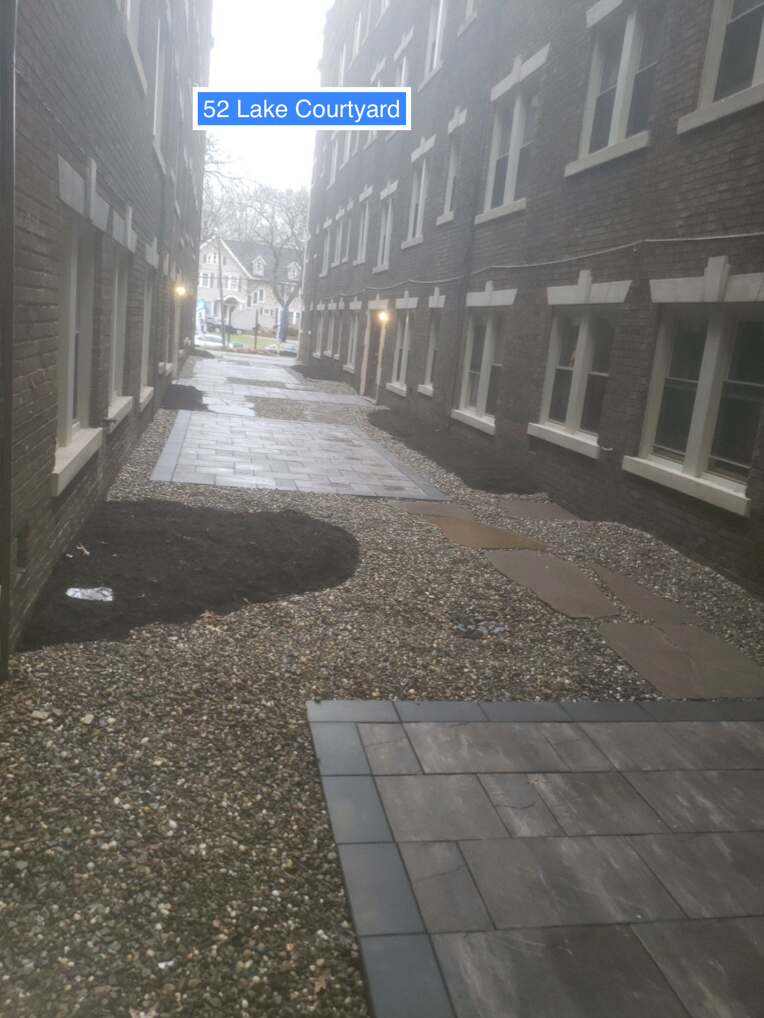
“52 Lake” –Apartment Portfolio
DEAL SPECIFICS
52 Units / A Class Location
7 Minute Drive from “296 Triskett”
Same Submarket / Same Comps
Since May 2021
Hard Turned 27 / 52 Units
Installed Courtyard
New Carpet Squares in Commons
New Paint in Commons
Installed Wifi in Entire Building
Security Camera Upgrade
Rent Roll
Eff Raised Rents from $625 to $850
1/1 R Raised rents from $700 to $950
1/1 L Raised rents from $775 to $1100
2/1 Raised rents from $825 to $1275

Slide 10
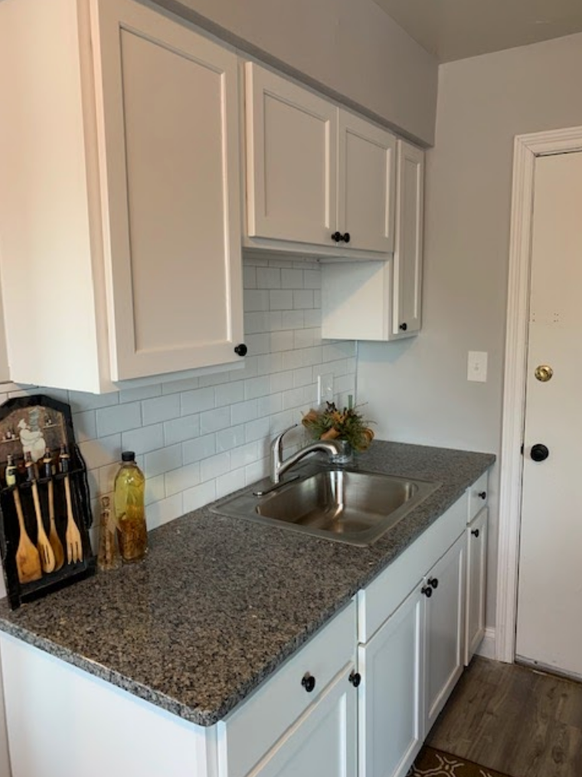
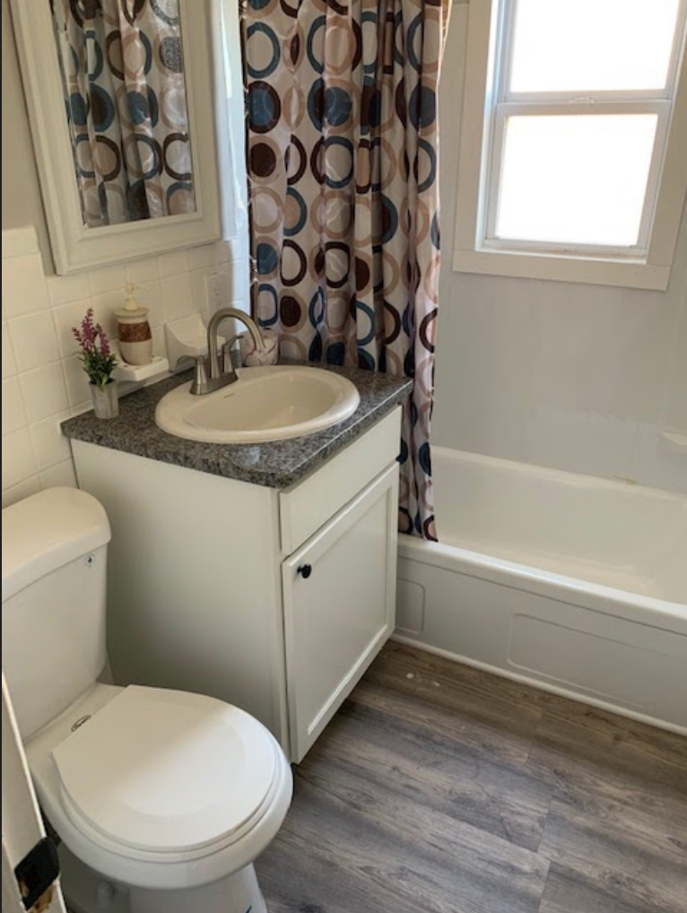
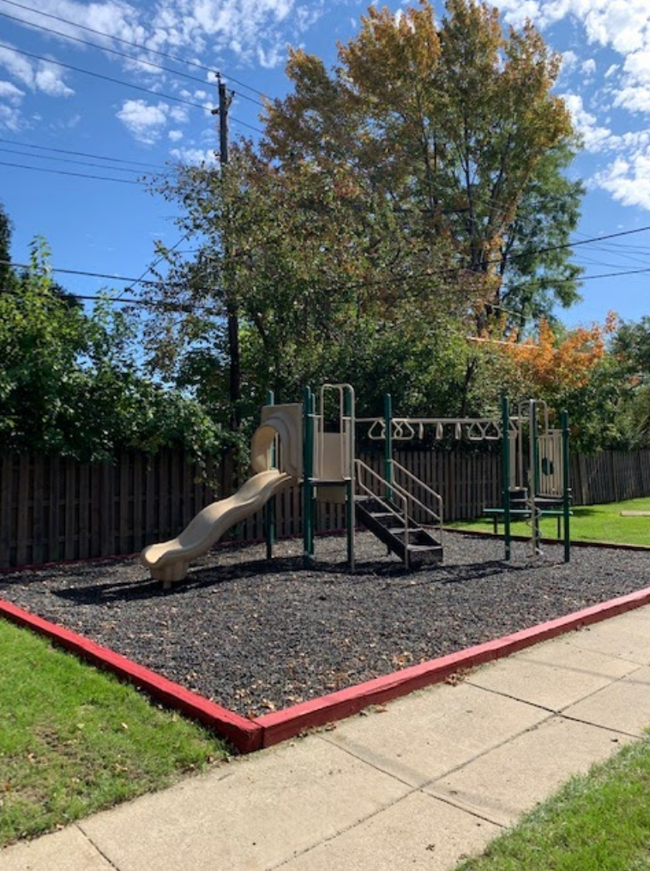
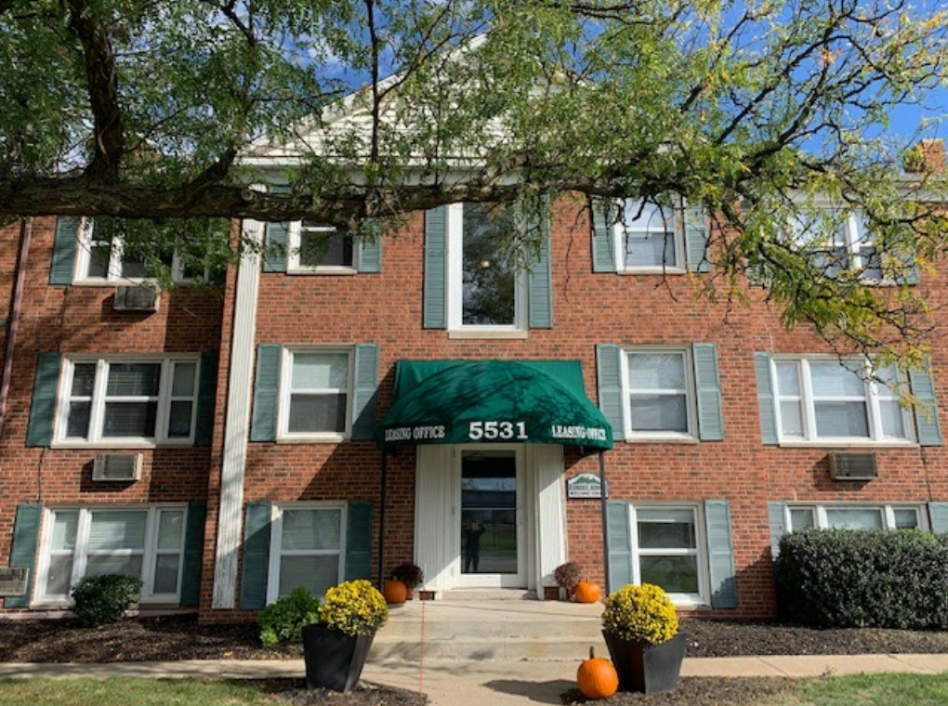
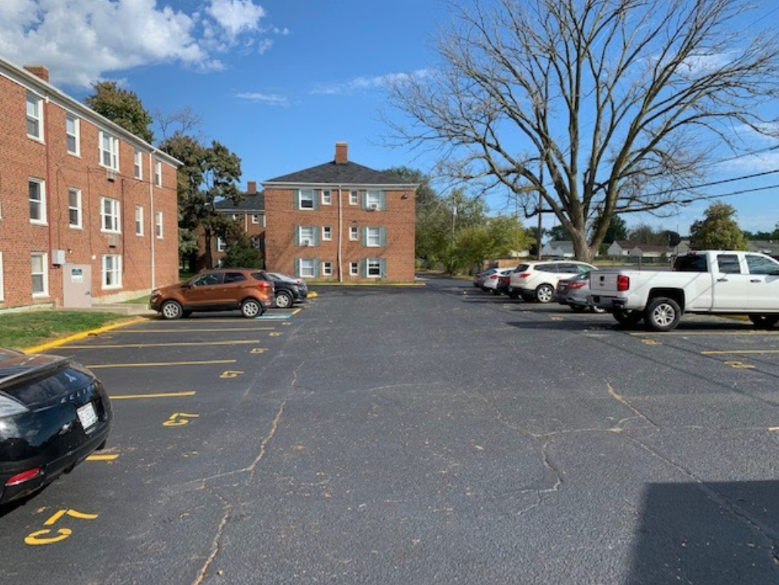
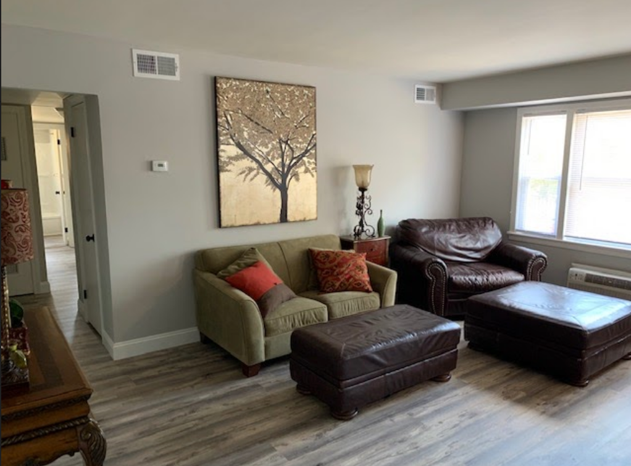
“220 Chevy” –Apartment Portfolio
DEAL SPECIFICS
220 Units / B Class Location
13 Minute Drive from “296 Triskett”
Same Submarket / Same Comps
Since April 2021: Cap Ex
Hard Turned 98 / 220 Units
Sealed and Striped Driveway / New Awnings
New Carpet Squares in Commons
New Paint in Commons
Security Camera Upgrade
Since April 2021: Cap Ex Rent Roll
1/1 616 Sq Ft Raised rents from $625 to $850
2/1 787 Sq Ft Raised rents from $750 to $975
Increased NOI by $360,000 a year in 10 months

Slide 11


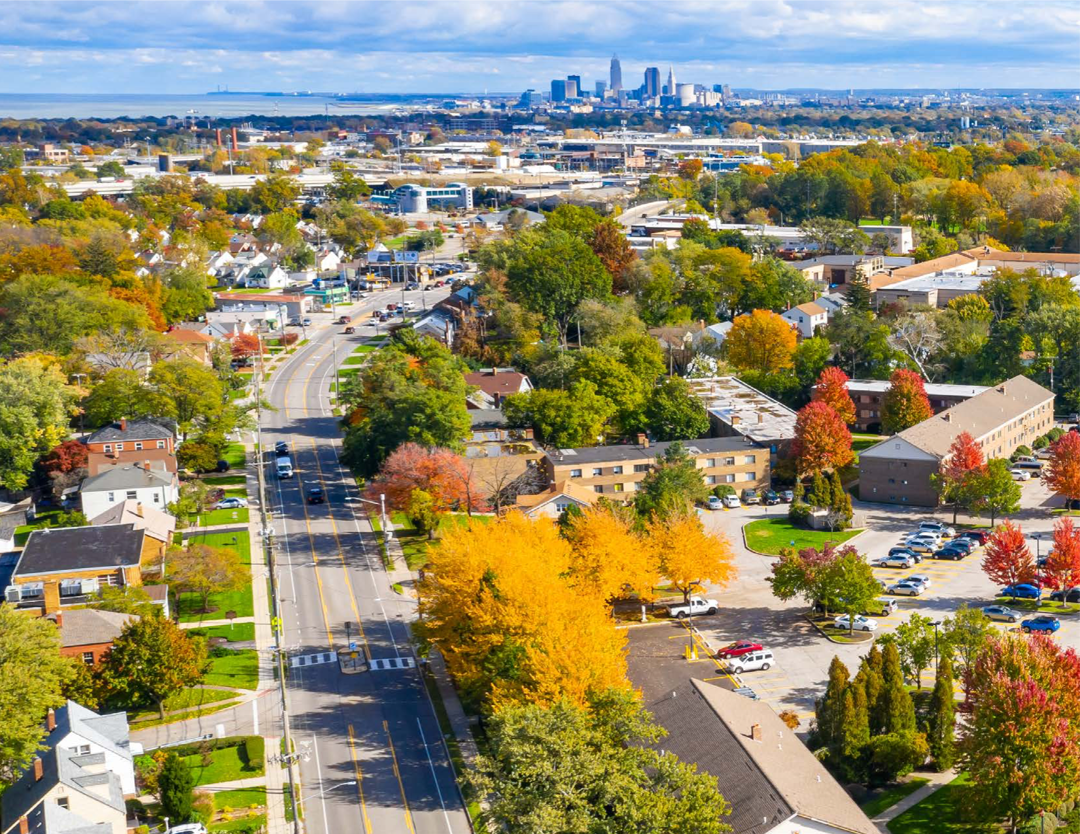
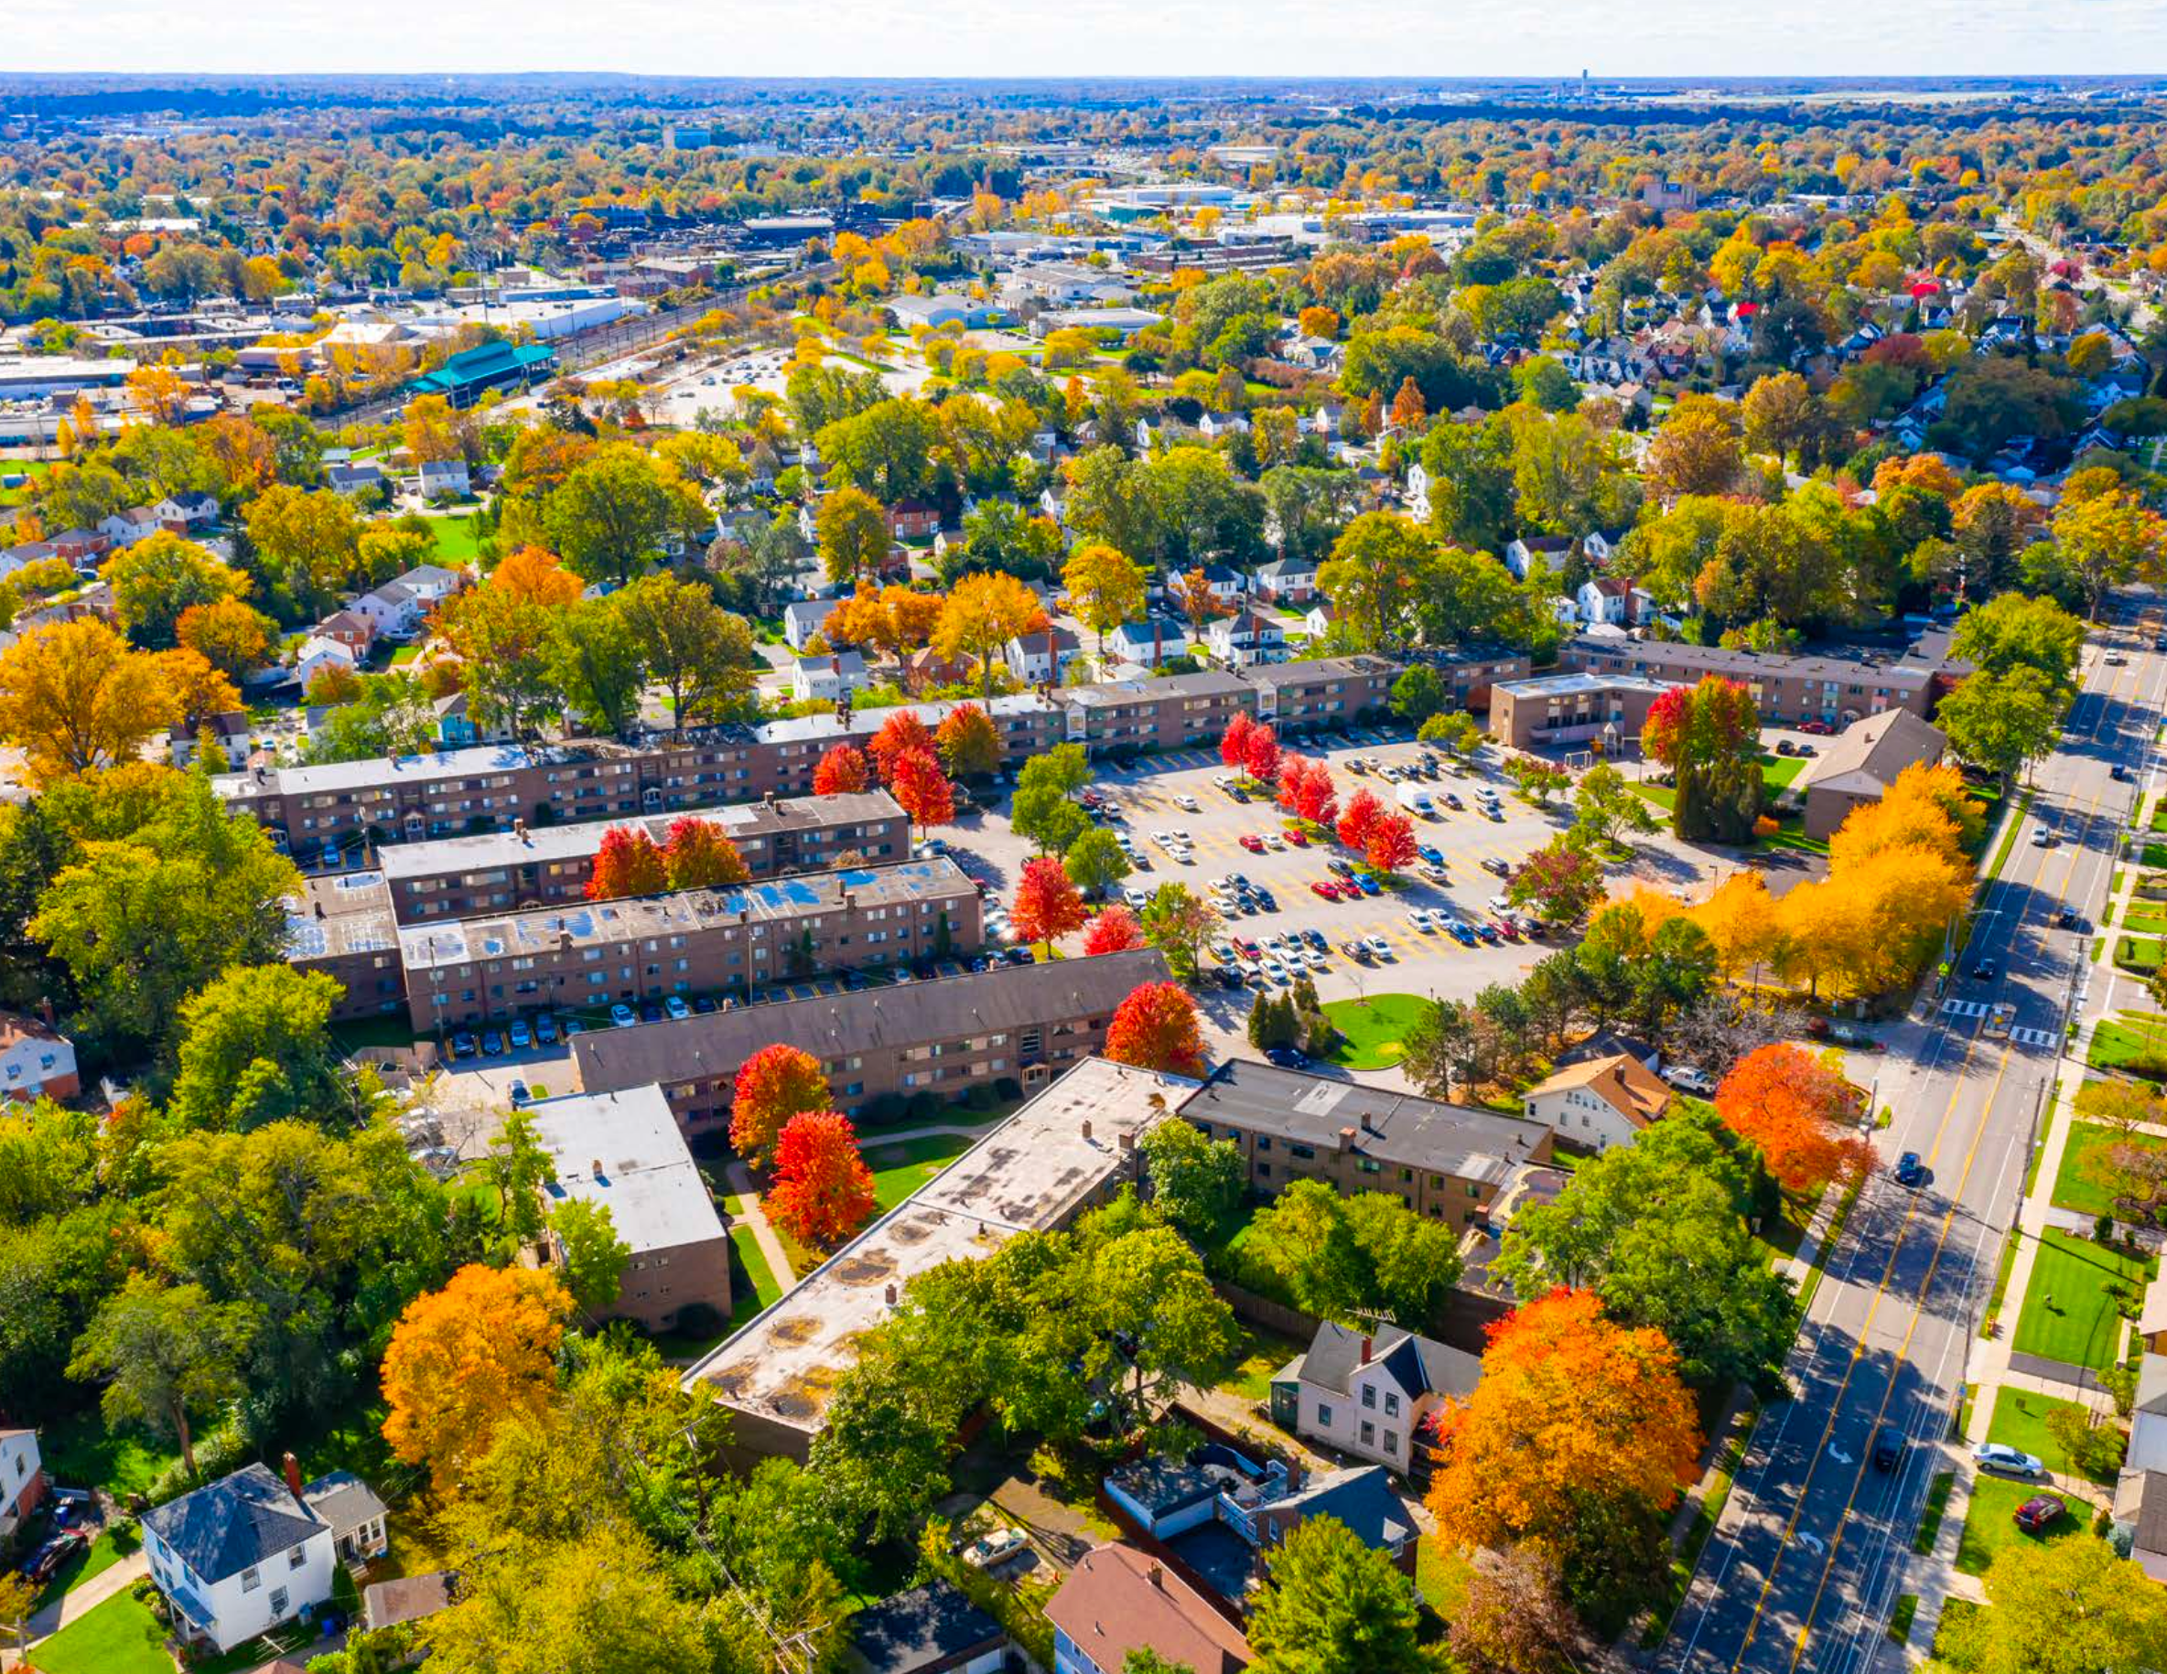
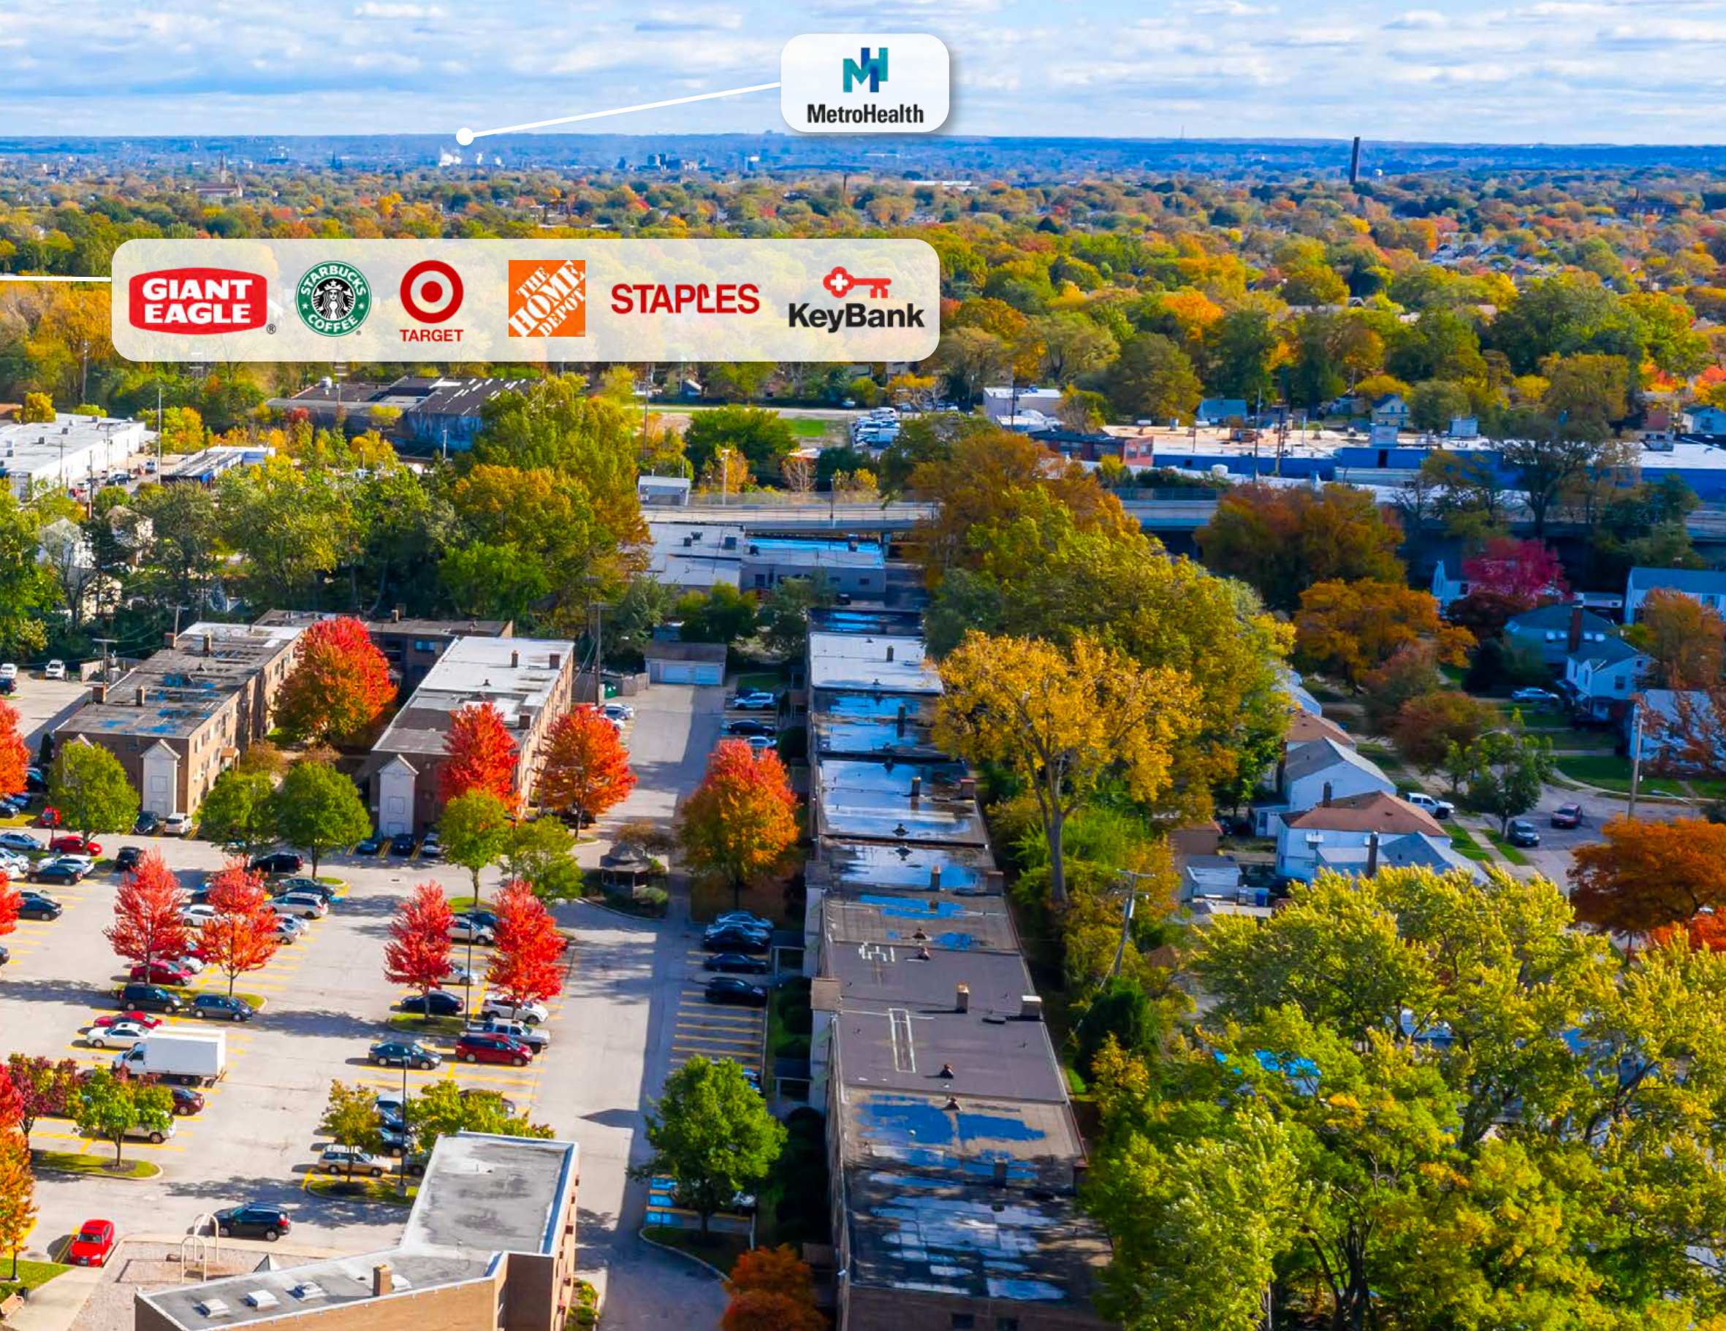
The “296 Triskett” Portfolio
Property Features:
Full time In-house leasing
RHM Property Management
24 hour In-house maintenance
RHM Property Management
On-site laundry centers in every building
On-site storage lockers for every unit
8,000 Sq Ft Management Office and Storage
3 Story Garden Style

Slide 12
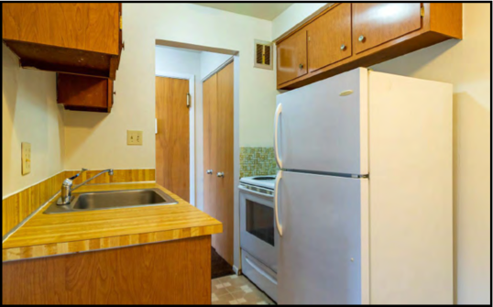
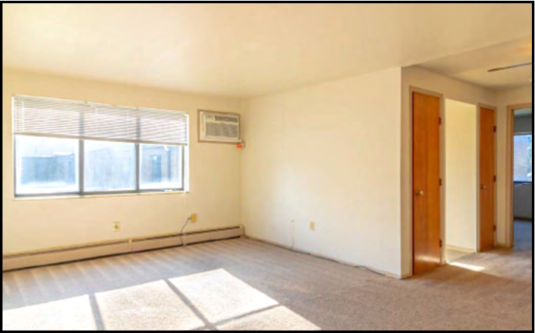
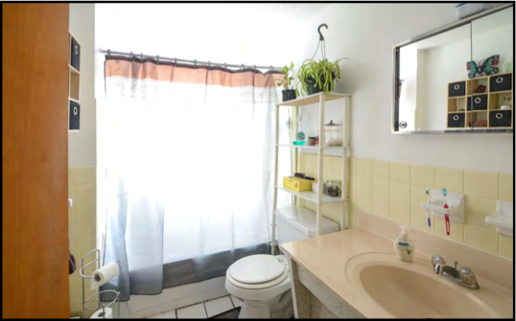
The “296 Triskett ” Portfolio
Property Features:
Average Annual HH Income $66,085 - 3 miles radius
Major Employers: Cleveland Clinic, UH Hospital, US Steel, KeyCorp Bank HQ, Progressive Ins HQ, Sherwin Williams HQ, Lincoln Electric HQ, Nestle, Parker Hannifin HQ, and more
Lots of free grassy space to build pavilions, dog parks, playgrounds
7 Minutes Drive to “Shady Cove and Clifton Lakes”
Home Depot, Target, Walmart, Starbucks, Aldi’s, Staples, KeyBank in neighborhood
12 Minutes Drive to Downtown Cleveland
Easy Access to Freeways: I-480, I-176, I-71, I-77

Slide 13
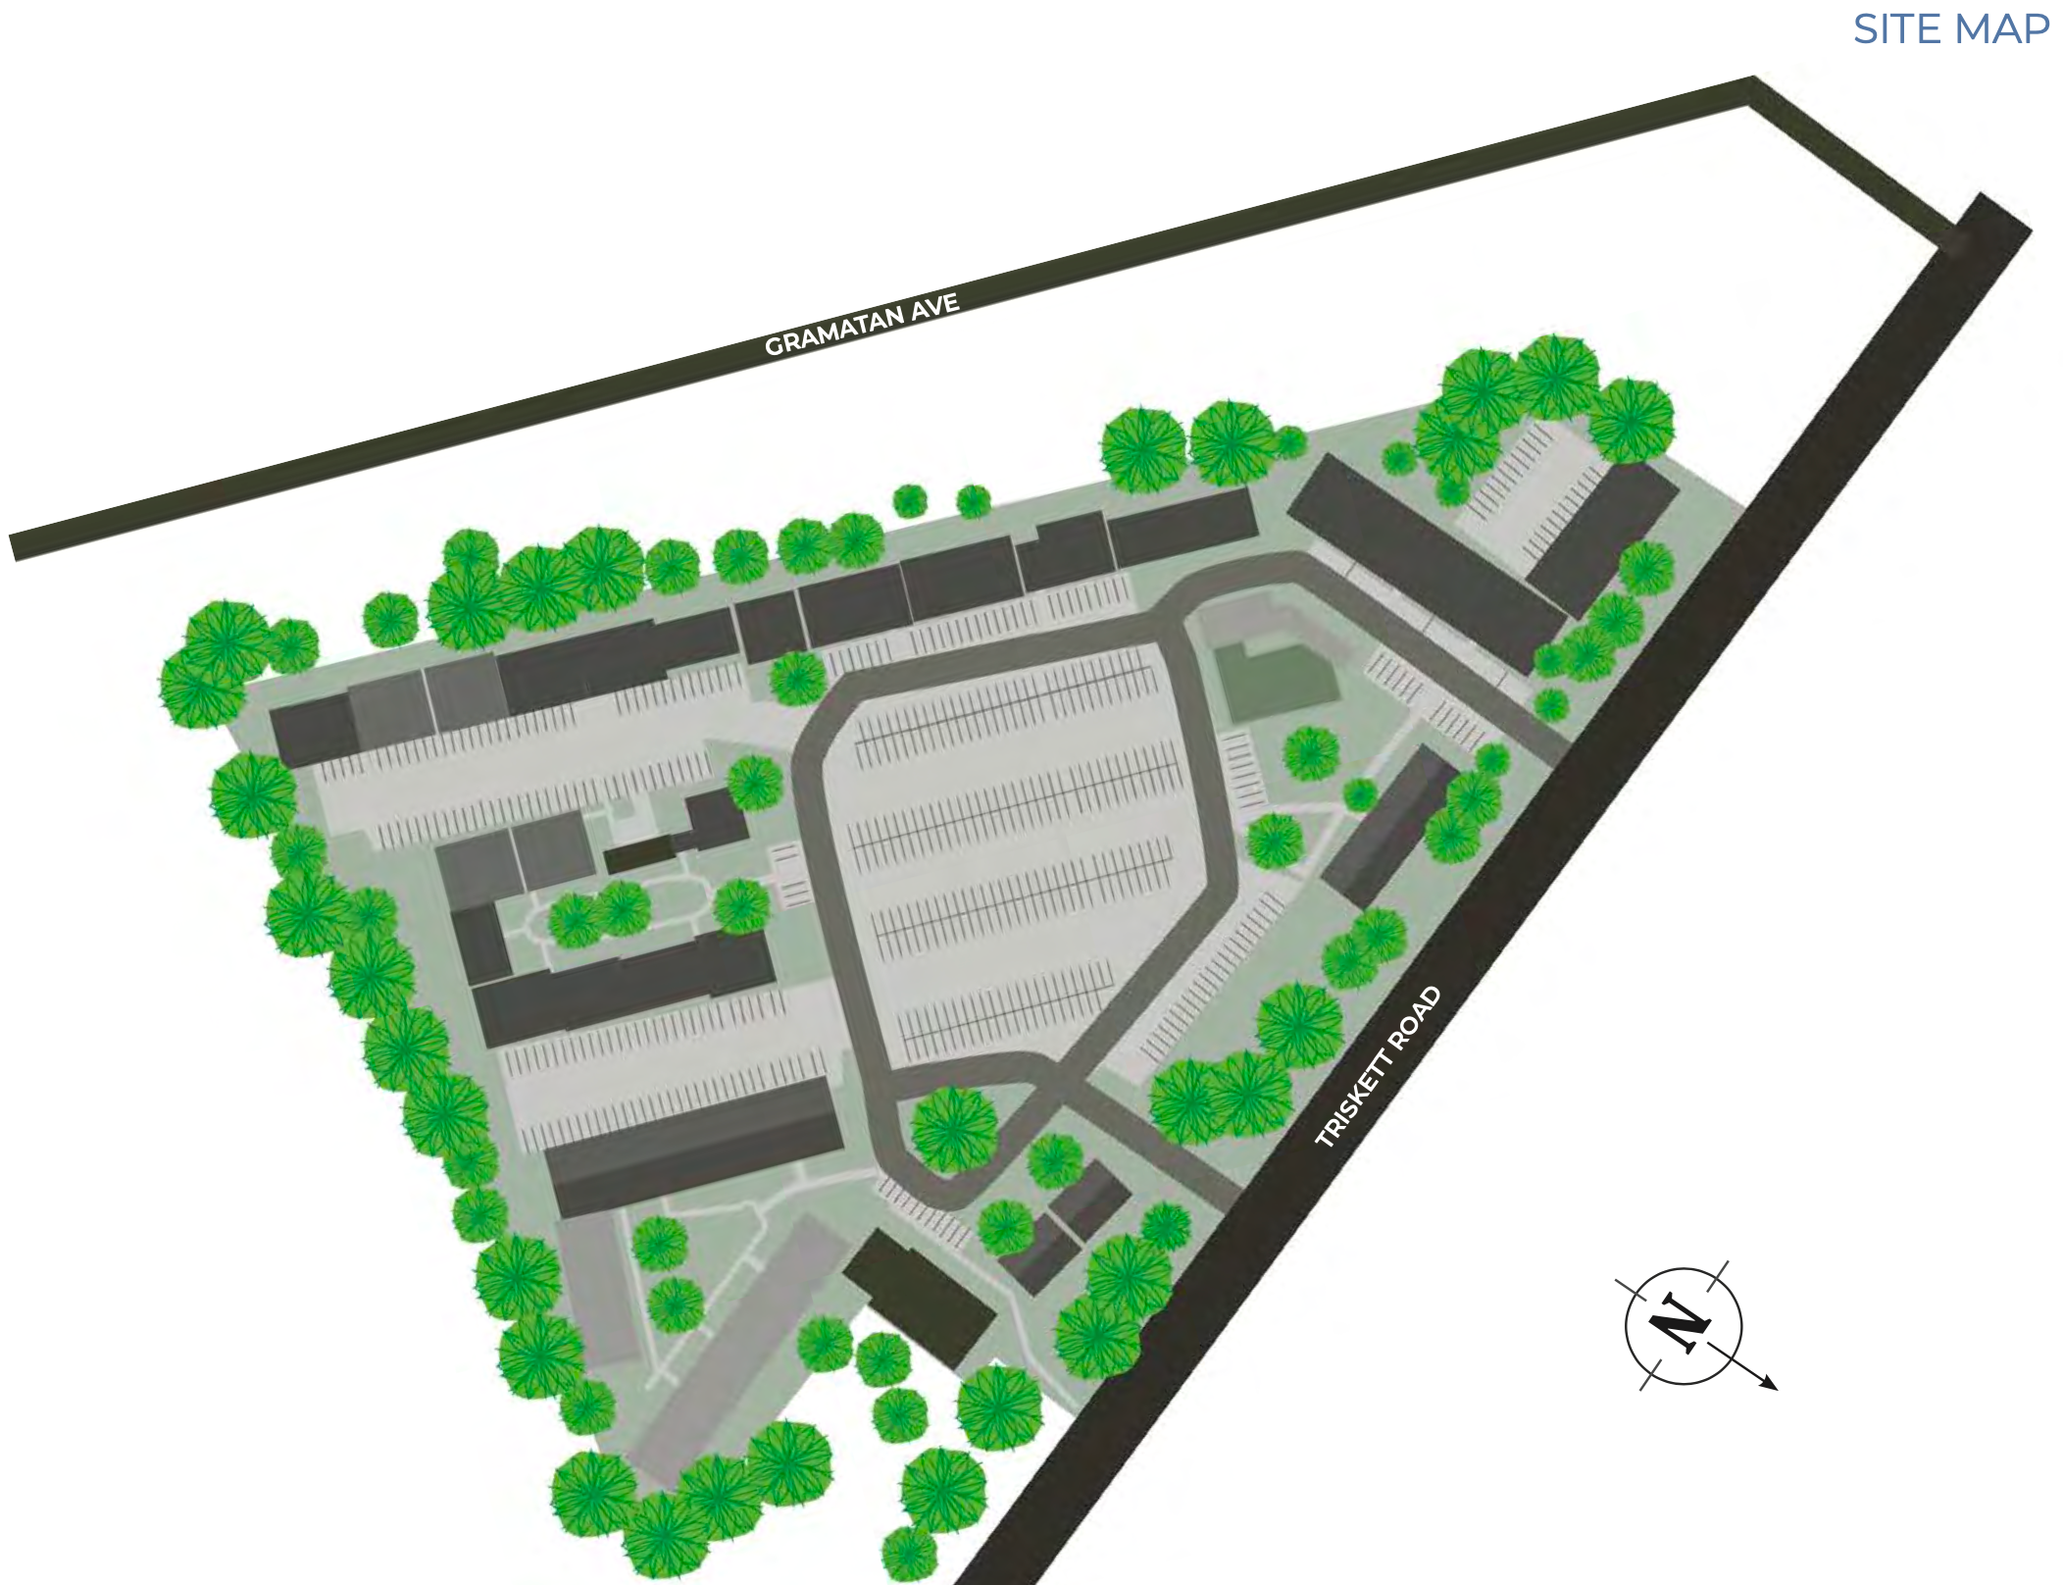

Slide 14
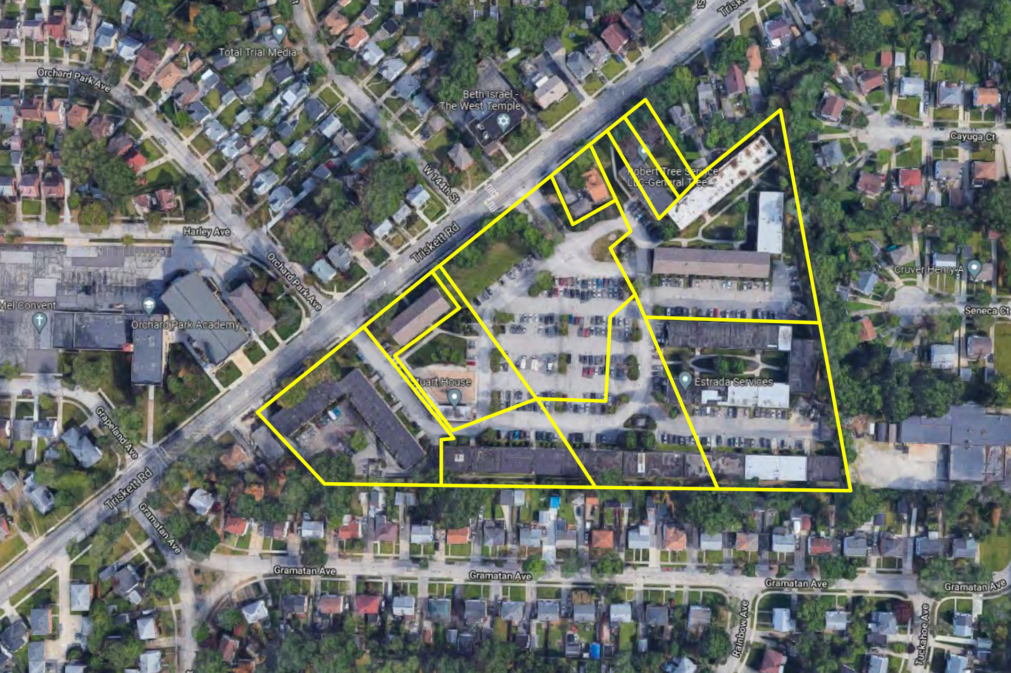

Slide 15
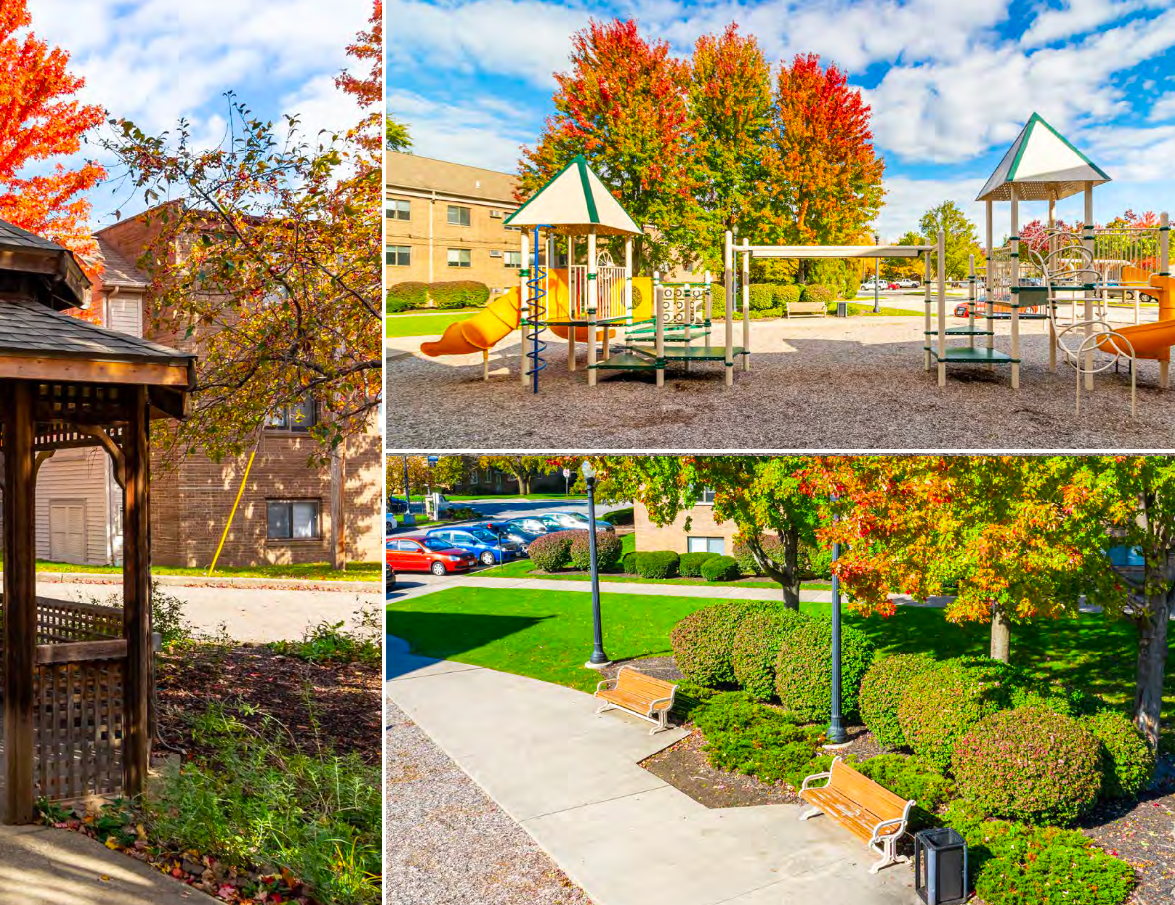

Slide 16
“296 Triskett”
296 - Unit Apartment Complex
Immediate Rent Increase Opportunity
296 Units
39 Vacant as of 2.16.22 from “The Book”
13.17% Vacancy as of 2.16.22 “The Book”
The Seller has not raised rents in 4 years
Rents are Currently $75 - $150 Below Market Value with Zero Cap Ex Program
Immediate Opportunity to raise rents by $75 - $150 / mo to market value at renewals
Notes:
In the residential real estate investing space, getting in on profitable, high-value deals is simple -- it takes six simple steps that you can repeat over and over again. These are the foundation of real estate and real estate investing. To get in the market and make serious profits, you need.
FOUNDATION
FIND It
FIGURE It
FUND It
FIX & FILL It (hold or refinance)
FLIP It

Slide 17
“296 Triskett”
296 - Unit Apartment Complex
Immediate Plan
Improve all Commons and Exteriors within 60 days of takeover
Paint Commons, Trim, Hand Rails, Door (Freeland Blue), and Laundries
Carpet Squares in the Commons (Black 24 x 24)
Renovate the Management Office
Onboard Resident Portal and Software
Landscape, Seal and Stripe the driveway
New Rebranded Sign Out Front on Triskett Rd
Then Raise rents by $75-$150 on all renewals immediately
Then Remodel and Turn the 39 Vacant Units plus new Organic Move outs as they become available
39 Vacancies to Fill at Take Over
Hard Full Turn = 30 + Make Readies / Half Turns = 9
Notes:
In the residential real estate investing space, getting in on profitable, high-value deals is simple -- it takes six simple steps that you can repeat over and over again. These are the foundation of real estate and real estate investing. To get in the market and make serious profits, you need.
FOUNDATION
FIND It
FIGURE It
FUND It
FIX & FILL It (hold or refinance)
FLIP It

Slide 18
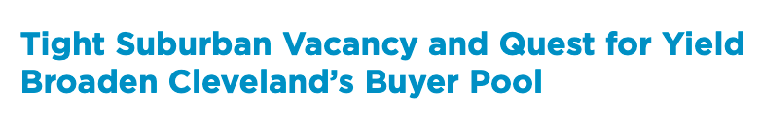
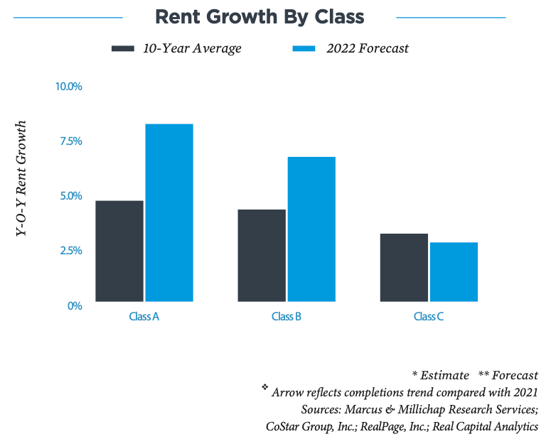

Slide 19
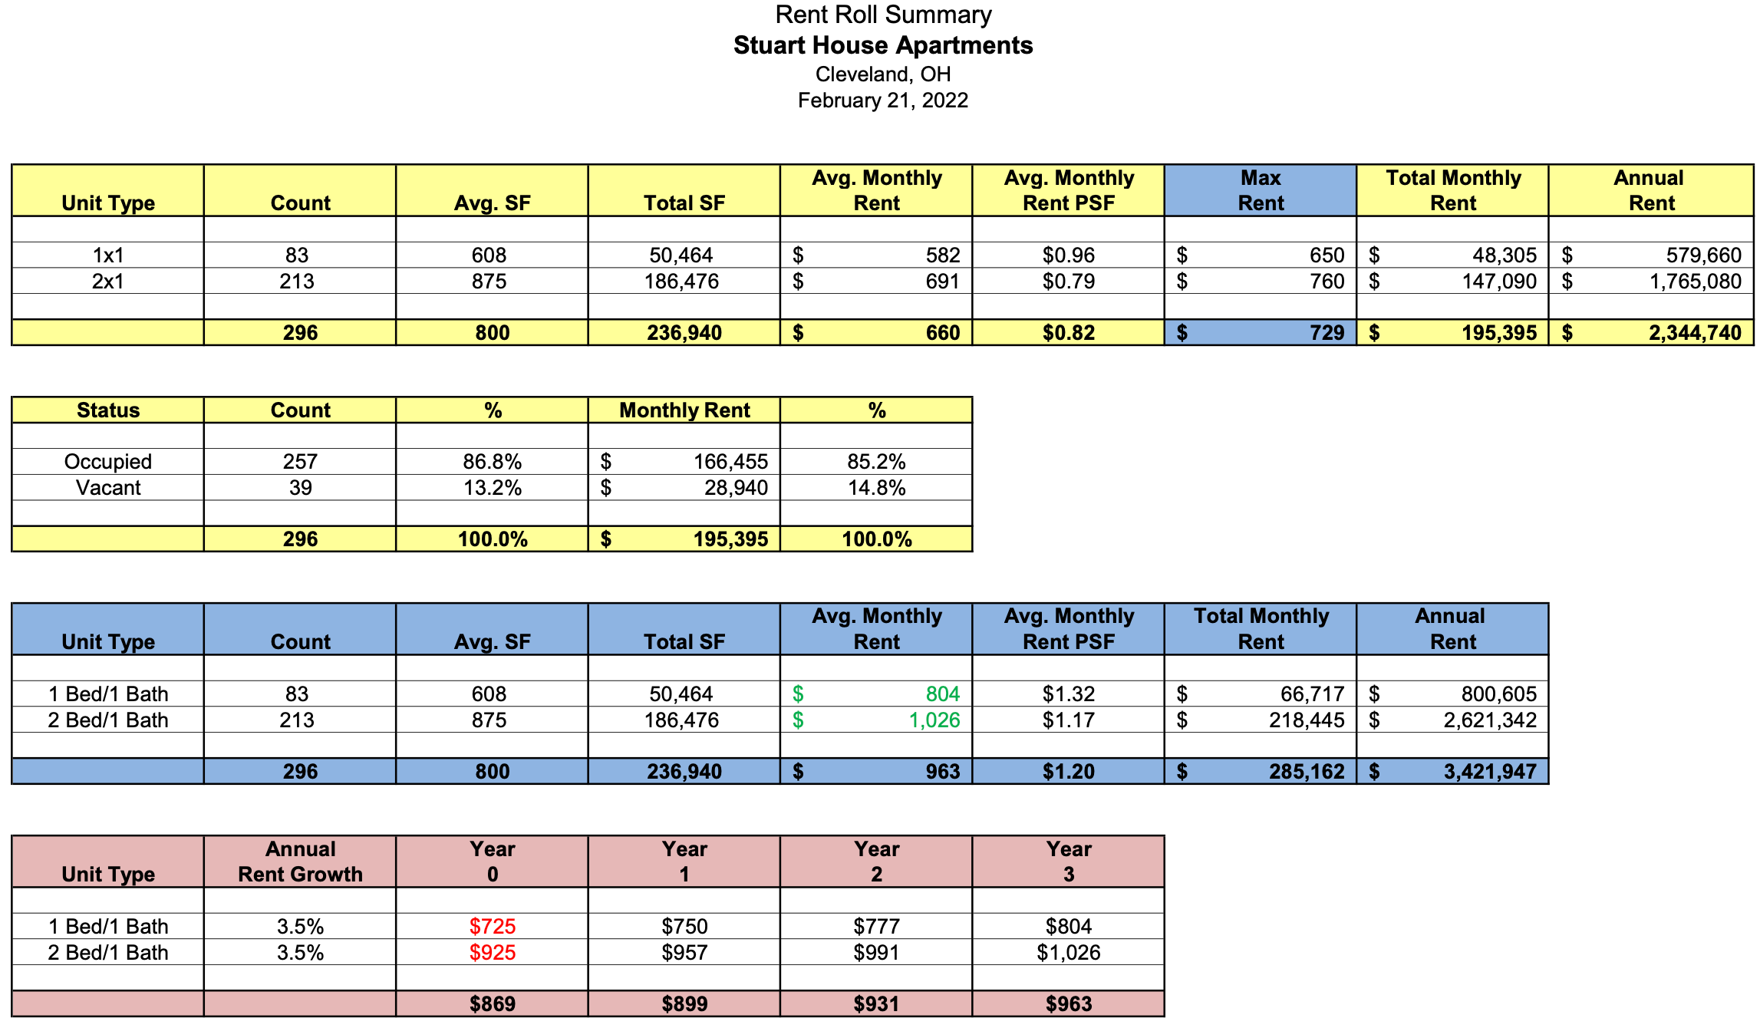

Slide 20
“296 Triskett”
296 - Unit Apartment Complex
Painting Commons and Replacing Carpets + Professional Management + Timely Maintenance should raise rents $75 - $150 in the next 2 years with zero cap ex
1/1 S - In Place Rents = $571 (Max Rent $650 Now)
Raise to $675 at Renewals with no cap ex
Raise to $750+ with Full Hard Turn
Raise to $800 within 42 months
1/1 L – In Place Rents = $595 (Max Rents $650 Now)
Raise to $700 at Renewals with no cap ex
Raise to $850+ with Full Hard Turn
Raise to $900 within 42 months
2/1 R – In Place Rents = $676 (Max Rents $760 Now)
Raise to $825 at Renewals with no cap ex
Raise to $950+ with Full Hard Turn
Raise to $1,000 in 42 months
Notes:
In the residential real estate investing space, getting in on profitable, high-value deals is simple -- it takes six simple steps that you can repeat over and over again. These are the foundation of real estate and real estate investing. To get in the market and make serious profits, you need.
FOUNDATION
FIND It
FIGURE It
FUND It
FIX & FILL It (hold or refinance)
FLIP It

Slide 21
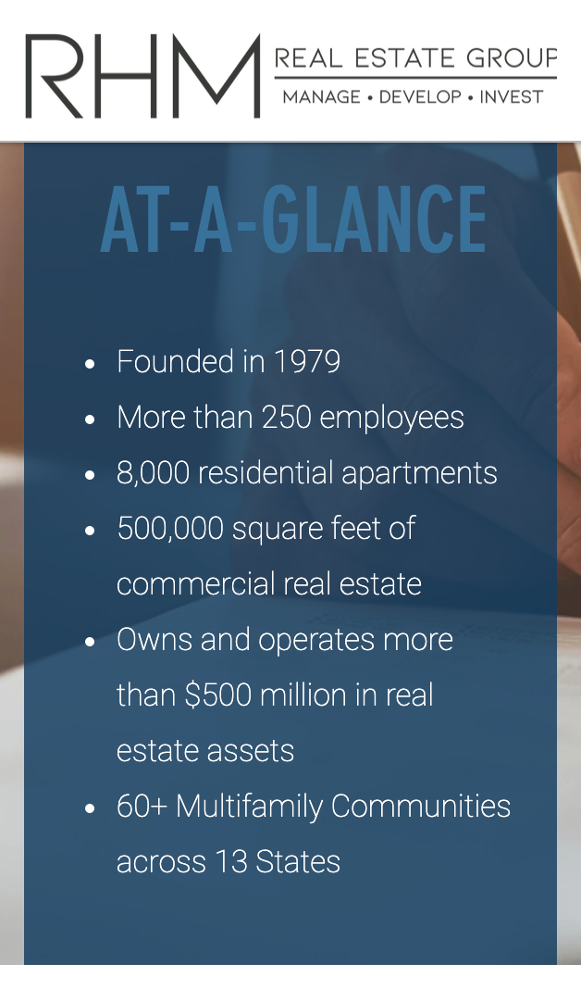
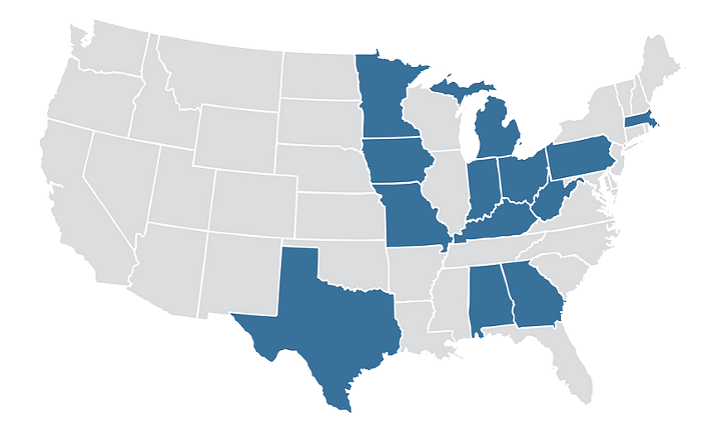
RHM Management
Freeland has decide to retain RHM, the existing asset and property manager at “296 Triskett” so that Freeland can focus heavily on Capital Expenditures, Renovations and Repairs and thus force the increase in the rents.

Slide 22
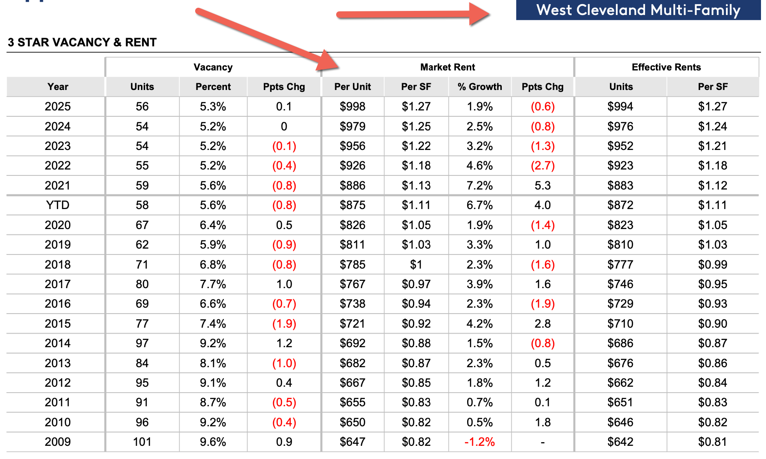
Co Star 5 Year Rent Projections

Slide 23
“296 Triskett”
296 - Unit Apartment Complex
Current Financials (87% Occupied)
Stabilized (After Repair) Financials
Rental Income $2,070,140
Vacancy (10%) (included)
Other Income $71,324
Gross Income $2,040,432
Expenses ($1,448,139)
Taxes ($236,179)
Insurance ($31,000)
Utilities ($463,000)
Maintenance ($436,000)
Payroll ($230,734)
Management ($119,662)
Net Op Income $644,024
68.5% Expense Ratio – Should be 50%
Rental & Other Income $3,421,947
Vacancy (5%) (171,079)
Other Income (103,680)
Gross Income $3,354,530
Expenses ($1,698,052)
Taxes ($503,324)
Insurance ($78,440)
Utilities ($399,750)
Maintenance (incl reserve) ($310,800)
Payroll ($230,880)
Management ($117,409)
Net OP Income $1,656,477
Expenses back in line at 50.6%
At 42 months (projected)
Notes:
In the residential real estate investing space, getting in on profitable, high-value deals is simple -- it takes six simple steps that you can repeat over and over again. These are the foundation of real estate and real estate investing. To get in the market and make serious profits, you need.
FOUNDATION
FIND It
FIGURE It
FUND It
FIX & FILL It (hold or refinance)
FLIP It

Slide 24
“296 Triskett”
296 - Unit Apartment Complex
Acquisition
Stabilized Projections
All In $20,100,000
Purchase Price - $16,300,000
Renovation Budget - $2,553,496
Acq Fee $326,000
Closing & Legal Costs - $463,785
Operating Capital (Draw Starts) $450,000
Financing $20,100,000
Bank Loan - (Advanced at Closing) $12,225,000
Rehab Draw Loans $2,553,496
Private Investors $5,300,000
Stabilized (After Repair) Value
NOI - $1,656,477
ARV - $27,610,000 @ 6.00 Cap
Agency Loan - $20,710,000 in 42 mos. @ 6.00 Cap
75% LTV, 4.5% int rate, 30 yr am, non-recourse
Pay off Acquisition Loan & Private Investors
Net Refi Proceeds $300,000
Net Free Cash Flow of $397,263 per year – 30 year amm
OR 3 Year I/O of $724,527 per year for 3 years
Remaining Equity of $6,900,000
Notes:
In the residential real estate investing space, getting in on profitable, high-value deals is simple -- it takes six simple steps that you can repeat over and over again. These are the foundation of real estate and real estate investing. To get in the market and make serious profits, you need.
FOUNDATION
FIND It
FIGURE It
FUND It
FIX & FILL It (hold or refinance)
FLIP It

Slide 25
“296 Triskett”
296 - Unit Apartment Complex
Expected Investor Returns for each $100k Investment
Fixed Preferred Return of 10%
Earns $10,000 in interest per year
10k (year 1) + 10k (year 2), + 10k (Year 3) + $5k (Half of year 4)
Taxed at sale at long-term capital gains rate
Perpetual Equity of .70%
Earns .70% of refi proceeds
$2,100 Projected Cash Out Refi Proceeds
Non-taxable Loan Proceeds
Earns $1,739.76 Cash Flow from Month 30-42
Holds $48,300 in equity at Refi
Increases annually with principal paydown
Taxed at sale at long-term capital gains rate
Earns $2,780.85 per year in cash flow in perpetuity after refi
($5,071.70 after Refi ~IF~ Interest Only for 3 years)
Taxed at earned income rate, offset by depreciation
Notes:
In the residential real estate investing space, getting in on profitable, high-value deals is simple -- it takes six simple steps that you can repeat over and over again. These are the foundation of real estate and real estate investing. To get in the market and make serious profits, you need.
FOUNDATION
FIND It
FIGURE It
FUND It
FIX & FILL It (hold or refinance)
FLIP It

Slide 26
Total Projected Investor Return @ 100k
Assuming Full 42 Month Stabilization & Refi
$35,000 Preferred return (10% annualized interest)
+ $2,100 Cash Out Refi Proceeds
+ $1,739.76 Cash Flow (Mos. 30-42)
= $38,839.76 Total Return On Investment in 42 months
11.1% Cash on Cash (tax advantaged)
+ $48,300 Equity Retained
Total = $87,139.76 total return in 42 months
/ $100,000 investment
= 24.90 % Annualized ROI
+ Cash Flow after refi + Principal Paydown + Depreciation + Appreciation
+ Principal returned in 42 months (projected) + Highly tax advantaged

Slide 27
Want Units?
Text Josh Now to Secure Your Spot
To secure units:
Josh Cantwell, CEO
Phone: 216-233-5448

Slide 28
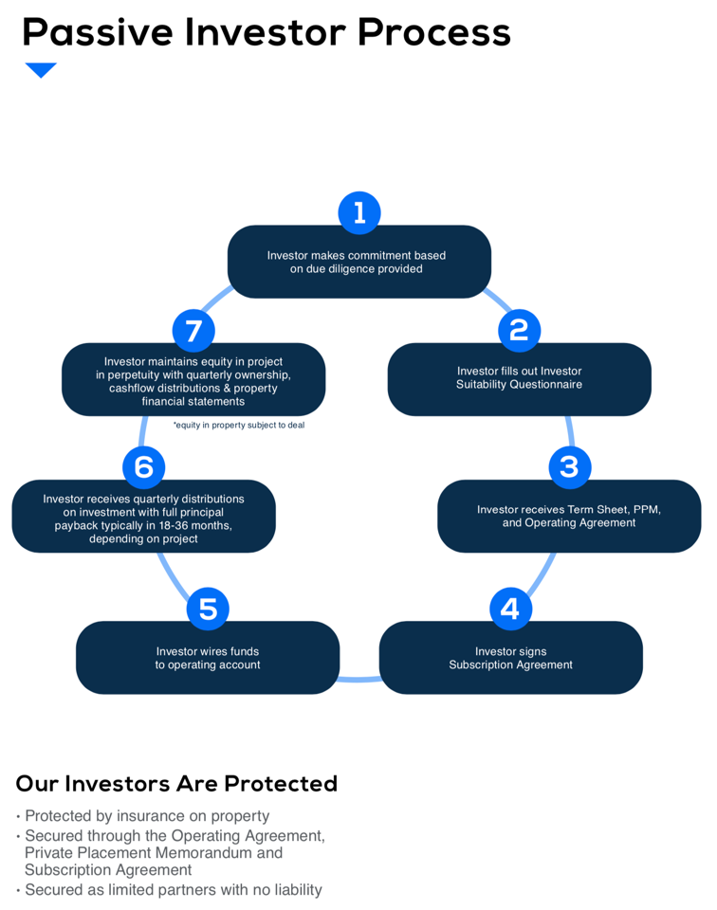

Slide 29
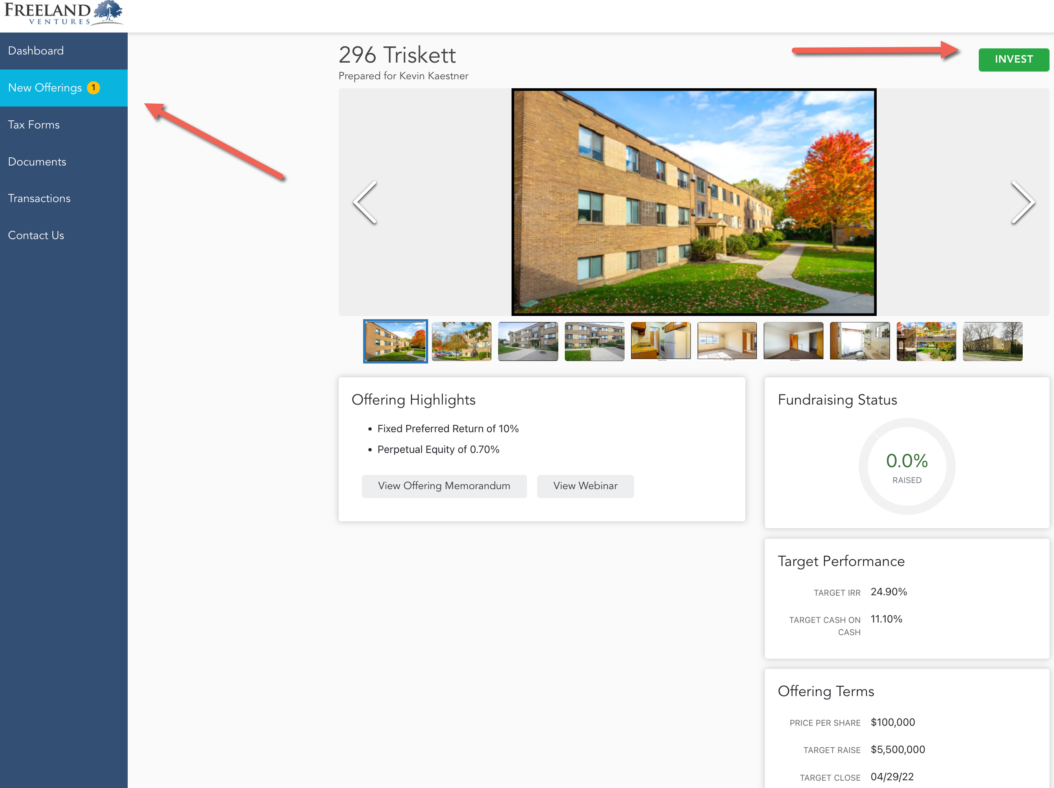

Slide 30
Thank You
NEXT STEPS
To request additional information (PPM, Operating Agreement, Subscription Agreement, etc) for “296 Triskett” please contact:
Jen Pennington
Phone: 440-783-2047
Email: jpennington@freelandventures.com

