Slide 1
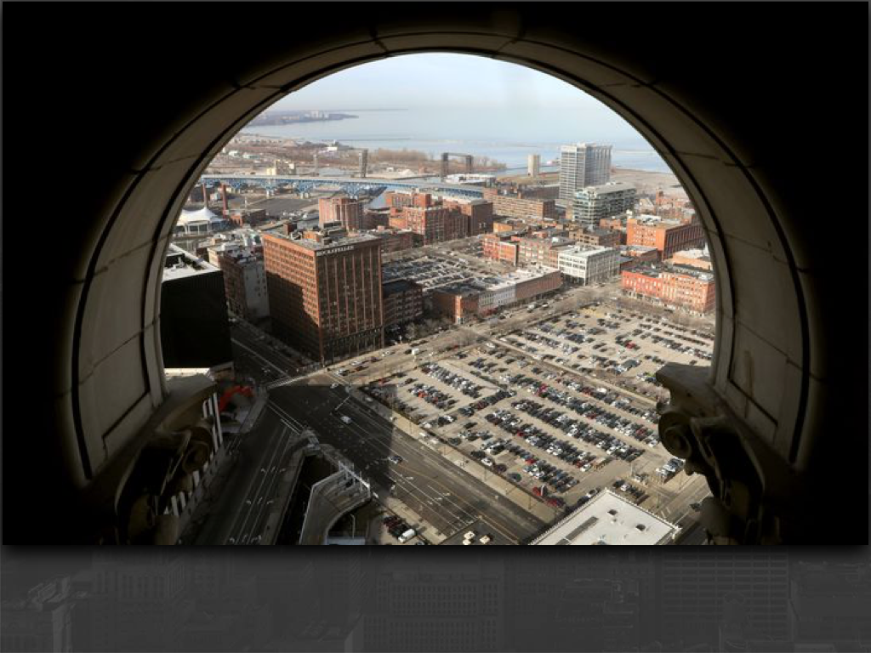

Private Investing with Multifamily
Presented By
JOSH CANTWELL
Chief Executive Officer

Slide 2
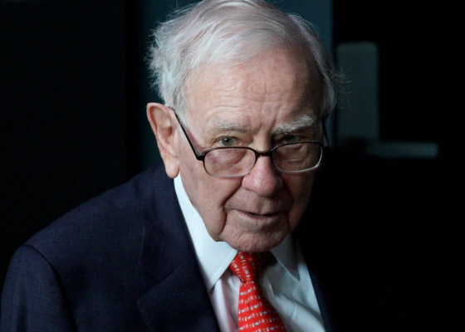
“If you don’t find a way to make money while you sleep, you will work until you die.”
-Warren Buffet

Slide 3

Complimentary
One-On-One
Strategy Session
Andrew Ziebro
aziebro@freelandventures.com
440 • 863 • 7850

Slide 4
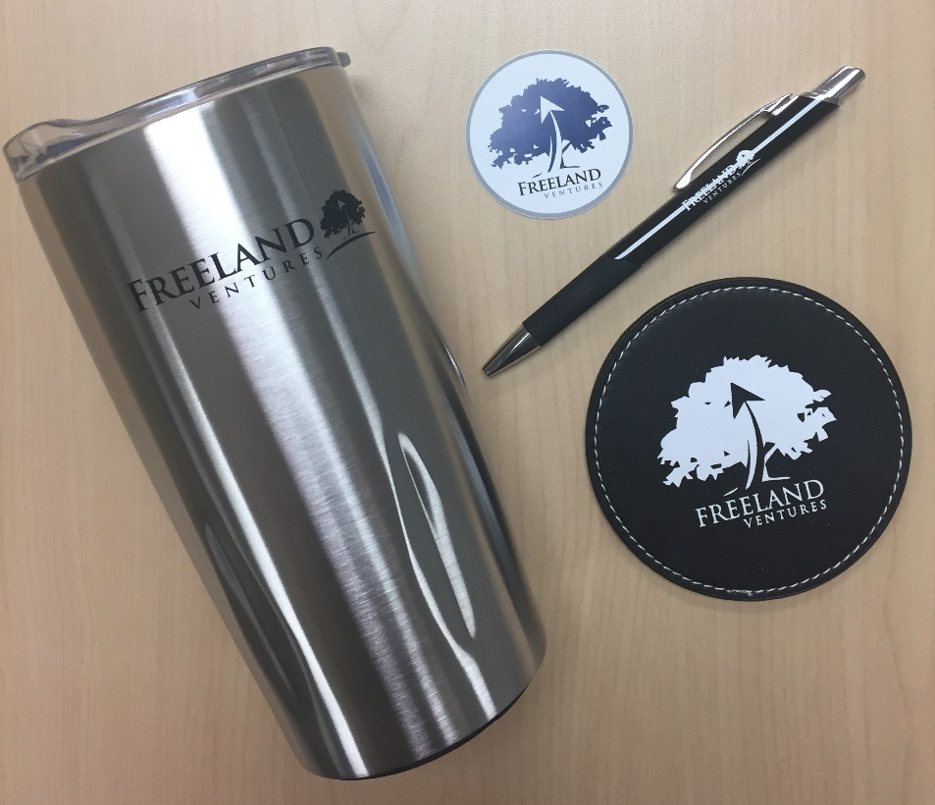
GIVEAWAY: Freeland Prize Pack
To enter the drawing, drop your business card
No Cost, No Obligation
Winner chosen tonight

Slide 5
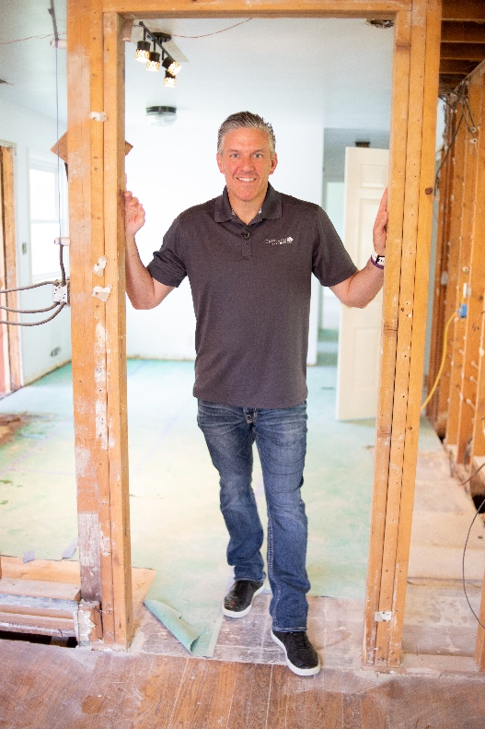
Career Path
Northeast Ohio native, Baldwin Wallace College graduate
Obtained Series 6, 63, 66, life, & health insurance licenses
Financial Advisor: 1997 - 2004
Bought 1st investment property: 2001; Flipped first rehab: 2003
Full-time real estate investor/entrepreneur: 2004
Founded Strategic Real Estate Coach: 2007
Invested in 700+ wholesale, rehab, rental, foreclosure, pre-foreclosure & short sale transactions
Holds robust rental portfolio of cash-flowing properties
Completed 400+ private money & hard money loans
$10M invested and Equity owner in 2,408 apartment units
100,000 email subscribers and 15,000 paid clients and students
Founder of a variety of successful businesses including Strategic Real Estate Coach, Realeflow (REI Software - sold in 2010), Co-founder – Freeland Ventures Private Equity and Direct Real Estate Lending
JOSH CANTWELL
Chief Executive Officer
Notes:
5

Slide 6
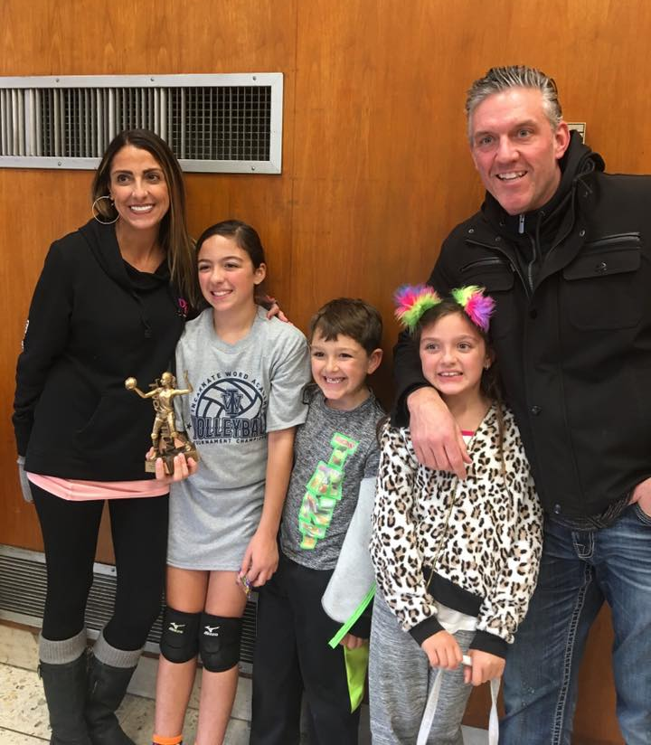
Who Is Josh Cantwell?
  Father of 3: Guiliana, Alessandra, & Dominic
  Husband to Lisa for 12+ years
  Volleyball, Football and Basketball Coach
  Interests: Golf, fantasy football
  Pancreatic Cancer Survivor
  Personally raised & manage $35M in private money
  $200M+ portfolio of Private Lender Loans, Single and Multi-Family Rentals & Apartments
Notes:
In addition guys I am just like you. I’m a family man, this is my family, this is my wife Lisa, we’ve been married six and a half years, this is my daughter Juliana in the blue dress she’s five, this is Alexandra in the black dress she’s four, this is my little buddy Dominique in the plaid, he’s two and guys the most important thing in my life is to spend time with my family and so coming out of my surgery, I realized that I’m only going to focus on things that I love and I’m going to build a real estate business around me that could function, and serve my life. So how many of you guys would love to do the things you do and the things you love and still make a ton of money? Okay, beautiful family. Thank you I appreciate that. Give it to me George says. All right guys so guys look I love my family so I coach my little girls at soccer, I play golf with my buddies and my little Juliana here she even plays golf with me.
You know I love sports,

Slide 7
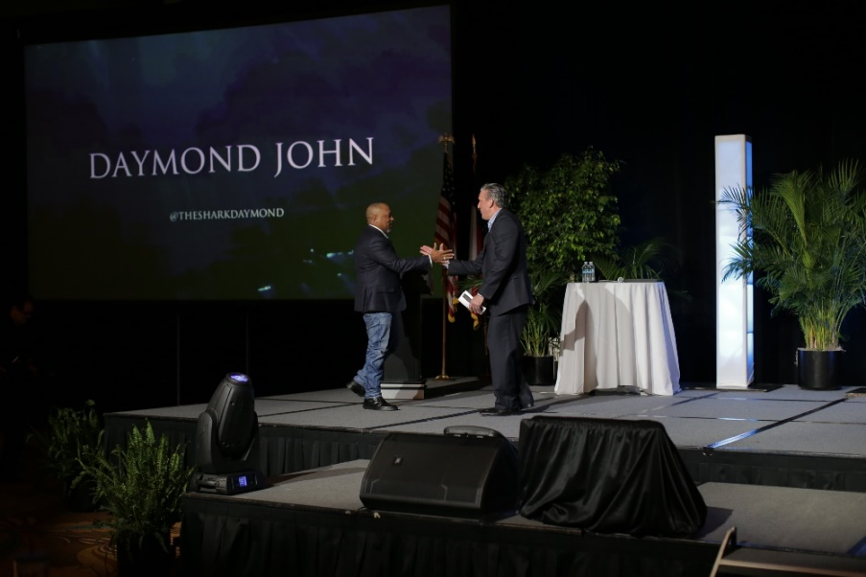
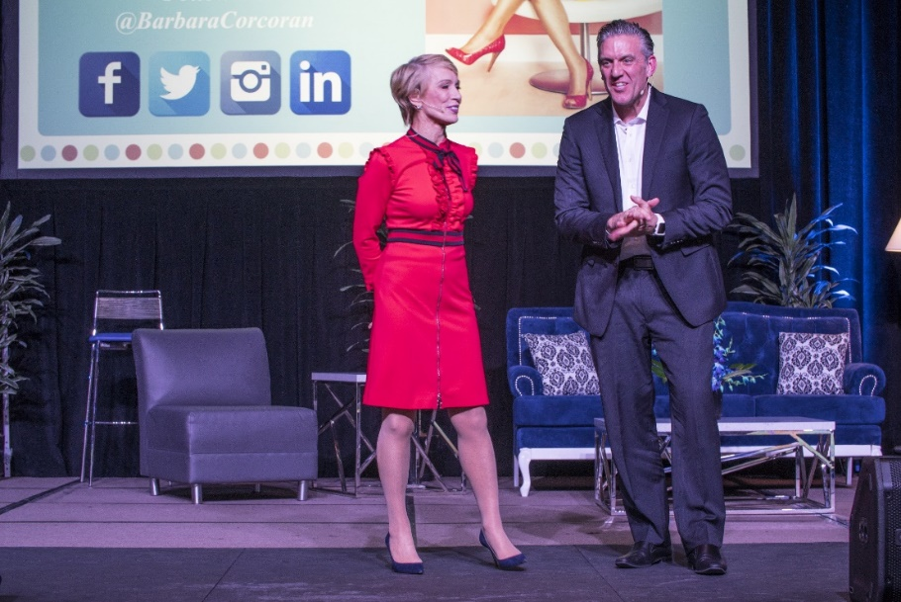
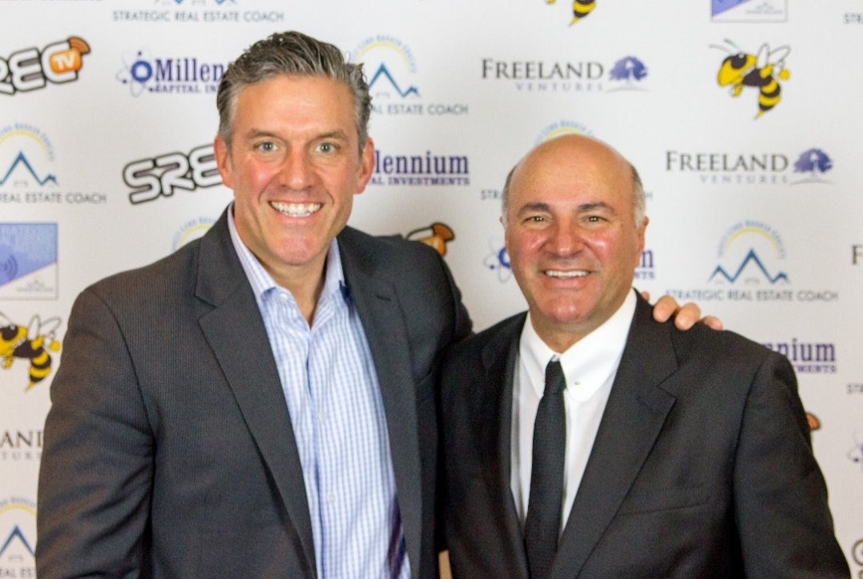
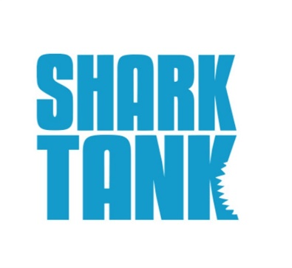
Notes:
So im going to skip the slides and the long intro.
If this is the first web class that you’ve ever been on with me you may be wondering hey besides the 1000 deals he’s closed ……. “whats makes josh such an expert”
So let me just give you 1 minute of background…….in case the 1000 deals closed ins’t enough……
All im going to say is this
Ive had to priveldge to be invited speak on seminar stages with Barbara Corcoran, Daymond John or Kevin Oleary from Shark Tank

Slide 8
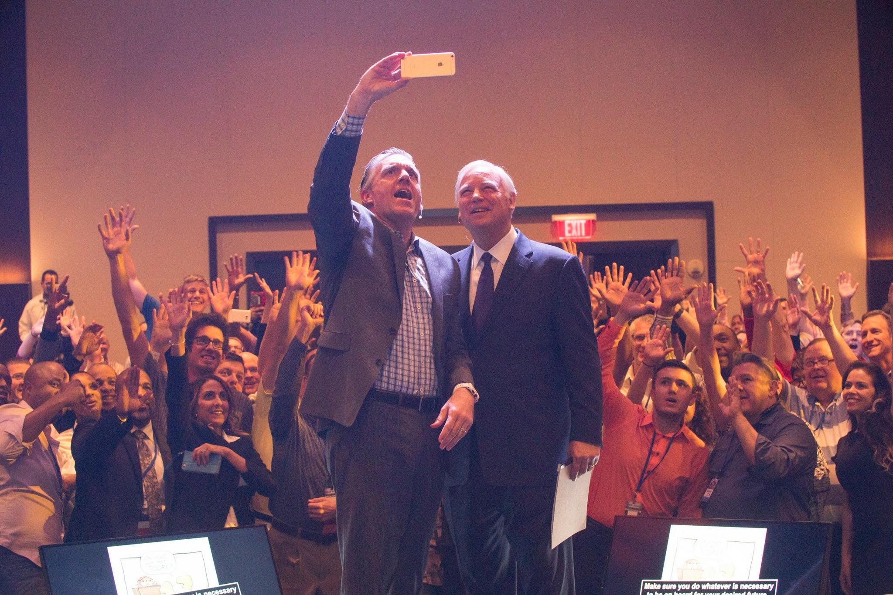
Jack Canfield
Chicken Soup For The Soul
The Big Secret
“Josh‘s genuine commitment to help you be successful is evident. Whether you are a new investor or a seasoned professional, you‘ll find great value in this.“
Notes:
IN 2017 I had the opportunity to speak on the same stage with Jack Canfiend
Now Jack is the author of chicken soup for he soul and the secret and he said ("Josh‘s genuine commitment to help you be successful is evident. Whether you are a new investor or a seasoned professional, you‘ll find great value in this.“

Slide 9
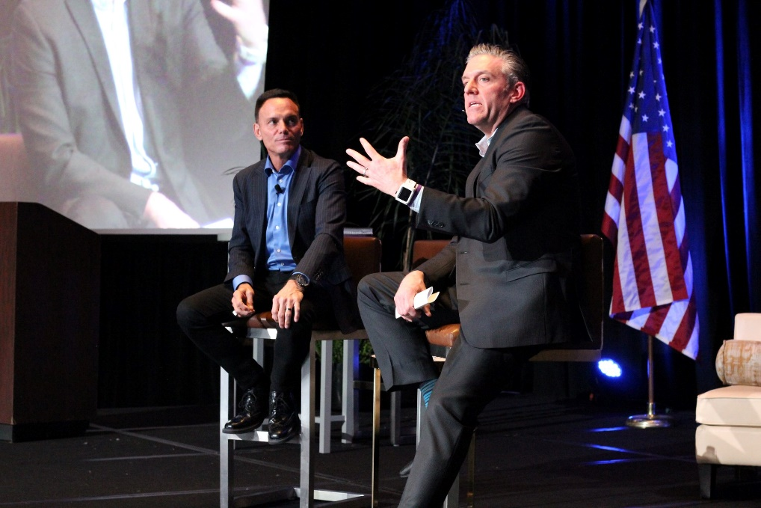

Kevin Harrington
“Josh Cantwell is relentless in his drive to bring proven and profitable real estate investing strategies to the residential real estate investor. His energy is contagious. It’s truly inspiring.“
“Tease → Please → Seize”
Notes:
IN April 2018 i was teaching on staghe with Kevin Harrington
kevin harrington is the Original Shark Tank Shark from the very first season and the Owner of the “AS SEEN ON TV” BRAND and Kevin said(“Josh Cantwell is relentless in his drive to bring proven and profitable real estate investing strategies to the residential real estate investor. His energy is contagious. It’s truly inspiring.“

Slide 10
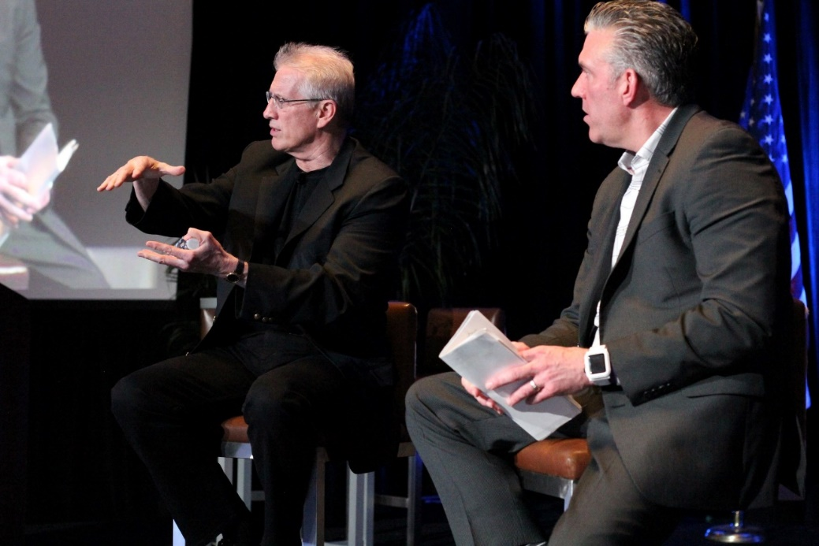
Dr. Peter Linneman
Wharton School of Real Estate (UPENN)
Realtor Magazine: 25 Most Influential People in Commercial Real Estate
“If you are ready to invest in flipping homes, I can think of no better resource than Josh. He is clear and thorough and a great teacher on flipping houses."
Notes:
And finally Dr Peter Linneman, who is the founding chairman and founding professor at the Wharton’s Real Estate Department at the Univerisyt of Pennsylvania said (“If you are “ready to invest in flipping homes, I can think of no better resource than Josh. He is clear and thorough and a great teacher on flipping homes."
What you DO care about is how to simplify, accelerated and automote your real estate investing and flipping.

Slide 11
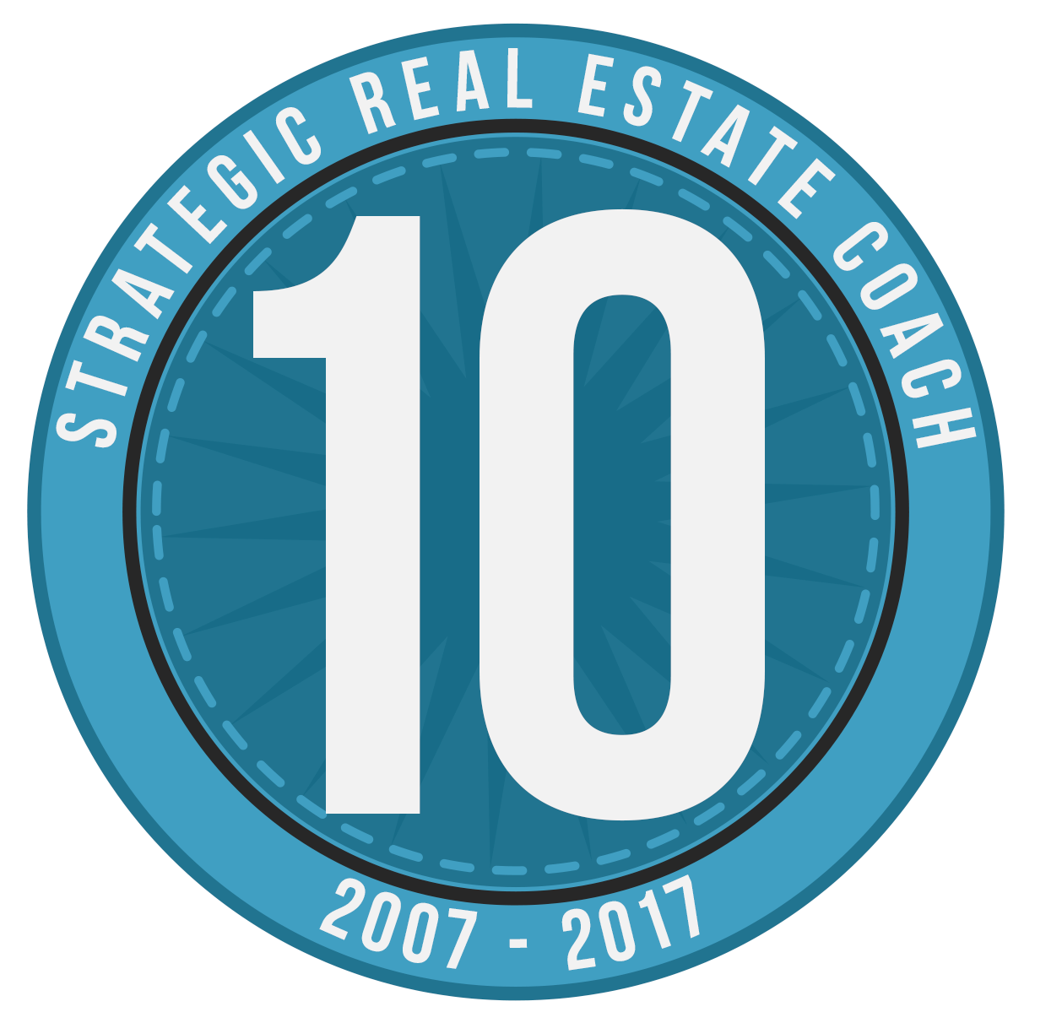

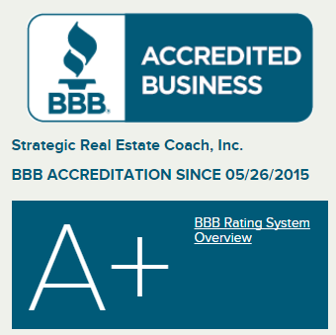
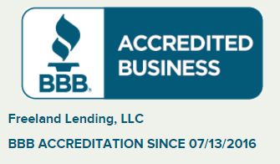
BBB Accreditation & 13 Year Anniversary

Slide 12
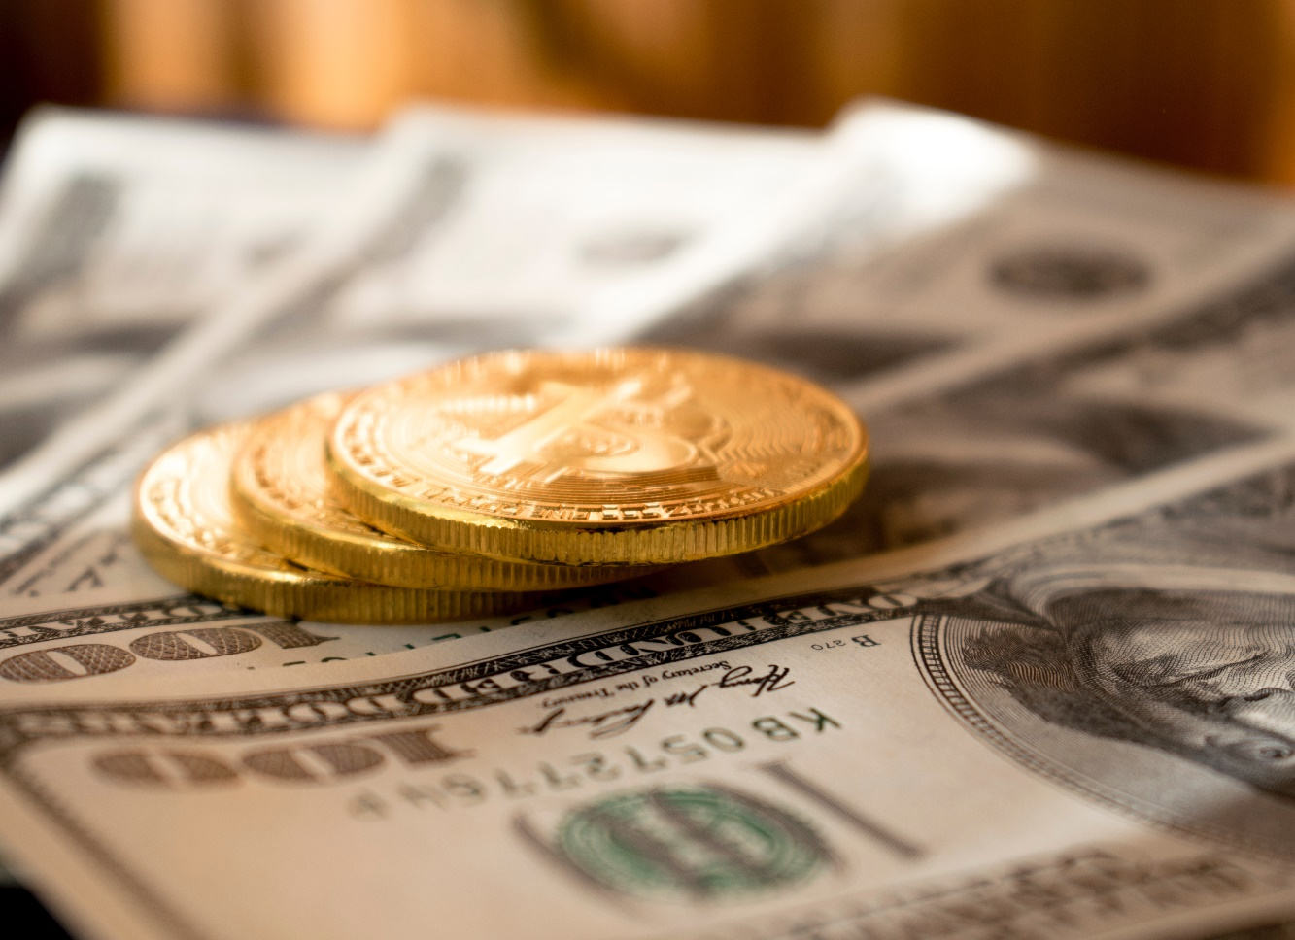
FUNDING = FREEDOM
Cash to close deals
Confidence in offers
Never take money out of your pocket
100% Funding
Even Get Paid when you BUY
NO MONTHLY PAYMENTS
  …..unless you have cash flow
Pay “all cash”
  For small balanced properties
No points, fees, prepayment penalties
Notes:
So here is what I’m going to cover today and what the 40K Flip training is going to do for you. Number one, you are going to learn the exact blue print of how I have made $92,996 in the past 19 months focusing only on properties I can make $40,000 each or more. And again that’s using none of my own cash or credit so I want you to know it doesn’t matter what your credit situation is right now. You are not going to need hard money loans you are not going need bank loans to do this. Number two, proof that all the cheap, no income, no asset, no credit check capital that you would ever need to fund your deals is easily accessible and right in front of you. You probably just don’t where to look, so I’m going to show you where to get the funding okay and where to look for the funding, and then that way you would be able to make offers with confidence,. Number three I am going to show I personally really buy three to six houses a month for 30 to 40 cents on the dollar.
Okay. In great middle class and upper middle class neighborhoods and I flip every one of them for 30 to $70,000 profits. Okay, number four I’m going to show how you can get an average of $42,300 cash back in closing. So let me ask you a question, so Rodney, Rodney is on the line right now, Rodney if I could show you a way where you could buy a house at a discount get the funding and get $42,000 cash back at closing and that will cover, all of your purchase all of your renovation, all of your repairs, all of your insurance, all of your utilities and then you can also put $3,800 in your pocket, in your savings account when you bought it Rodney would you be interested in learning that? Okay, how about Dinah would you be interested in learning that? Darrell says, yes Reginald says I would, okay, Heck yes I would Bryson says I would. Okay that’s exactly what you are going to learn guys. You are going learn how to find discounted properties how to get the funding, how to buy this properties and get all of the funding upfront. So you don’t have get to a nickel out of your own pocket you get cash back at closing. And then out of the cash back at closing you get to take some of that money and you get paid when you buy a house, okay in addition I’m going to show the automated offer formula that you will use to bid on homes, I’m going to show what an accepted offer looks like, I’m going to show what you will do with an accepted offer.
Now, guys I make about $40,000 a deal but I have some students like Kyle, who I’m jealous of because Kyle makes about 80 to $100,000 a deal. Kyle is in the Chicago. And I have a student Scott, his name is Scott Benedict, he is in California and he makes between a 100 to even $200,000 a deal. Is there anybody on the line from California? Okay, so Edward from California, Antonio is from California, Cathy is from California, Oh my goodness, so if I was you guys I would be, oh my God I would be so excited to do this because my buddy Scott he is also one of coaches now because he is so successfully with this he consistently finds property in California and make a 100 to 200,000. Okay and I’m going to show you a few other things as well but let me let me show you guys the proof that this business is automated for you

Slide 13

      The real truth about raising private money in real estate and the securities laws…
      Once you understand the law and the rules, you can use them to your advantage, be more professional and raise money in compliance with the law.
      Why Am I Passionate About Real Estate and Private Money?

Slide 14
Once you offer to take someone’s money, this is an offer of a “security.”
      Why Am I Passionate About Real Estate and Private Money?
      The offer and the sale of a “security” are regulated by state and federal agencies.
      You must find an exemption or register your offer and sale of securities.
      These slides are summaries and are not a substitute for working with your own attorneys, financial and tax advisors.

Slide 15
What is a Security?
Under section 2(a)(1) of the securities act of 1933, the term "security" includes:
  Any note, stock, treasury stock, security future, bond, debenture, evidence of indebtedness, certificate of interest or participation in any profit-sharing agreement, collateral-trust certificate, preorganization certificate or subscription, transferable share, investment contract, voting-trust certificate, certificate of deposit for a security, fractional undivided interest in oil, gas, or other mineral rights, any put, call, straddle, option, or privilege on any security, certificate of deposit, or group or index of securities (including any interest therein or based on the value thereof), or any put, call, straddle, option, or privilege entered into on a national securities exchange relating to foreign currency, or, in general, any interest or instrument commonly known as a "security", or any certificate of interest or participation in, temporary or interim certificate for, receipt for, guarantee of, or warrant or right to subscribe to or purchase, any of the foregoing.
Thus the federal securities laws define "security" in both specific (any "stock," "bond," "note," "debenture," etc.) And general (e.g., Any "investment contract“ “participation in any profit sharing agreement” or "instrument commonly known as a 'security') terms.
Investment contracts
  SEC v. W.J. Howey co.
  United housing foundation, Inc. V. Forman

Slide 16
What is a Security?
What is a Security?, cont.
SEC v. W.J. Howey Co. : The orange grove case study
  The Howey Company, a Florida corporation that sold small tracts of land in a citrus grove to 42 purchasers. While investing in the enterprise for profit, the purchasers, for the most part, lacked the knowledge, skill, and equipment necessary for the care and cultivation of citrus trees. 85 percent of purchasers had a Howey affiliate company service the groves. The service contracts granted the Howey affiliate full and complete possession of the acreage. Individual purchasers had no right of entry to market the crop, but shared in the profits of the enterprise.
  The Howey company did not register the interests in the enterprise as securities. The SEC brought an action to enjoin the sale of the citrus grove interests. Because the interest at issue did not constitute any of the specific, traditional kinds of securities enumerated in section 2(a)(1) of the securities act, the SEC argued that the interests were "investment contracts." Noting that the term "investment contract" had not been defined by congress but was widely used in state securities laws. The US supreme court adopted the definition used by most state courts and held that an investment contract is a security under the securities act if investors purchase with (1) an expectation of profits arising from (2) a common enterprise that (3) depends "solely" for its success on the efforts of others. Applying this test, the court found that the interests in the citrus grove sold by the howey company were "investment contracts," and thus securities, subject to the securities act.

Slide 17

What is a Security?
What is a Security?, cont.
      Private notes = most popular way to borrow capital for resi
      Notes + other types of indebtedness = securities

Slide 18
What is a Security?
What is a Security?, cont.
      Equity with Pref return= most popular way to get capital for large apartments
      Equity + Notes + other types of indebtedness = securities

Slide 19
Notes = Security
      ONLY classes of notes which are NOT securities are those that are PURELY COMMERCIAL IN NATURE
      Example: Those issued by borrowers to a bank
      That commercial interpretation for a note is a very narrow and limited interpretation which is a matter of case law, its not statutory. It will not apply to any private company small investor situations.

Slide 20
REGISTRATION VS. EXEMPTION
REGISTRATION VS. EXEMPTION
      Securities Act = The "truth in securities" law
      The securities act of 1933 has two basic objectives:
        Require that investors receive financial and other significant information concerning securities being offered for sale.
        Prohibit deceit, misrepresentations, and other fraud in the sale of securities. The SECURITIES EXCHANGE ACT ALSO PROHIBITS deceit, misrepresentations, and other fraud in the sale of securities.

Slide 21
EXEMPTION PLANNING: THINGS TO CONSIDER
EXEMPTION PLANNING
Will you offer to everyone or just accredited investors?
Up to 35 non-accredited investors → private placement exemption of Regulation 506(b)
  More then 35 offerees → not more than 35 non accredited investors
Have only accredited investors → unlimited investors under Regulation 506(b)
  Can use 506(c) exemption
Will you operate only within your state or across state lines?
Intrastate includes risk of accidentally making offers to investors in other states
Requires federal and state exemptions / each state has its own laws and rules regulating offers & sales
Reg. D Rules 505, 506 (b) and 506(c) look to investors (not offerees) = benefit
506(b) = most well known & time tested
Will you raise money from only people you already know, or will you solicit the general population?
Private placement exemption: 506(b) → SEC guidelines on conversion
General solicitation exemption: 506(c) → Accredited investors only
Notes:
Intrastate is actually more tricky than 506(b) because of practical difficulty of not accidentally making offers to investors in other states. You need federal and state exemptions. Each state has its own laws and rules. Offers are normally the regulated activity as well as sales. But Reg. D Rules 505, 506 (b) and 506(c) look to investors not offerees This is a huge benefit to you. 506(b) is the most well known and time tested.
For people you already know or are willing to get to know properly—you can use the private placement exception: 506(b). The SEC has guidelines on how to convert strangers into preexisting relationships. Its takes effort.
For general population solicitations—you can use the 506(c)
exemption, but its complicated. Only accredited investors.

Slide 22
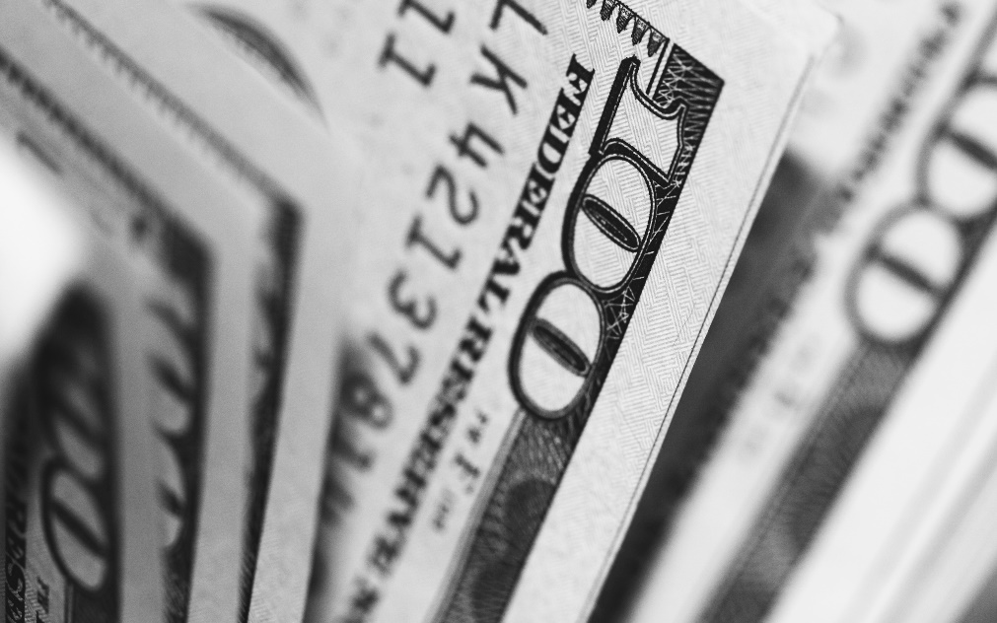
Get All The Private Money Funding You Need For
All The Deals You Want

Slide 23
Did You Know?
Did You Know?
2010
    More Than $1Trillion Was Raised By Private And Public Companies
    Public Companies Use Private Placements Also To Raise Money
    More Money Was Raised From Private Placements Than I.P.O.'s
    Under Private Placements You Don't Generally Give Up Control Unless You Plan It That Way

Slide 24
1
Irresistible Offer
Identify Your Ideal Investor = AVATAR
Where Can Your Ideal Investor Be Found?
Recurring Multimedium Marketing Plan = Top Of Mind Reference
Follow Proven Sales and Follow Up Process
      5 Steps: Getting Capital You Need for Deals You Want
2
3
4
5

Slide 25
How to Find Investors: Step 1
Irresistible Offer
FOR REHABS: 12% Interest OR 15% of Profits Whichever is Better, No Payments, All Interest Accrues, 1 Year Balloon
FOR REHABS: 10% Interest AND 10% Of Profits, No Payments, All Interest Accrues, 1 Year Balloon
FOR RESI RENTALS: 10% Interest AND 10% Ownership in perpetuity w/ Principal Paid Back at Refi, Equity, Cash Flow and Tax Deductions in Perpetuity
FOR VALUE ADD APARTMENTS: 10% Preferred Interest + Equity, Principal Paid Back at Refi, Cash out Refi Proceeds, Equity, Cash Flow and Tax Deductions in Perpetuity

Slide 26
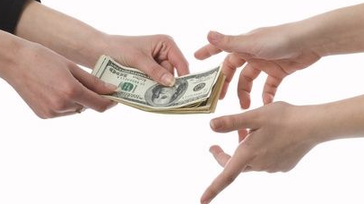
What is a Private Lender?
Someone who has cash that partners with you or invests/loans to you on a real estate deal
Assets can include:
  Savings accounts
  Checking accounts
  CD’s
  Brokerage accounts
  Liquidated mutual funds
  Stocks
  Bonds
  Retirement accounts
  SDIRA’s
  Health savings accounts
  Lines of credit

Slide 27
Why Private Lenders Give Real Estate Investors Money
Subpar Investment Alternatives
Better & More Predictable Returns
Unparalleled Tax Advantages

Slide 28
Investment Marketplace
28
Notes:
Have you been paying to the stock market?
Have you been paying attention real estate market?
What do you about your finances?

Slide 29
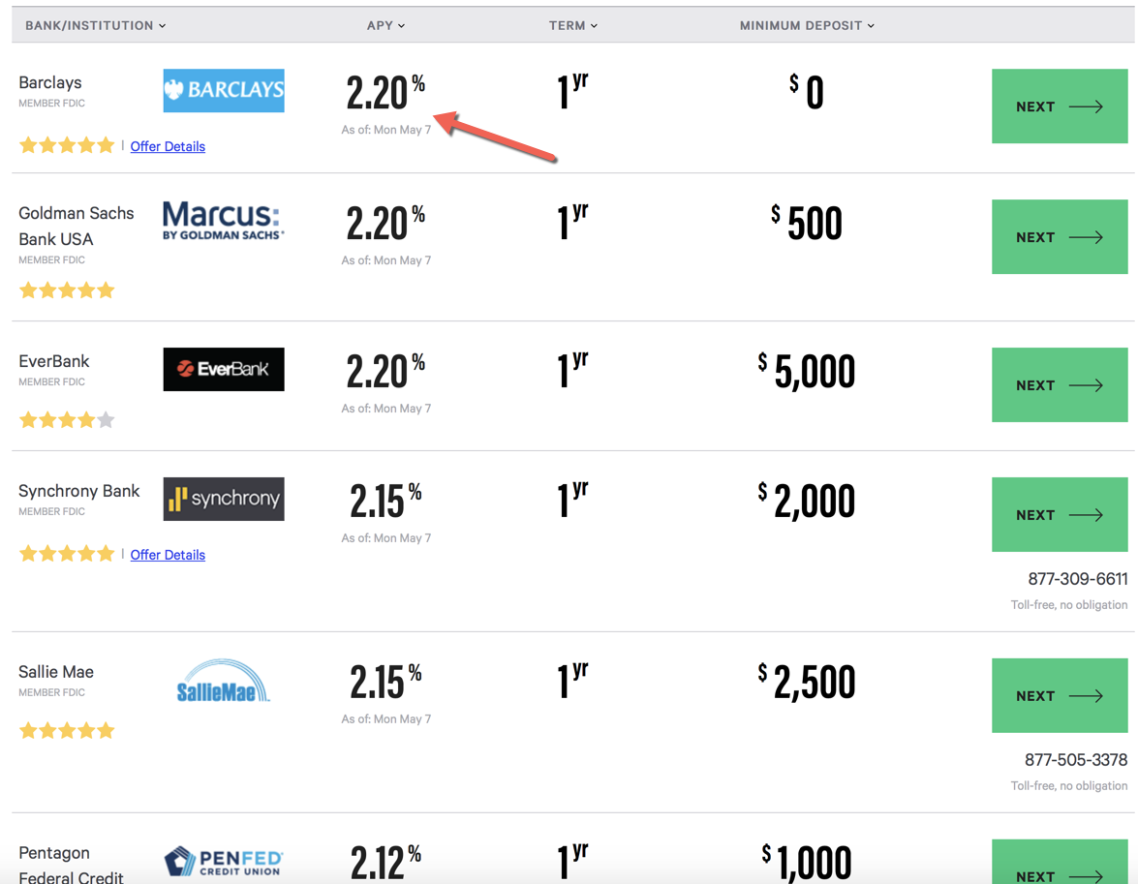
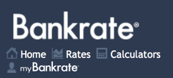
Investment Marketplace
Notes:
Okay, so let me explain, so if you went into Google right now and you ‘Googled’ CD rates, you’d find that CD’s are paying 1.3% okay?

Slide 30
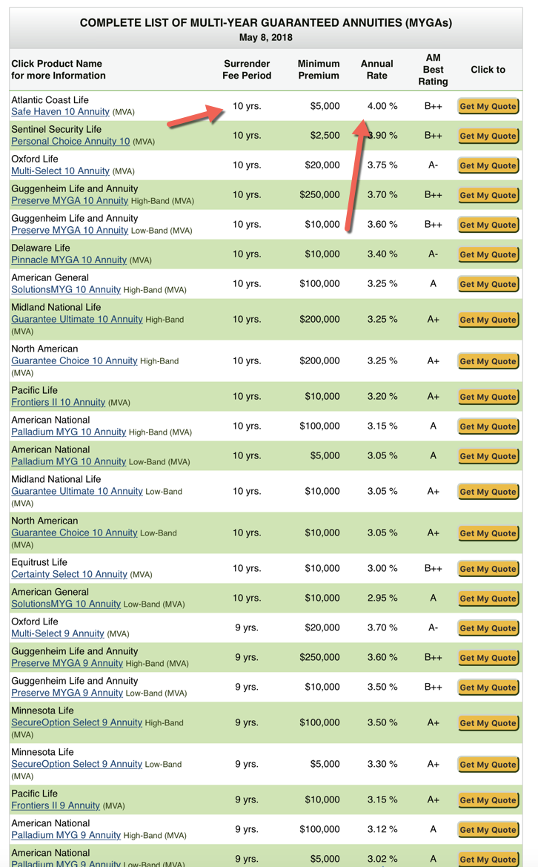
ANNUITY RATES
4.00% Return on Investment
10 Year Surrender Period Penalty
Notes:
Okay, so let me explain, so if you went into Google right now and you ‘Googled’ CD rates, you’d find that CD’s are paying 1% okay?

Slide 31
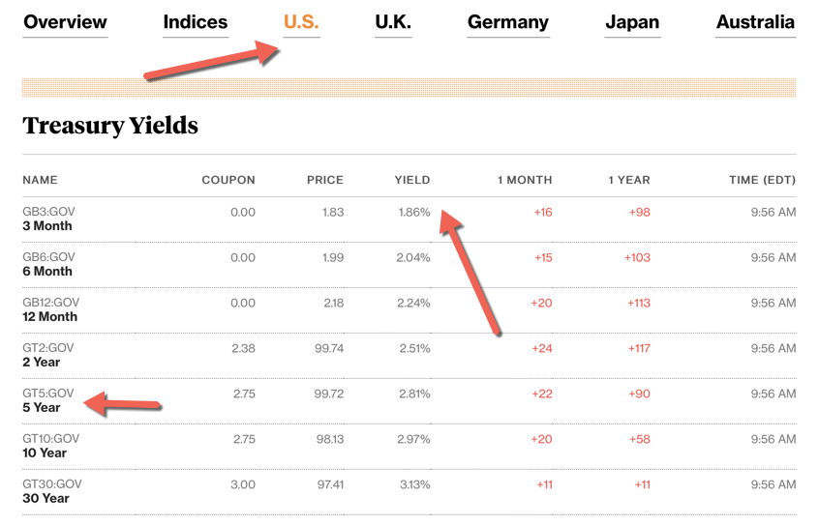
BOND RATES
2.24% Return on Investment for 1 year Bond
Notes:
Okay, so let me explain, so if you went into Google right now and you ‘Googled’ CD rates, you’d find that CD’s are paying 1% okay?

Slide 32
S&P 500: One Year Return
Jan 1st 2019 - Dec 31st 2019
Gain of (30%) - Before Fees
Notes:
NEED NEW PIC OF GOOGLE S&P 500
And if you couldn’t live with those low interest rates, you could put your money in the stock market okay? But I don’t know about you; if you’ve been paying attention to the stock market lately, but the stock markets been getting hammered in 2014. Okay, it was down 300 point the other day, it’s down 200 points today; it was down 400 points last week. And so investors are scared, they are looking for somewhere to put their money. Okay, stock markets only average 8% over the last 10 years and so
And approximately 9% over the past 100 years.

Slide 33
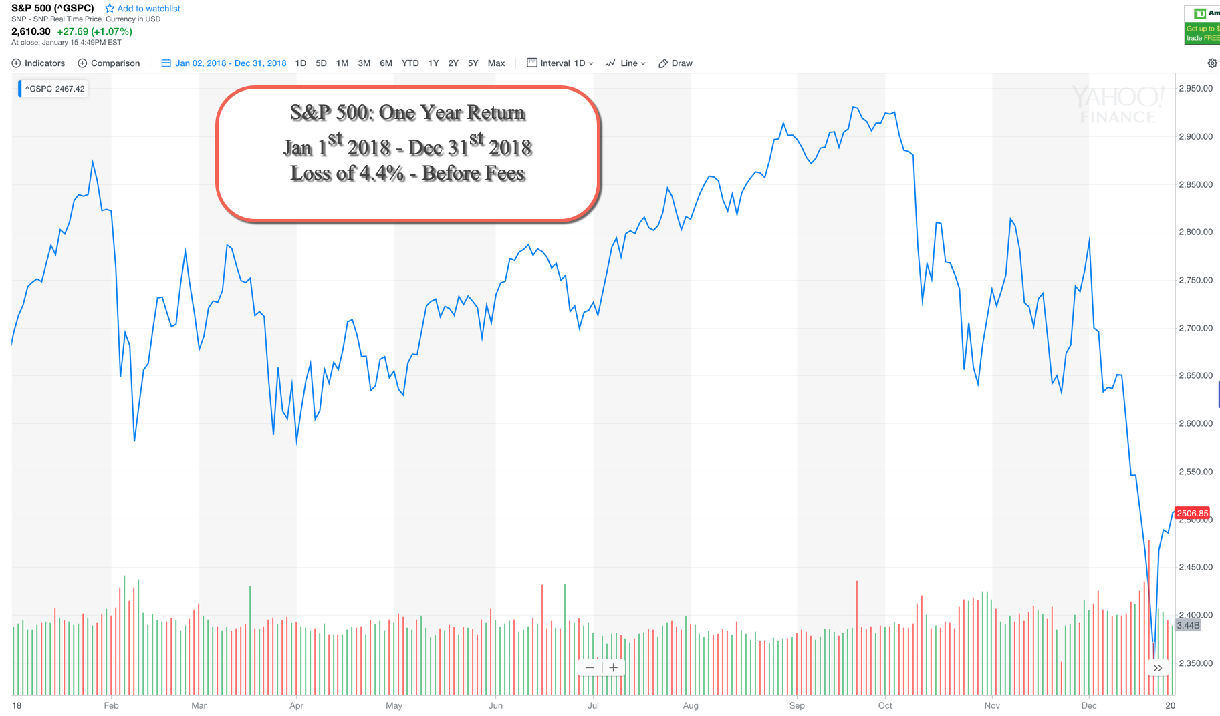
S&P 500: One Year Return
Jan 1st 2018 - Dec 31st 2018
Loss of (4.4%) - Before Fees
Notes:
NEED NEW PIC OF GOOGLE S&P 500
And if you couldn’t live with those low interest rates, you could put your money in the stock market okay? But I don’t know about you; if you’ve been paying attention to the stock market lately, but the stock markets been getting hammered in 2014. Okay, it was down 300 point the other day, it’s down 200 points today; it was down 400 points last week. And so investors are scared, they are looking for somewhere to put their money. Okay, stock markets only average 8% over the last 10 years and so
And approximately 9% over the past 100 years.

Slide 34
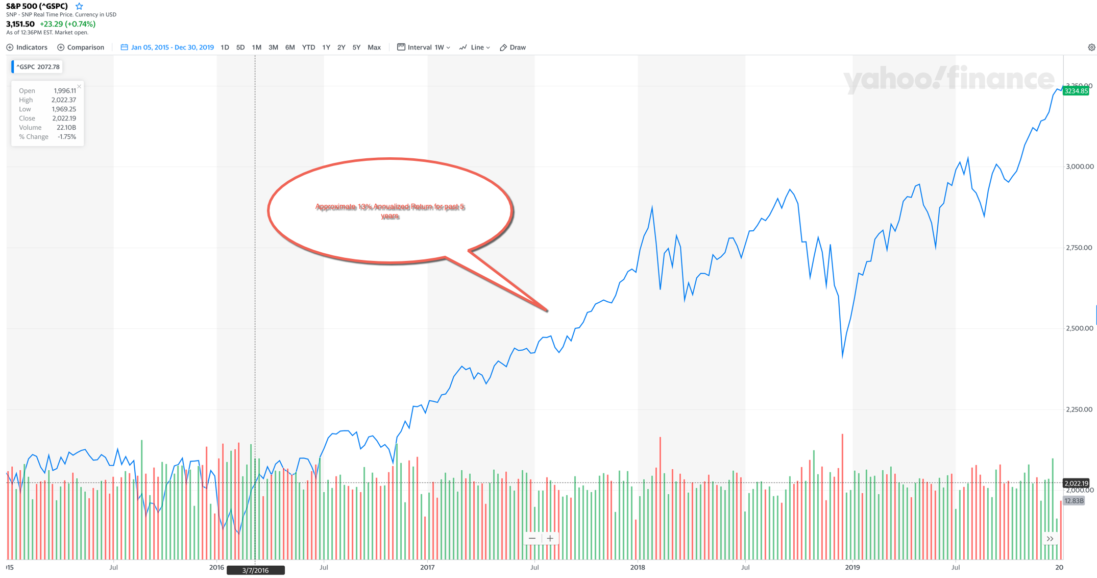
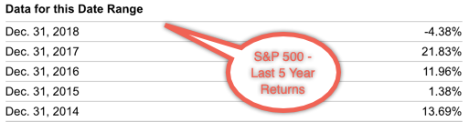
S&P 500: Last 6 Year Return
Jan 1st 2014 - Dec 31st 2019
Avg. Gain of 12.58% Per Year
Notes:
NEED NEW PIC OF GOOGLE S&P 500
And if you couldn’t live with those low interest rates, you could put your money in the stock market okay? But I don’t know about you; if you’ve been paying attention to the stock market lately, but the stock markets been getting hammered in 2014. Okay, it was down 300 point the other day, it’s down 200 points today; it was down 400 points last week. And so investors are scared, they are looking for somewhere to put their money. Okay, stock markets only average 8% over the last 10 years and so
And approximately 9% over the past 100 years.

Slide 35
S&P 500: Last 10 Years Return
Jan 1 2010 – Dec 31st 2019
Avg. Gross ROI Per Year
  12.78
  0.00
  13.41
  29.60
  11.39
  -0.73
  9.54
  19.42
  -6.42
  28.88
  -3.17
  **Removing 2020
  **Avg. annualized = 11.78% Before Fees
  **In the longest economic expansion in history
Notes:
NEED NEW PIC OF GOOGLE S&P 500
And if you couldn’t live with those low interest rates, you could put your money in the stock market okay? But I don’t know about you; if you’ve been paying attention to the stock market lately, but the stock markets been getting hammered in 2014. Okay, it was down 300 point the other day, it’s down 200 points today; it was down 400 points last week. And so investors are scared, they are looking for somewhere to put their money. Okay, stock markets only average 8% over the last 10 years and so
And approximately 9% over the past 100 years.

Slide 36
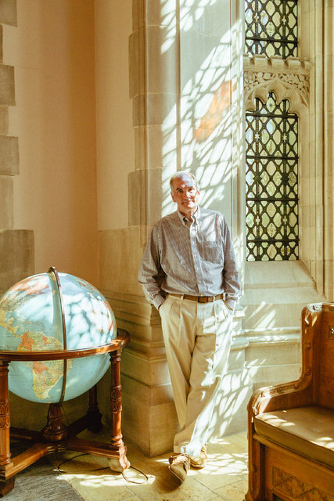
Mutual Funds & 401K Plans
      Myth: “Invest in mutual funds…
      and beat the market.”
  “96% of actively managed mutual funds and money managers underperform the Index (S&P500, Bond Index, etc.).”
  -David Swenson, Yale Endowment Fund Manager,
  who grew Yale’s Endowment from $1B to $25B
  Mutual Fund = “Fee Factory”

Slide 37

Mutual Funds & 401K Plans
According to DALBAR, the financial community’s leading independent research firm, founded in 1976:
Over a 30 year period from 1985 – 2015, the S&P 500 Index returned an average annual return of 10.28% per year, while the average investor made just 3.66 %.
Why?
  Lack of investor clarity/insight on market timing
  Fees (avg 3.12%, according to Forbes)
  Churn
  Buying & Selling
  Underperforming mutual funds

Slide 38

According to Forbes
Average cost of owning a mutual fund = 3.12% per year
  1.2% - 1.5% for Expense ratio (published online and in prospectus)
  0.83% for Cash Drag, 12 b-1 marketing fees (not reflected in expense ratio)
  1.4% for transaction costs (not reflected in the expense ratio)
  401k’s and Mutual Funds can carry up to 12 different expense charges

Slide 39

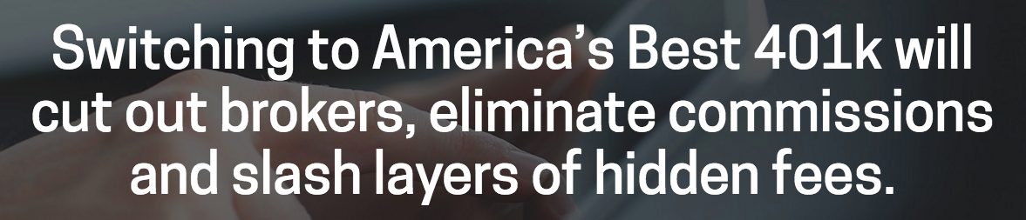
According to America’s Best 401k
Potentially up to 12 different mutual fund fees + the expense ratio:
Total Mutual Funds Fees:
  Expense Ratio
  Transaction Costs
  Tax Costs
  401k Costs
  Soft Dollar Costs
  Cash Drag
Redemption Fee
Exchange Fee
Account Fee
Purchase Fee
Sales Charge (Load)

Slide 40
Mutual Funds & 401K Plans
In 2013, 75% of 401k’s audited by the Department Of Labor
resulted in plan sponsors being fined, penalized or forced to make reimbursements for plan errors. Average fine = $600K
This is before taxes…
  From 1972 – 2012, the market averaged 10%, but assuming 30% in taxes, the number is less than 7%

Slide 41
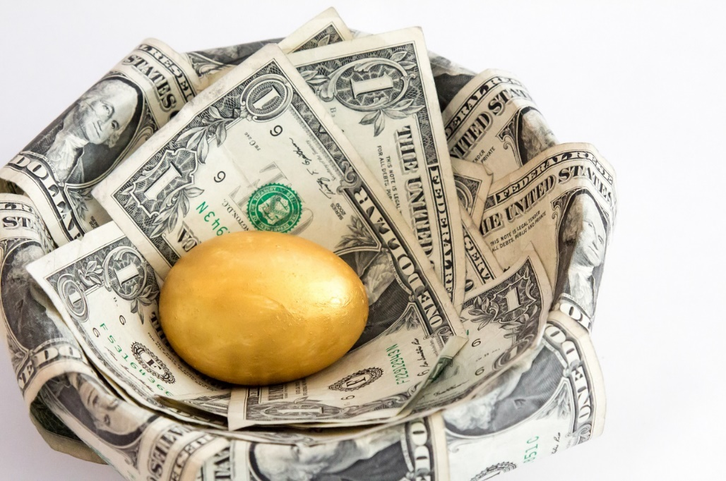
According to Forbes
You can own the entire market (i.e. The S&P 500 Index) for just 0.14%
401k and Mutual fund Fees are eating up 50-70% of your future nest egg
$100K invested at 7% for 30 years:
    1% fees = $574K
    2% fees = $432K
    3% fees = $324K

Slide 42
The Lost Decade
2000 – 2012: The S&P 500 was essentially flat
If you invested $100K in mutual funds → Paid the avg 3.1% annual fee → You would have paid $30K in fees from your $100K investment that wasn’t earning a return
You put up the capital, took all the risk,
and they made money no matter what

Slide 43
According to FINRA
49% of managers own ZERO shares
in the funds they manage…
What does this mean?
The chef doesn’t eat his own cooking.

Slide 44
Mutual Funds & 401K Plans
Myth: “Your retirement is just a 401K away.”
Failed DIY Pension System
Lack of investment expertise vs. trained money managers
Example: An individual who makes $90K per year will spend almost $300K in 401k fees over their lifetime
3.1% Mutual Fund Fees + 401k Administrator fees (1.3% - 1.5% annually) = 4.37% Total Fees
Notes:
-The 401k = this do-it-yourself pension system has failed because it expects individuals without investment expertise to reap the same results as a professional investor or trained money manager. What results would you expect if you were asked to pull your own teeth or do your own electrical wiring?
-A worker making $90K per year will spend almost $300K in 401k fees over their lifetime
-In addition to the 3.1% mutual fund fees, 401k administrators charge an additional 1.3% - 1.5% annually bringing your total fee to 4.37%

Slide 45

Mutual Funds & 401K Plans
Expenses Paid
in 401k’s =
Exchange for taxes that would have been paid otherwise

Slide 46
$500K Mutual Fund Investment
American Funds = “Small Cap World”
Expense ratio: 1.09% (paid to fund manager)
  At 10% = $50,000 profit/ROI
  At 8.91% = $44,550 profit/ROI
“A” Share Commission
  Paid to financial advisor who sells fund
  $500,000 = 2% (breakpoint) = $10,000
$500,000 - $10,000 = $490,000 - $5,341 (1.09% expense ratio) = $484,659 left (ZERO ROI)
$15,341 in FEES for American Funds
vs.
$750 in FEES for Horizon Trust (Self-Directed IRA)
              $50 account set-up fee
              Annual maintenance fee (depending on the balance of your account)
Notes:
I used to sell this ALL the time when I was a financial planner

Slide 47
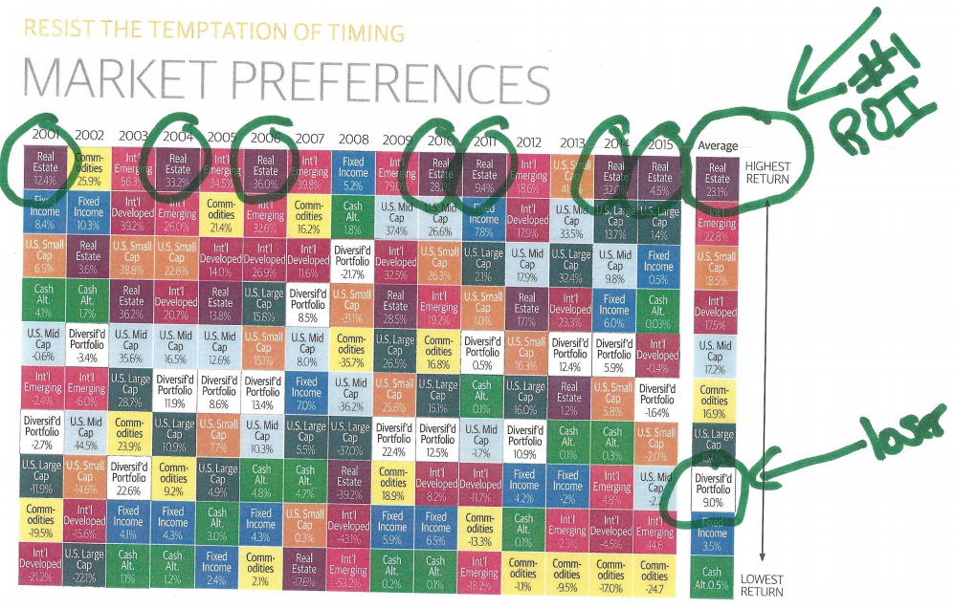
From My Financial Advisor

Slide 48
Have an Old 401K or Cash to Invest?
Option A = Not Us
CD = 1%
Annuities = 4% or less
Bonds = 3% or less
Stock market past 10 years = 11.78%
Significant volatility
No control over investments
Significantly higher fees
Option B = Us
Local Private Lender Loans – 12% OR 15% or profit whichever is greater
High Yield Notes and Mortgages – 13% Fixed
Diversified High Yield Debt Fund – 9-16%
Value Add Apartments – 8-24% IRR
  Predictable
  Control over investments
  Lower/no fees
The wealthy don’t choose Option A…
they choose Option B

Slide 49
Rule of 72
72 divided by your annual interest rate = Number of years until you double your money
7% Net Annual Returns |  | 12% Net Annual Returns
Start with $200,000 |  | Start with $200,000
Double your money every 10.29 years |  | Double your money every 6 years
After 20 years you will have approx. $800,000 |  | After 20 years you will have approx. $1.6 million
Variable returns |  | Fixed returns
Which one would you rather have?

Slide 51
Private Investing: Investing Structure #1
SUMMARY
Apartment bought with 80% Bank Financing @ 5-6% & Personal Guarantee
  + 20% Private Money for Down Payments
  Private Lenders → Equity Ownership & Promissory Note @ 10% Fixed Simple Interest
Property Repositioned & Stabilized with Value Add Improvements & Increased Rents
REFI (18 – 30 months): Bank Loan and Equity Investment Paid Off @ Refi
Private Investors get all principal back
  PLUS percentage of refi “cash out” proceeds
Private Lenders Keep % of Building Cash Flow and Equity with Zero Cash left in deal
No Fees, No Commissions
Value Add Apartments
Private Lender
Construction Financing
Refi to Perm Financing

Slide 52
5 Complexes • 730 Units in Georgia
Equity Investor: Georgia Plains
Executive Summary:
Purchase Price… $9.6M
Improvements… $10.4M (Heavy Lift)
Soft Costs… $4.1M
All In… $24.1M
Stabilized NOI… $2.8M (divide by .07 = CAP RATE)
Stabilized Cap… 11.7%
Stabilized Value… $40.3M
Equity Created… $16.2M
Profit Centers
Refinance Proceeds…$6.1M
Cash Flow… $874K
Equity in Property… $10M

Slide 53
Equity Investor: Georgia Plains
Investment Summary:
Closed: September 2018
10 PL’s: @ $200K each
Projected IRR: 20-25%
2-3 year stabilization
  10% fixed annual return
Post stabilization:
  Principal returned
  Refi Proceeds: Approx. $60K
  1% Equity ownership: Approx. $100K value
  Projected Cashflow: Approx. $8,737/year

Slide 54
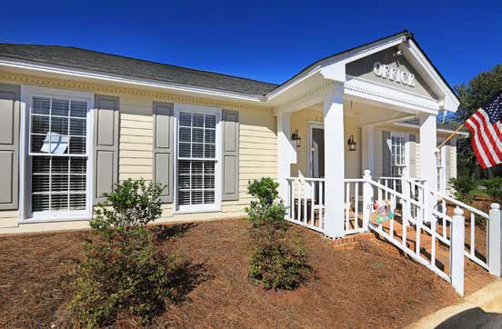
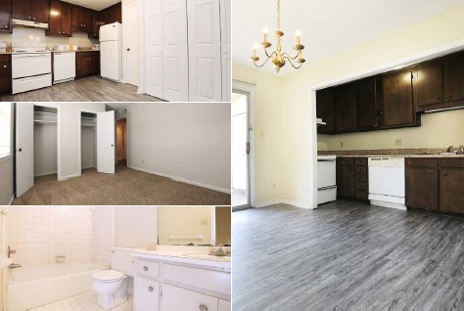
3 Complexes with 407 Units
Equity Investor: Albany, Georgia
Executive Summary:
Purchase Price… $14.6M
Improvements… $1.M
Soft Costs… $272k
All In… $15.9M
Current NOI… $1.4M
Stabilized NOI… $2.2M (divide by .0725 = CAP RATE)
Stabilized Cap… 14%
Stabilized Value… $30.6M (70% perm loan)
Equity Created… $14.7M
Profit Centers
Refinance Proceeds… $5.5M
Cash Flow… $760K

Slide 55
3 Buildings with 407 Units in Albany, Georgia
Equity Investor: Albany, Georgia
**Equity Investor**
Investment Summary:
Closed: February 2019
25 units @ $100K each
2-3 year stabilization
  10% fixed annual return
Post stabilization:
  Principal returned
  Refi Proceeds: Approx. $22K
  0.4% Equity ownership: Approx. $36K value
  Projected Cashflow: Approx. $3,040/year

Slide 56
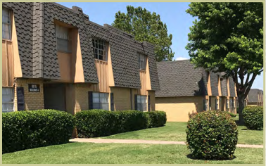
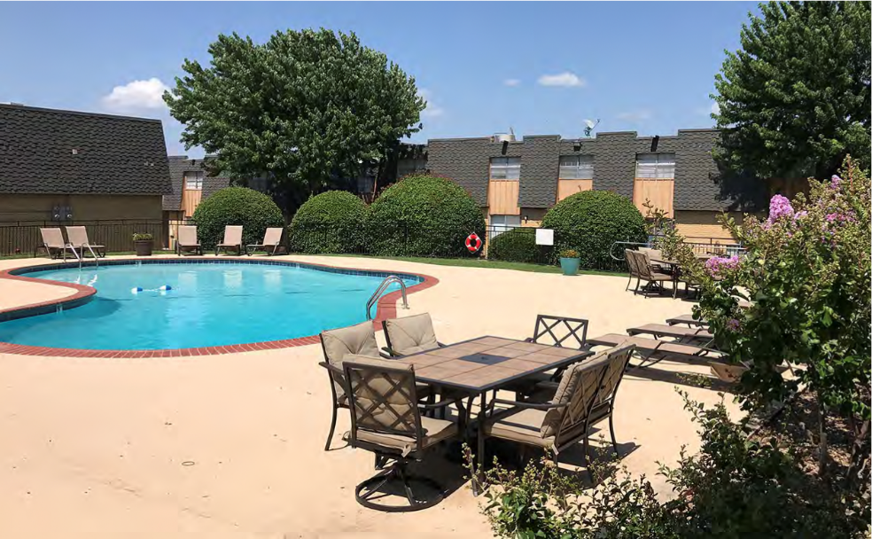
27 Buildings with 216 Units
Equity Investor: Crosby Park – Lawton, OK
Executive Summary:
Purchase Price… $6.17M
Improvements… $1.194M
Soft Costs… $186k
All In… $7.55M
Current NOI… $538k
Stabilized NOI… $738k (divide by .065 = CAP RATE)
Stabilized Cap… 12%
Stabilized Value… $11.35M (70% perm loan)
Equity Created… $2.63M
Profit Centers
Refinance Proceeds… $400K
Cash Flow… $213K

Slide 57
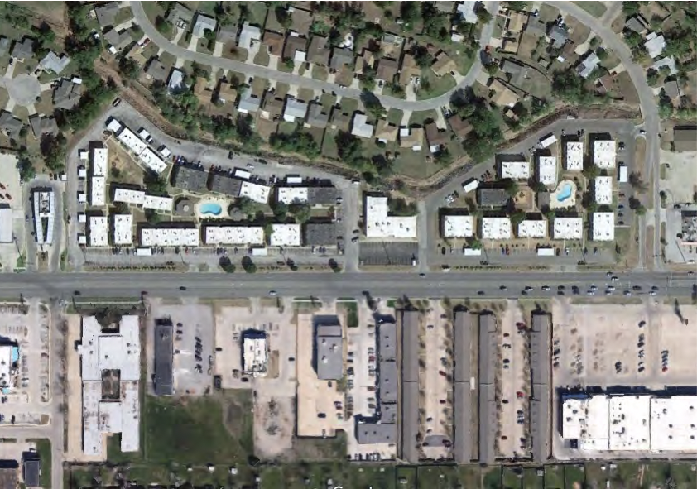
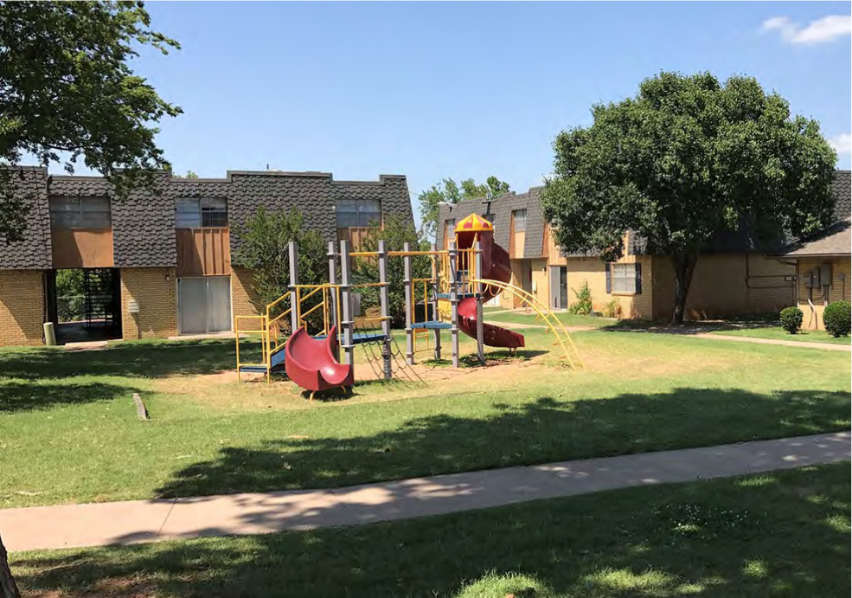

3 Buildings with 407 Units in Albany, Georgia
Equity Investor: Crosby Park – Lawton, OK
**Equity Investor**
Investment Summary:
Closed: May 2019
22 units @ $100K each
2-3 year stabilization
  10% fixed annual return
Post stabilization:
  Principal returned
  Refi Proceeds: Approx. $10K or 1.5%
  1.5% Equity ownership: Approx. $39.45K value
  Projected Cashflow: Approx. $3,202/year

Slide 58
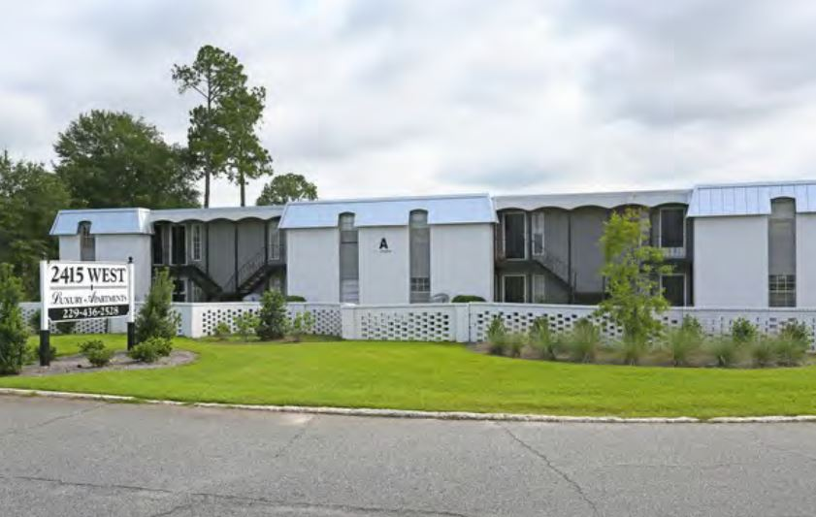
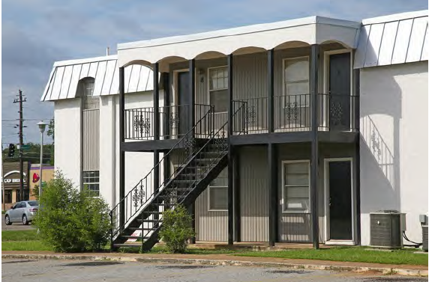
1 Complex with 200 Units
Equity Investor: Westwind – Albany, GA
Executive Summary:
Purchase Price… $5.35M
Improvements… $1.5M
Soft Costs… $275k
All In… $7.125M
Current NOI… $650K
Stabilized NOI… $804.7K (divide by .065 = CAP RATE)
Stabilized Cap… 11%
Stabilized Value… $12.37M (70% perm loan)
Equity Created… $5.2M
Profit Centers
Refinance Proceeds… $1.5M
Cash Flow… $217K

Slide 59
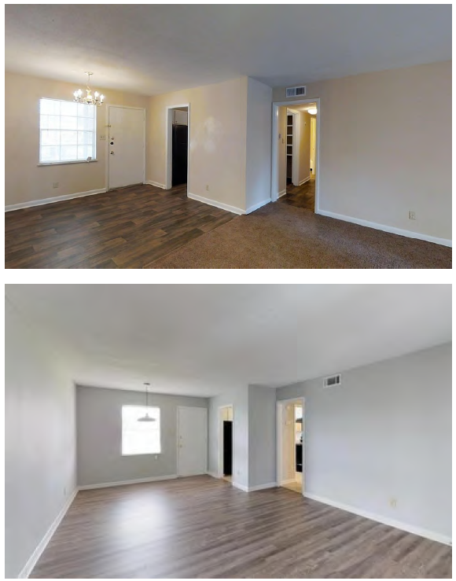
3 Buildings with 407 Units in Albany, Georgia
Equity Investor: Westwind – Albany, GA
**Equity Investor**
Investment Summary:
Closed: April 2019
20 units @ $100K each
2-3 year stabilization
  10% fixed annual return
Post stabilization:
  Principal returned
  Refi Proceeds: Approx. $15K
  1% Equity ownership: Approx. $28.7K value
  Projected Cashflow: Approx. $2,170/year

Slide 60
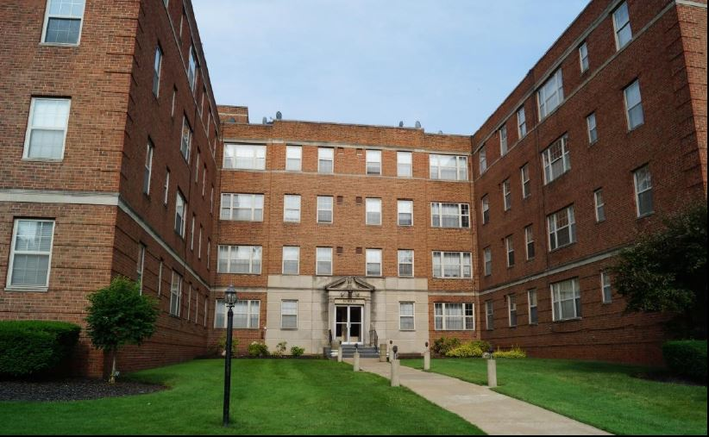
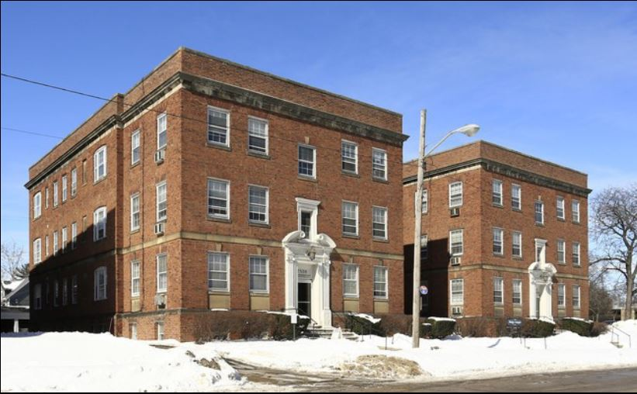
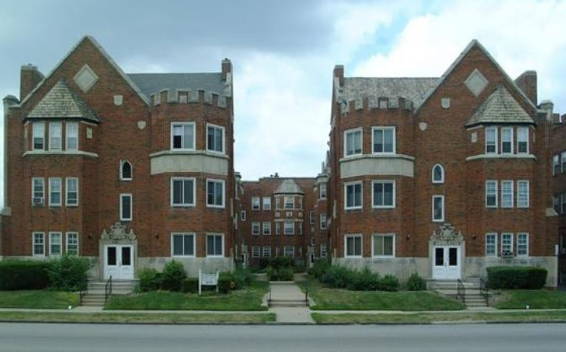
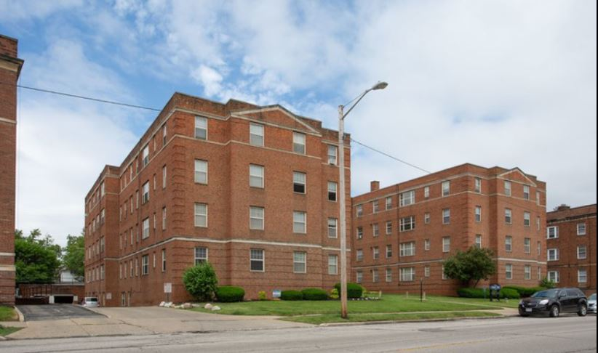
8 Buildings with 164 Units
Equity Investor: Heights Portfolio
Executive Summary:
Purchase Price… $9.2M
Improvements… $410k
Soft Costs… $260k
All In… $9.86M
Current NOI… $803k
Stabilized NOI… $924k (divide by .065 = CAP RATE)
Stabilized Cap… 9.4%
Stabilized Value… $14.23M (75% perm loan)
Equity Created… $4.4M
Profit Centers
Refinance Proceeds… $800k
Cash Flow… $217k

Slide 61
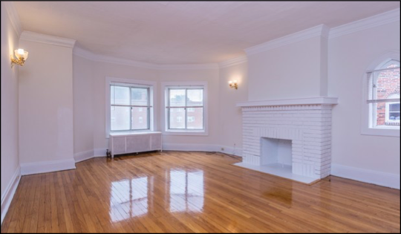
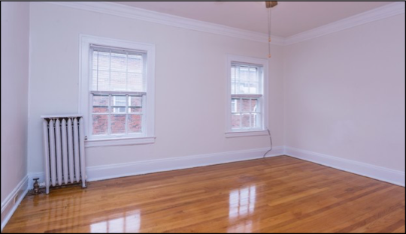
3 Buildings with 407 Units in Albany, Georgia
Equity Investor: Heights Portfolio
**Equity Investor**
Investment Summary:
Closed: July 2019
22 units @ $100K each
18 month stabilization
  10% fixed annual return
Post stabilization:
  Principal returned
  Refi Proceeds: Approx. $12K
  1.5% Equity ownership: Approx. $53K value
  Projected Cashflow: Approx. $3,261/year

Slide 62
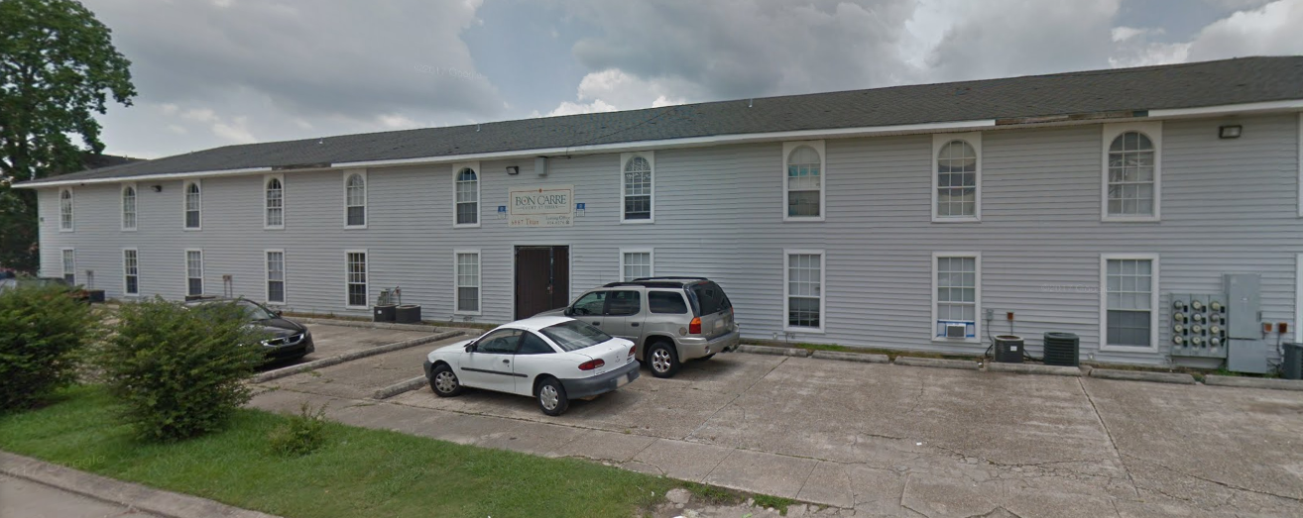
36 Unit Apartment Building • Baton Rouge, LA
Debt Lender: 1st & 2nd Position
CASH OUT REFINANCE
24 Month Bridge Loan • 10% - Interest Only
Refinance of Existing 1st Lien: $385,000 • 2 Points (sold to institutional buyer)
Cash out new 2nd Lien: $235,000 • Fire Damaged Building
Closed Nov 2018

Slide 63
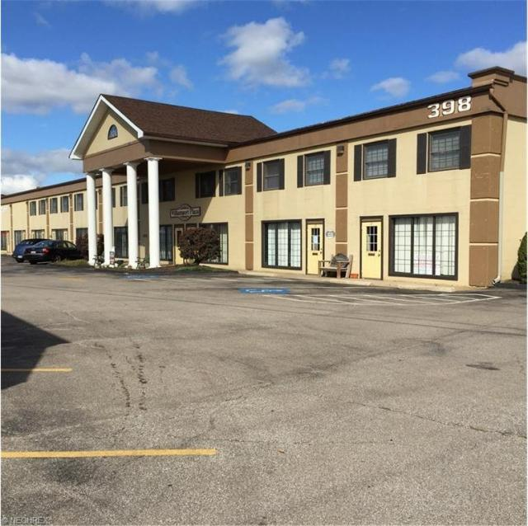
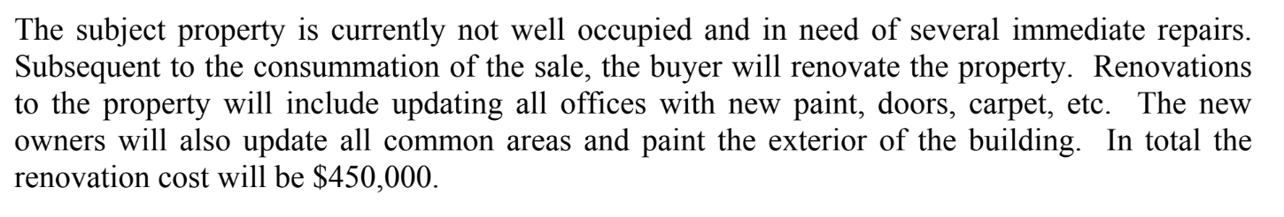
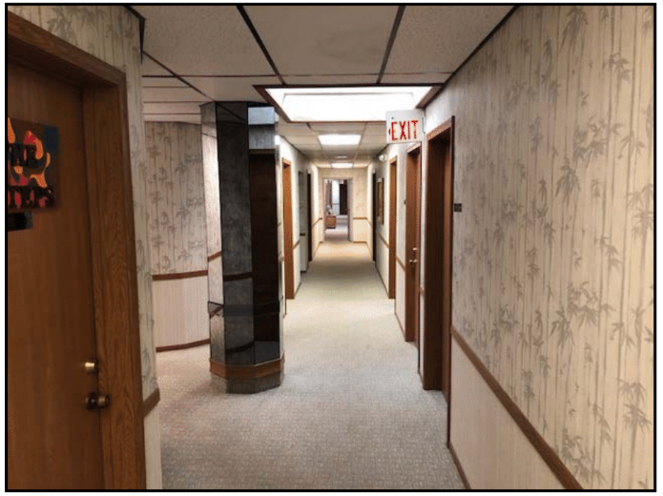
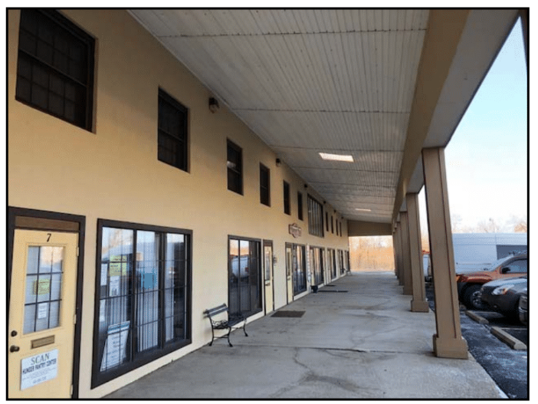
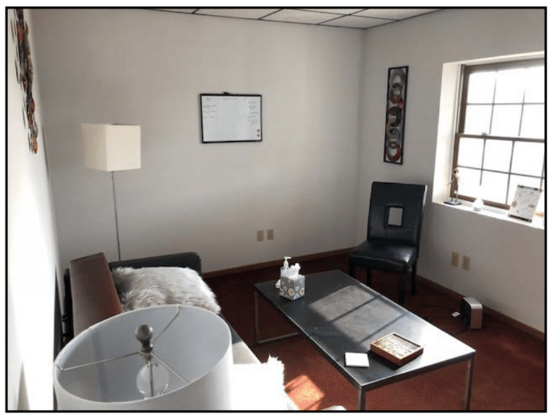
Debt Lender: Commercial Office Building
PURCHASE AND RENOVATION FUNDED
Berea, OH
36 Month Bridge Loan
10% - Interest Only / 2 Points
85% of Purchase Price Funded
100% of Renovation Cost Funded
Total Loan Amount $775,000 – *Sold to Institutional Buyer
Seasoned Investor / No Docs required – Closed Jan 2019

Slide 64





Debt Lender: 16 Unit Multi-Family
Value Add Transaction
PURCHASE AND RENOVATION FUNDED
2 Buildings
18 Month Bridge Loan
10% - Interest Only / 2 Points
85% of Purchase Price Funded
100% of Renovation Cost Funded
Total Loan Amount $477,000
Seasoned Investor / No Docs required

Slide 65

Debt Lender: 19 Unit Multi-Family
Medina, OH
Property Details
Purchase Price: $700,000
Rehab Costs: $460,000
Freeland Funded: $1,074,000
  1st Mortgage senior debt & portion of down payment
Stabilized Proforma
NOI: $116k
Cap Rate: 9.7%
ARV: $1,660,000
Equity/Profit: $460k
$20k per month – gross cash flow

Slide 66

Debt Lender: 19 Unit Multi-Family
Lakewood, OH
Property Details
Purchase Price: $563,000
Rehab Costs: $150,700
Freeland Funded: $671,950
  1st Mortgage senior debt
Stabilized Proforma
ARV: $1,083,000
Equity/Profit: $300k
$20k per month – gross cash flow
$6k per month – net passive cash flow

Slide 67

Debt Lender: 11 Unit Multi-Family
Lakewood, OH
Property Details
Purchase Price: $290,000
Rehab Costs: $125,000
Freeland Funded: $342,500
  1st Mortgage senior debt
  2 pts + 7-10%
Stabilized Proforma
ARV: $683,000
Equity/Profit: $270k
$8k per month – gross cash flow

Slide 68
1
Irresistible Offer
Identify Your Ideal Investor = AVATAR
Where Can Your Ideal Investor Be Found?
Recurring Multimedium Marketing Plan = Top Of Mind Reference
Follow Proven Sales and Follow Up Process
      5 Steps: Getting Capital You Need for Deals You Want
2
3
4
5

Slide 69
Step 4: “R2M3”
Regular Recurring Multi-Medium Marketing Approach
2) Content: Podcast,
You Tube, Blog Posts, FB Lives, FB Posts, Linked In
3) Physical Newsletter
1) Meet Ups, FB Groups, Seminars
4) Weekly Email Broadcasts
6) Swag: Golf Shirts, Coffee Mugs, Birthday and Holiday Cards
5) Move to Step 5
~ Webinars / Zoom

Slide 70
Step 5: Proven Sales Process
Discovery / Fact Finding Appointment
  High Level on Experience
  General Description of Syndication and Exit Strategies
  Zoom Call or GoToMeeting
  Audio Only
Discovery / Fact Finding #2 + High Level Description of Previous Deal
  Audio + Screen Share
Past Deal Walk Thru: Deep Dive & Q’s
  Heavy Screen Share
Show New Deal without pitch
  Heavy Screen Share
Pitch and Ask for Money
  Screen Share if Needed
Group Call to Showcase and Pitch Deal with Scarcity
  “We have 42 investors on the line and I only have room for 12 investors at $100k each
  “First 12 who text my phone get a unit”

Slide 71

Freeland Ventures
Simple, Strong, Secured Passive Investing and Private Lending

Slide 72
Complimentary
One-On-One
Strategy Session
Andrew Ziebro
aziebro@freelandventures.com
440 • 863 • 7850

Slide 73

Local Apartments
Rentals • Rehabs
Tim Roth
troth@freelandventures.com
440 • 554 • 9546
Notes:
Mention Tim – looking for contractors. For local apartments, rentals, rehabs, looking to connect with contractors.

Slide 74

Questions?
Questions?

Slide 75







Connect With Josh
fb.com/groups/AcceleratedInvestor
fb.com/srecnow
AcceleratedInvestorPodcast.com
youtube.com/users/srecvideo
twitter.com/joshcantwell

