Slide 1

JOSH CANTWELL
Become A Money Magnet In
12 Easy Steps

Slide 2
Lesson
“Life will pay whatever price you ask of it.”
If you are afraid to ask for money, you’ll probably get none.
If you are only comfortable asking for a little bit of money, you’ll get a little bit.
If ask for a lot of private capital and work hard, you will get it.

Slide 3
12 Step Money Magnet
Step 1: Project 100: List of prospective private lenders or referrals and centers of influence who can refer us
Step 2: Make a second list: Places you can go to meet more potential investors and partners
Step 3: Tell EVERYBODY what you do in a cool way
Step 4: Create your pitch book / 3 Ring binder / online
Step 5: Develop a System for tracking all of your Private Lenders
Step 6: Send out a monthly mailer (physical mailer)
Step 7: Social Media / Email “Deal of the Week”
Step 8: Follow Up with a phone call
Step 9: Set up Money Magnet appointment
Step 10: Hold Money Magnet Meeting
Step 11: Follow up
Step 12: Gain commitment

Slide 4
How do you find these investors? Step 1: Strategies to Find Private Lenders
Step 1
Make a List of Everyone You Know
Use “Discover Your Sphere” Questionnaire (See Appendix)
Family, Friends, Spouse’s Family & Friends, Kid’s School Connections, Neighbors, Doctor, Dentist, Church Contacts, Home Service Providers, Co-Workers, Vendors, Suppliers, Trade Organizations and Clubs etc.
Communicate
Never make a judgment call about how someone looks or acts!
Everyone has same goal save money and invest it wisely!

Slide 5
Step 1: Strategies to Find Private Lenders
Become the “Top Of Mind” Real Estate Reference For Everyone You Know
Buy From You
Sell To You
Refer You Deals
Refer You Investors
Cheerlead For You
Loan To You
Invest With You

Slide 6
Lets assume everyone you know is broke, busted and disgusted. But lets also assume they love you and want you to succeed.

Slide 7
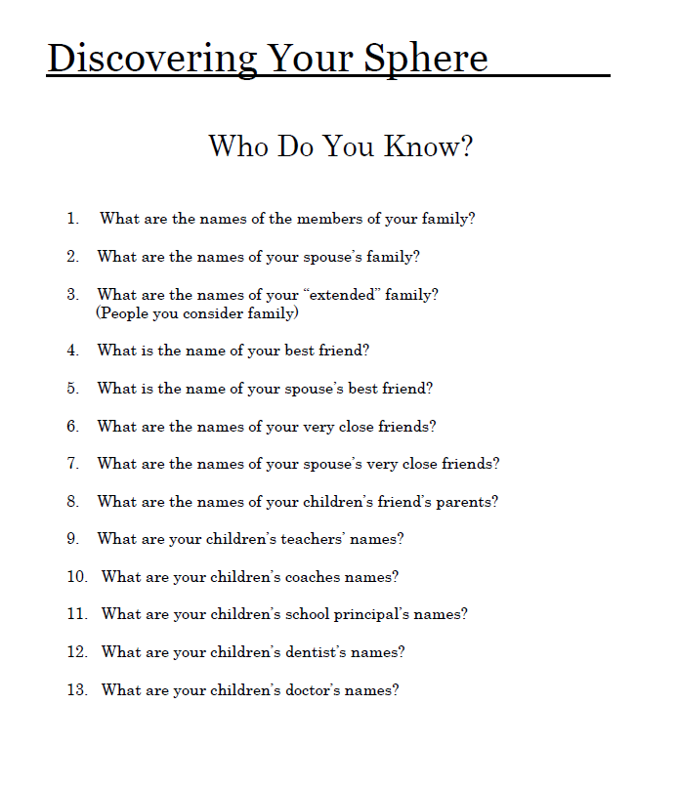
Discover your sphere

Slide 8
Step 2: make a second list
Real Estate Groups on Facebook/LinkedIn
REI Clubs / Meet Ups
Chamber of Commerce
Kiwanis
Fraternal Organizations
Social Groups
BNI
Home Builders Association
Marketing and Real Estate Meet Ups
Golf Courses / Country Clubs
Yacht Clubs
Open Houses & Realtors
Real Estate Agent Meetings
Home Owner Association Meetings

Slide 9
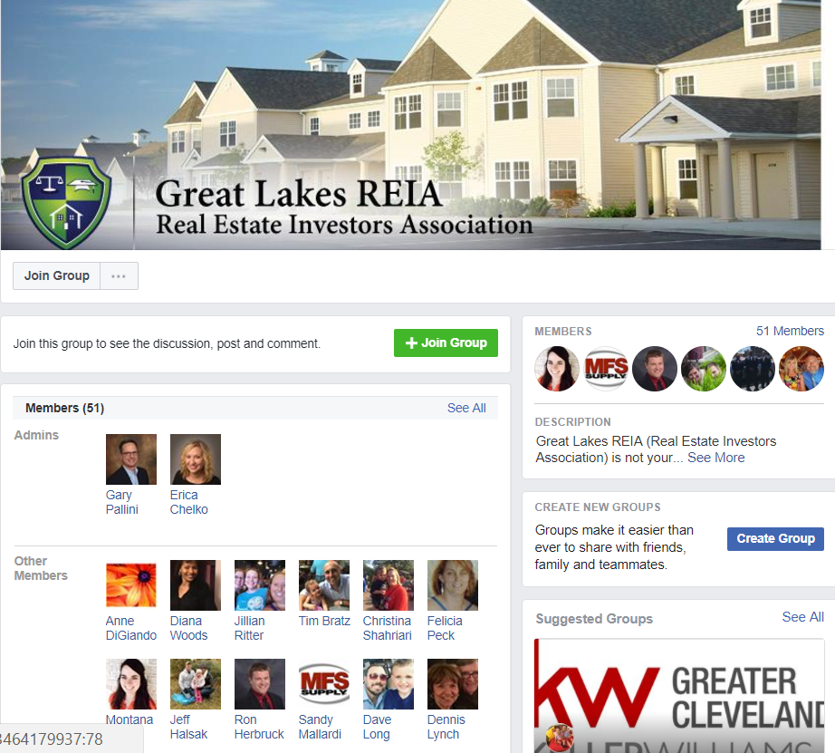
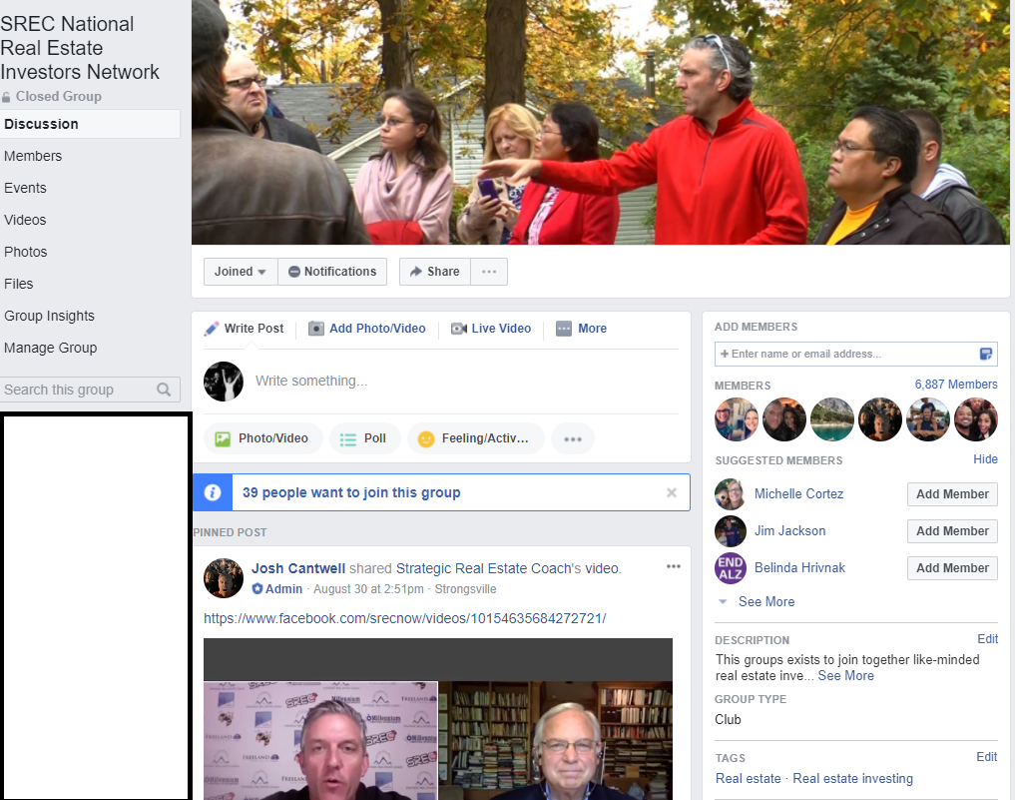
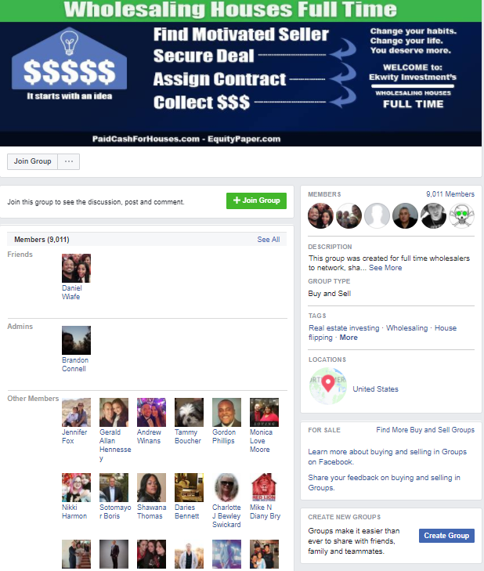
Real estate groups on Facebook

Slide 10

Step 3: Tell Everyone What You Do In A Cool Way
PRIVATE MONEY PARTNER ELEVATOR SPEECH
“Hey Josh what do you do?”
My favorite responses:
“Well, I raise capital for real estate!”
“I raise money for real estate deals from private investors. We buy foreclosures and distressed properties and pay our investors a fixed double digit rate of return.”

Slide 11
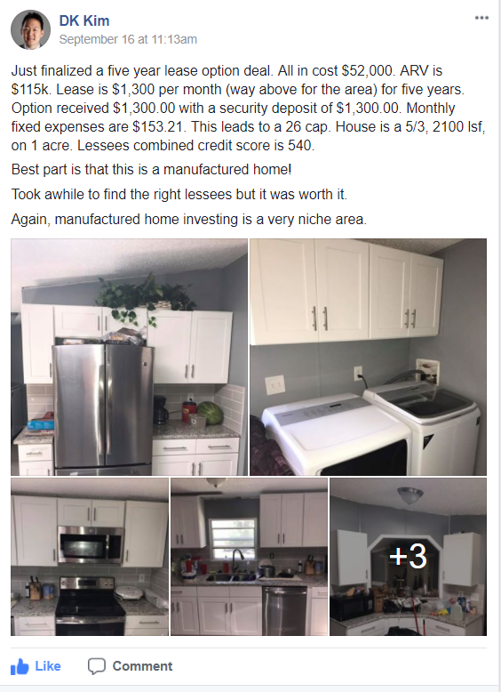
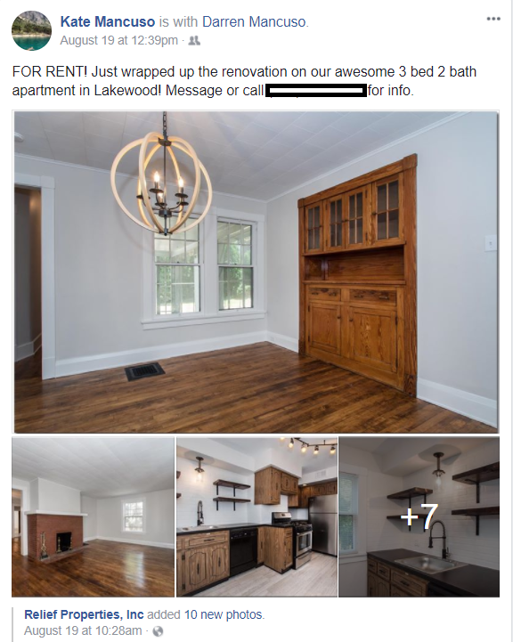
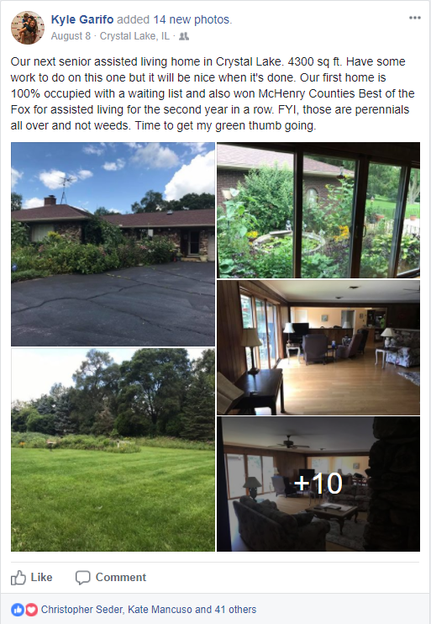
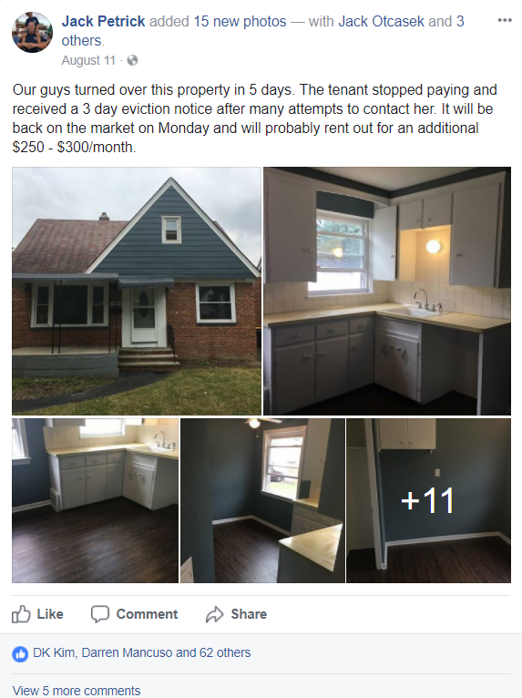
Tell everyone on social media what you’re working on

Slide 12
Step 3: Tell Everyone What You Do In A Cool Way
PRIVATE MONEY PARTNER ELEVATOR SPEECH
“I own a bunch of real estate businesses and I raise capital to fund projects. I work with investors and pay them a double digit rate of return.”
“Because it’s super sexy!”
“Oh, that's great, I've always wanted to buy a rental!”
“Oh, kind of like HGTV?”
“Sounds interesting tell me more…”

Slide 13
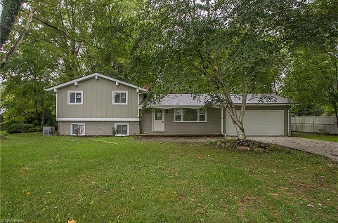
Step 3:Tell Everyone What You Do In A Cool Way
Question: “Well how does that work?”
Answer: “It works great for everyone: My investors earn a fixed double digit rate of return and I can move faster and close quicker because we can pay cash. I'm able to find and buy the best deals before anyone else.” *I find telling a specific rate of return lands more powerfully, such as 11 – 15% annualized returns.
Question: “Tell me more…”
Answer: “The SEC requires that we create a prior substantial relationship before I can make you a formal offer and you invest with me. So let’s get together and I can bend your ear about what I do.” Question: “Tell me now - how does it work?” Answer: "Well it works great. When’s a good time to get together so I can explain?"
16994 Briarwood, Columbia Station, OH
Purchase Price: $96,00
Private Money: $140,000
Sold For: $192,500
Profit to Private Investor: $10,000
Total Net Profit: $28,000

Slide 14
Step 4: Create Your Money Magnet Pitch Book & Marketing Collateral “Rip Off & Duplicate”
3 Ring Binder
Inside Right Pocket
Company Leadership Document
Evaluation Document
Improving Communities Document
Investment Highlights Document (one pager with Offer)
(Do Not Give “Investment Highlights Doc” To Funding Partner Unless You Have A P.E.R. B/C Its Contains The Offer And Specific Interest Rates)

Slide 15

Step 4: Create Your Money Magnet Pitch Book & Marketing Collateral “Rip Off & Duplicate”
Josh’s Pitch book example
3 Ring Binder
Outside Cover = “IRA: Secure Your Future” Flyer

Slide 16
Step 4: Create Your Money Magnet Pitch Book & Marketing Collateral “Rip Off & Duplicate”
3 Ring Binder
Inside Left Pocket
Example Mortgage
Example Note
Executive Summary
Private Placement Memo (don’t give to them unless you have a P.E.R.

Slide 17
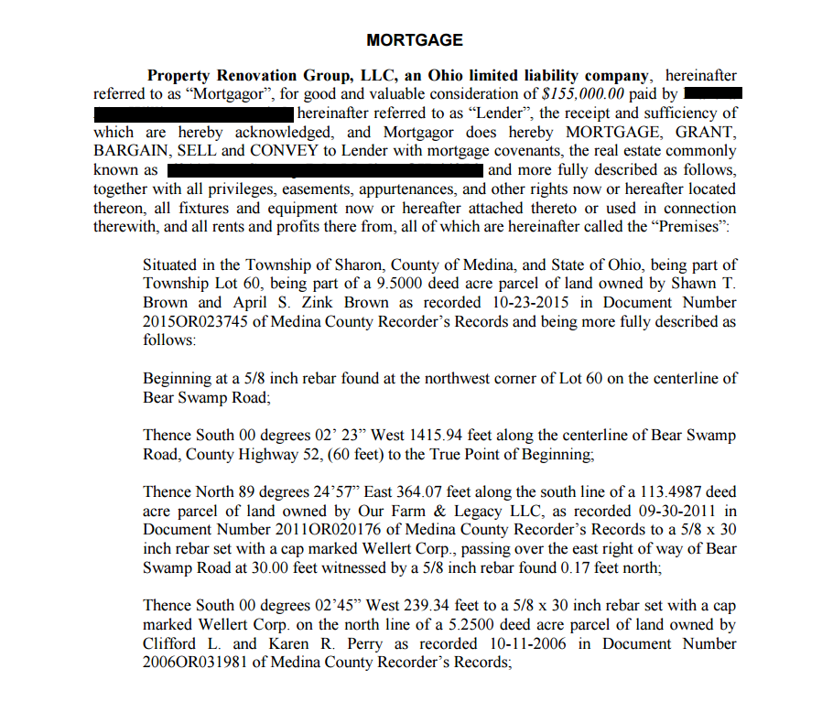
Step 4: Create Your Money Magnet Pitch Book & Marketing Collateral “Rip Off & Duplicate”
Left Side:
Example Mortgage

Slide 18
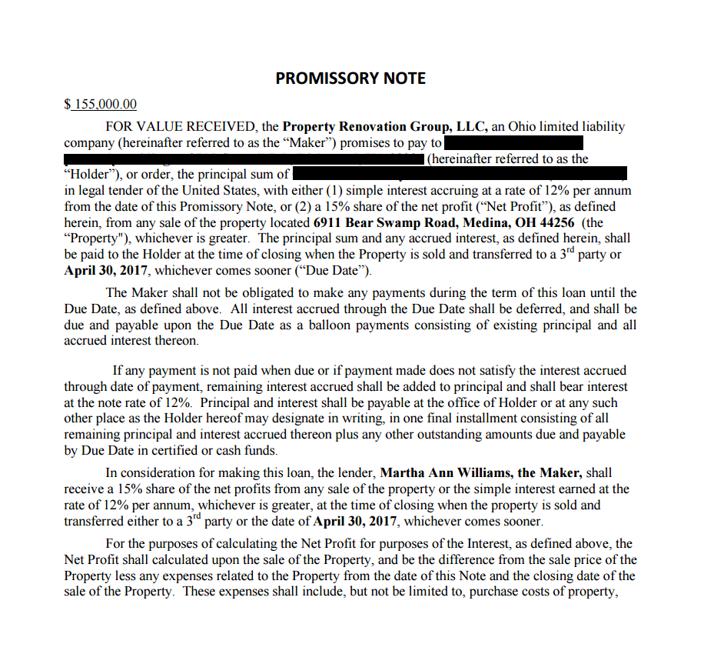
Step 4: Create Your Money Magnet Pitch Book & Marketing Collateral “Rip Off & Duplicate”
Left Side:
Example Note

Slide 19
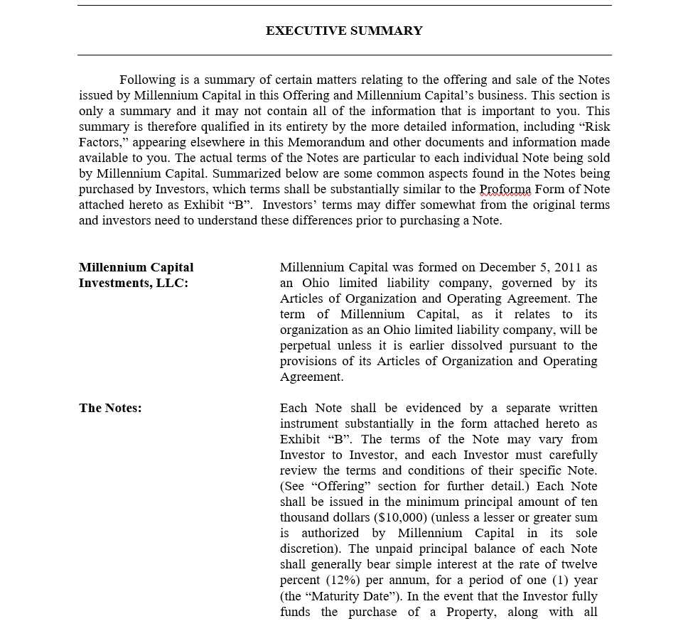
Step 4: Create Your Money Magnet Pitch Book & Marketing Collateral “Rip Off & Duplicate”
Executive Summary
Section 1: Confidential
Section 2: The Company
Section 3: Risks
Section 4: Management
Section 5: Company Operations
Section 6: Use of Funds
Section 7: Financial Information
Section 8: Securities Counsel
Section 9: Litigation
Section 10: Disclaimers

Slide 20
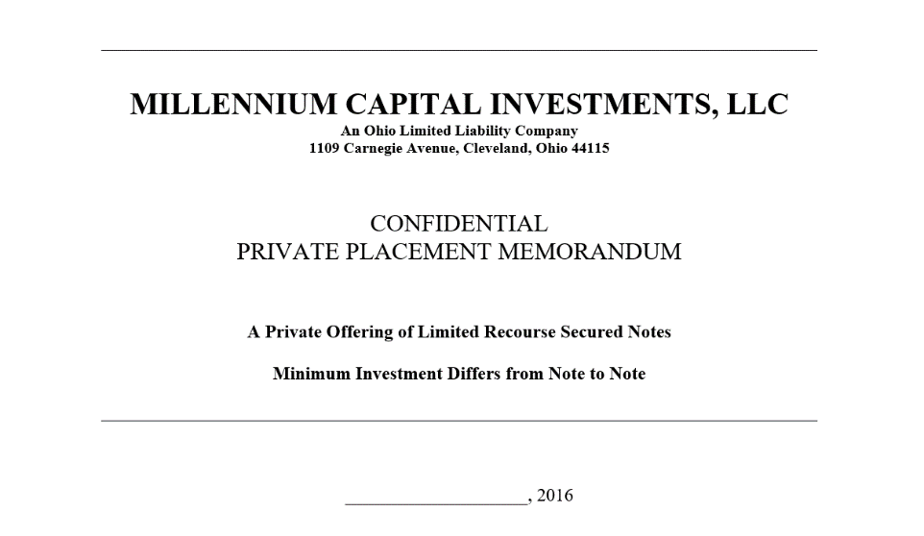
Step 4: Create Your Money Magnet Pitch Book & Marketing Collateral “Rip Off & Duplicate”
Private Placement Memorandum
(Only If I’ve Established A Prior Existing Relationship)

Slide 21
Step 4: Create Your Money Magnet Pitch Book & Marketing Collateral “Rip Off & Duplicate”
Millennium PowerPoint
Presentation
Center of 3 Ring Hole Binder

Slide 22
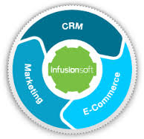
Step 5: Develop A System for Tracking Your Potential Private Lenders
CRM Database
Josh Uses Infusionsoft / Profit Pro
Other Options
Google Docs
Excel Spreadsheets
Basecamp
High Rise
AI OFFICE

Slide 23
Step 5 (cont.): Develop A System for Tracking Your Potential Private Lenders
CRM Database
“Tagging”
Are the “Local”
Amounts
Potential Investment
$40k-$80k / $80k -$150k / $150k+
Prior Existing Relationship Established
Self Directed IRA
Horizon Trust
Accredited or Non Accredited

Slide 24
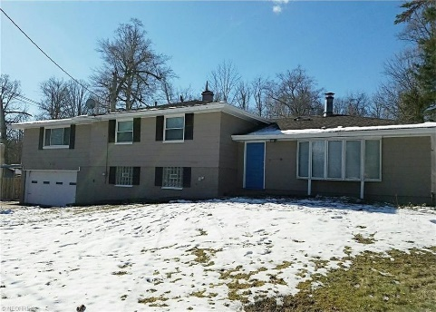
Step 6: Send Out The Monthly Money Magnet Mailer
OVERALL GOAL: Be the Top of Mind Real Estate Reference
Marketing is Sales In Print
We Want People to Be Pre-Disposed to Do Business With Us
Resources
Upwork.com
Virtual Assistants/Graphic Designers/Tech people
Fiverr.com
Logos
TextBroker.com
Writer
Dsnews.com
Real Estate Commentary
8022 Rushwood, Northfield, OH
Purchase Price: $76,00
Private Money: $130,000
Sold For: $219,900
Profit to Private Investor: $13,000
Total Net Profit: $71,000

Slide 25

Step 7: Send Out The Weekly Money Magnet Funding Opportunity Sheets
Email Broadcasts
We Send Every Monday
We Broadcast Out of Infusionsoft
To Everyone We Have A Prior Existing Relationship With
First Monday of Every Month Send A Funding Opportunity Email Broadcast
Second Monday of Every Month We Send a Funding Opportunity Email Broadcast
Third Monday of Every Month a Deals Closed Funding Opportunity Email Broadcast
Fourth Monday-Wednesday of Every Month We Email to a Webinar that We Host Wednesdays At 1:00pm EST
Cover Funding Opportunities
Deals Closes
Optimizations to Our Business

Slide 26

Step 8: Money Magnet Phone Follow Up
Phone Follow Up
4-6 Days After the Physical Mailer Hits
the Addresses

Slide 27

Step 9: Set The Money Magnet Face to Face Appointment
Face to Face Appointment
Private Money Is A Face To Face, Belly To Belly Business
Location
Coffee Shop
High End Restaurant
Sit In The Bar
Other Casual Cool/Hip Place

Slide 28

Step 10: The Money Magnet Meeting
Education Based Selling
Walk Through The Private Lender Pitch Book
The point of the PowerPoint is to get to the end and ask them "Hey do you know anyone who may be interested in learning more about what I do?"
And they say "WHAT ABOUT ME?“
EXCLUSION MENTALITY
I'm excluding them and NOT making them an offer so they want to work with me.
Education based selling
Exact opposite of what they are expecting they are expecting you to pitch them
when you don't they are let down BUT they respect you and want to work with you

Slide 29

Step 11: The Money Magnet Follow Up
Answering FAQs
Email Broadcasts
Individual Emails
Text Messages
Follow Up Phone Calls
Follow Up Conference Calls
Physical Newsletters

Slide 30

Step 12: Gain Their Commitment
Gain Trust
Start the Rollover Process if IRA
Locate A Good Deal and Make Offers
Have A Real Estate Attorney Craft A Sample Note & Mortgage with Your Name On It
So you will know what paperwork will look like.

Slide 31
12 Step Money Magnet
Step 1: Project 100: List of prospective private lenders or referrals
Step 2: Make a Second List: Places you can go to meet potential investors and partners
Step 3: Tell Everybody What You Do in A Cool Way!
Step 4: Create Your Pitch Book
Step 5: Develop a System for Tracking all of you Private Lenders
Step 6: Send Out a Monthly Mailer (physical mailer)

Slide 32
12 Step Money Magnet
Step 7: Email Deal of the Week
Step 8: Follow Up with Phone Call
Step 9: Set Up Money Magnet Appointment
Step 10: Hold Money Magnet Meeting
Step 11: Follow up
Step 12: Gain Commitment

Slide 33

EQUITY PARTNERSHIP
CASE STUDY SCENARIO
JV Partnership
1 partner puts up all the money
1 partner does all the work
One way - Own LLC 50/50
500 units
500 units

Slide 34
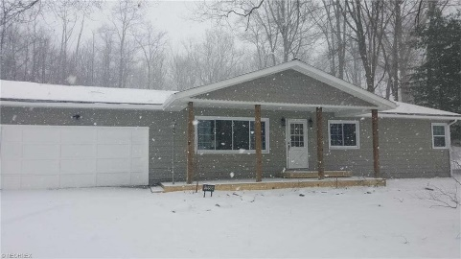
EQUITY PARTNERSHIP
CASE STUDY SCENARIO
This allows for a partnership, both parties to have equal control over the decision making process
Operating Agreement
Split Profits - Do Not have to equal the ownership
Control - is evidenced / shown thru stock, unit ownership, or an equity ownership lien.
25% of the profit
We are going to do multiple deals over and over
The lender / investor DOESN'T want to do a note and mortgage
THEY WANT OWNERSHIP / CONTROL over the deal
3665 Brookside Drive, Norton, OH
Purchase Price: $62,00
Private Money: $110,000
Sold For: $172,925
Profit to Private Investor: $7,700
Total Net Profit: $49,200

Slide 35
EQUITY PARTNERSHIP
STEP 1
Hire a lawyer and create the LLC ($400)
LLC set up and filing
Write operating agreement
STEP 2
Fund the LLC
Open a checking account and both deposit $500 each
$1,000
$500 matches your 500 units of ownership
$500 matches your units of ownership
Basis
STEP 3
Operating agreement is structured to determine who can do what / loans / decisions and profit splits

Slide 36
EQUITY PARTNERSHIP
STEP 4
The partner with the cash deposits $100k loan into LLC
LLC has a Note / Loan $100k
Note
If the Equity Partner (the partner with the investment capital) is going to loan $100K to the LLC from their IRA, they must own 49% of the LLC or less
STEP 5
Make Offers, EMD, POF and you are ready to go make money
STEP 6
If the LLC needs more money, the LLC can borrow additional money from private lenders

Slide 37
Become a money magnet in 12 easy steps
Q&A

Slide 38
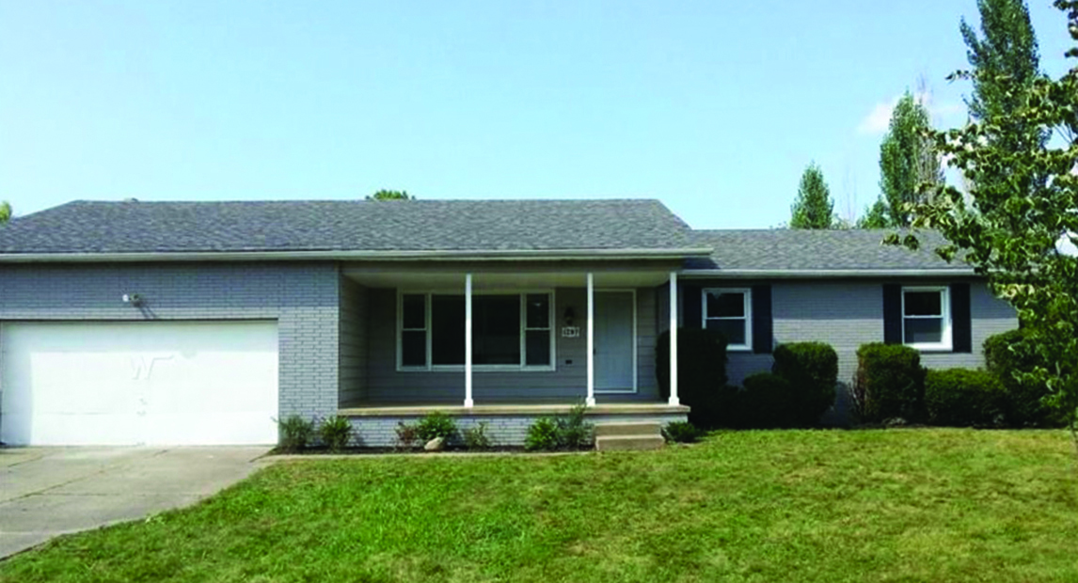
1297 STEVE DR.
PURCHASE
FNMA Foreclosure
MLS Listing
Nothing Special
Great Neighborhood
Ranch
Listing Price Doesn’t Matter
Outdated
Started Low

Slide 39
1297 STEVE DR.
PROFIT
Projection
Purchase $53,000
Improvements - $33,000
Investment - $90,000
Profit up front - $4,000
List - $149,900
SOLD - $139,900
$126,500 Net
Profit = $36,000

Slide 40
1297 STEVE DR.
HOW DID I FIND THESE PRIVATE LENDERS?
Greg
Newsletter
Mortgage broker for large brick and mortar bank
High school friend
Talked at golf outing – “Hey what are you up to?”
“Well I raise capital for real state deals. I buy foreclosures, and I partner with private investors and I pay them a double digit rate of return.”
Neighbor
Sent newsletters over last 8 months
Talked over regular interactions
Met at BW3's for lunch

Slide 41
1297 STEVE DR.
HOW DID I FIND THESE PRIVATE LENDERS?
Tobias
Long Term Friend
Getting my newsletter
Called me up and said he'd like to learn more about what you do
Wants to do what the other investors do
PROJECT 100
Write down 100 friends, family, network
Discover YourSphere.pdf
See appendix

Slide 42
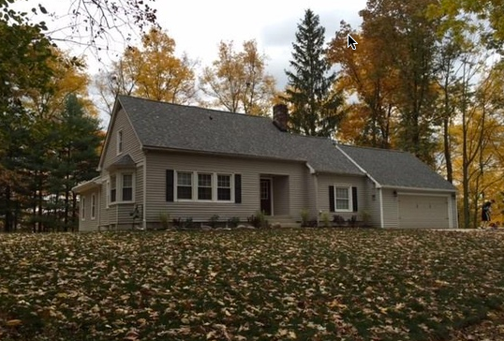
CASE STUDY #20 6415 Miller Road Brecksville, OH
Purchase Price $75,000
Rehab, Insurance, Mktg $80,000
Includes 1,000 Sq. Ft Addition
Private Money $165,000
Self Directed IRA
SOLD Price $268,000
Net Profit After ALL COSTS $45,000
Sean Gorius Traditional SDIRA (Old 401k) 12 % Interest or 20% of Profits whichever is greater.
Notes:
- Also reference Freedom Funding Presentation – slide 41 REIClub preso has Wyoming, Forest Hill, East Craig Street, Buena Vista, Oaklawn (ask Ken for update on last 12 we have closed)

Slide 43
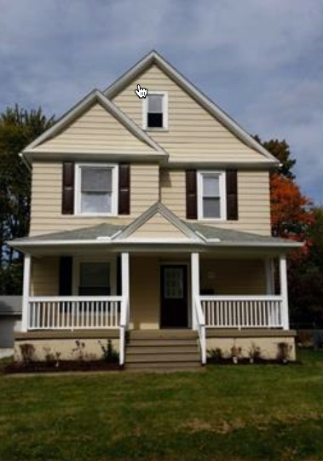
CASE STUDY #21 907 School Dr. Cuyahoga Falls, OH 44223
FNMA Foreclosure
Purchase Price $55,000
Private Money #1 $75,000
1st Mortgage 12 % Int. or 15% of Profit
Private Money #2 SDIRA 12% Interest
Cash Back at Closing $33,000
SOLD Price $120,000
Net Profit After ALL COSTS $27,000
Neighbor – Sent him my newsletter every month. He called me about real estate, wanted to learn more and invested.
Notes:
- Also reference Freedom Funding Presentation – slide 41 REIClub preso has Wyoming, Forest Hill, East Craig Street, Buena Vista, Oaklawn (ask Ken for update on last 12 we have closed)

Slide 44
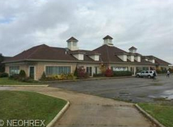
CASE STUDY #22 100 US Grant Street LaGrange, OH
9,000 Sq. Ft. Medical / Office
1st Mortgage Private Lender – Traditional SDIRA
2nd Mortgage Private Lender – Cash on Hand
12% Interest Only, No Payments for 12 Months
Then Interest Only Payments for 12 Months
Private Funding: $400,000
Appraised For: $1.2 Million
Repositioning building into 100 Units of Assisted Living
100 Units x $4,000/month/unit = $4.5 Million in annual cash flow
Projected: $1.5 Million Net Income
Notes:
- Also reference Freedom Funding Presentation – slide 41 REIClub preso has Wyoming, Forest Hill, East Craig Street, Buena Vista, Oaklawn (ask Ken for update on last 12 we have closed)

