Slide 1
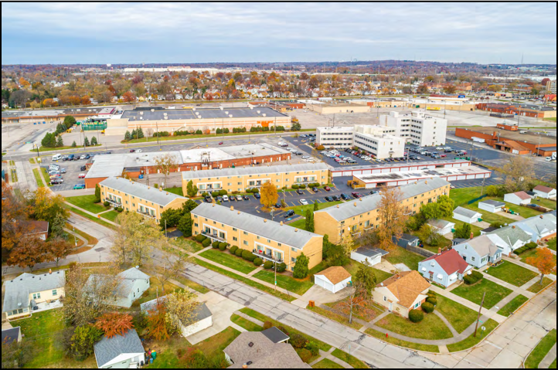
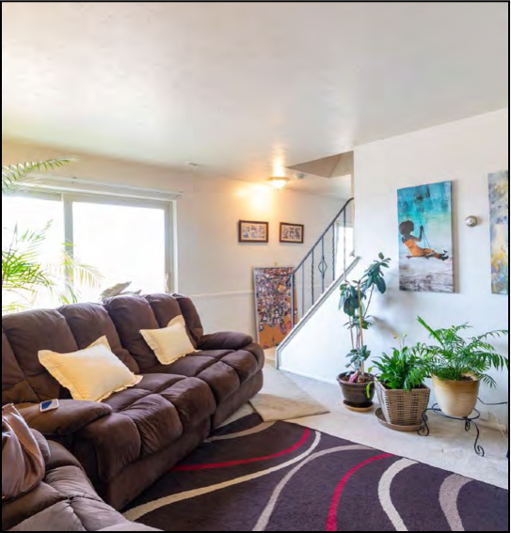
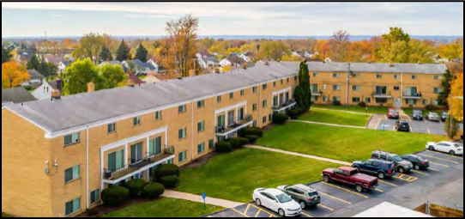
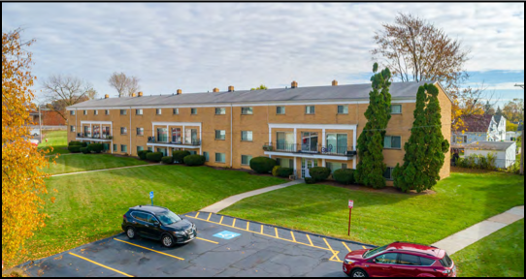
“80 Maple” Apartment Investment Opportunity
JOSH CANTWELL
Chief Executive Officer
GLENN LYTLE
Chief Strategy Officer

Slide 2

Agenda
INTRODUCTION
Freeland Overview
State of the Market
Current Projects
INVESTMENT OVERVIEW: PRIME SOUTHEAST APARTMENTS
Property Overview
Operating Partners
Financials & Stabilization Plan
Investment Opportunity
CLOSING
Next Steps

Slide 3



Freeland Ventures Overview
Fund I
Fund II
Fund III (41 Fund)
Freeland Accelerated Fund (506C)
Managing $37M+ in Equity Cash
Managing $200M+ in ARV Assets
Pre-Approval
Origination
Rehab Underwrite
Refi Opportunities
384+ Loans Closed
$46.8M+ Loan Value
$127K Avg. loan size
Loan Servicing
Fund Servicing
Asset Management
Project Management
Rehab Management
Default Resolution

Slide 4
STATE OF THE MARKET
BUSINESS MODEL
RISK MITIGATION
PROJECT OVERVIEW

Slide 5
506(B) Investment Opportunity
Accredited and Non Accredited (But Sophisticated) Investors with Prior Existing Relationship with Josh Cantwell, Glenn Lytle, Tyler Brummett, Freeland Ventures and /or Strategic Real Estate Coach

Slide 6
80 Maple – 80 Unit Apartment Portfolio
DEAL SPECIFICS
80 Units
C+ Class Location
6 Miles from Downtown CLE
Already 92% Occupied
3 year history over 90% occupied
Garden style apartments
Amenities:
On-site management
On-site leasing
On-site maintenance
On-site Laundry
Garages
Playground
Shopping in Walking Distance

Slide 7
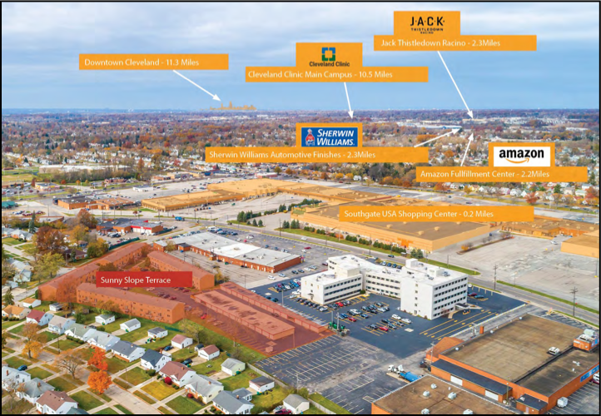

Slide 8
Upside Opportunity & Business Plan
Landlord is tired
Seller Depreciation and Tax benefits have run out
90%+ Occupied 3 year operating history
Rents are $55 - $170 Below Market Value
Rents have only been raised $15 in the past 5 years
All Units will be updated over the next 4 years
We only need to update 40 units and raise rents in next 21 months to achieve refi and return investor equity
Maintain Onsight Management and Leasing – VERY HANDS ON

Slide 9

Operations Overview
PROJECT & PROPERTY MANAGEMENT
950 Management: Josh Cantwell, Glenn Lytle, Tyler Brummett
Experience: 28 Years Combined
Residential & commercial experience in private lending, large rental portfolios, renovation and property management.
Joint ownership in 2,700+ apartment units & $200M+ of assets.

Slide 10
80 Maple – 80 Unit Apartment Portfolio
Acquisition
Refinance (21 months)
All In - $4,460,000
Purchase $3,745,000
Renovation Cost $350,000
Closing/Holding Costs - $365,000
Financing - $4,550,000
Primary Loan (FNMA)- $3,050,000
Private Lenders - $1,500,000
Stabilized (After Repair) Value
NOI - $380,000
ARV - $6,100,000
Stabilized Loan - $4,580,000
Up to 75% LTV on improved values
Pay Back Private Investors
Pay investors 1% kicker at refi
Annual Net Free Cash Flow of $110,589

Slide 11
80 Maple – 80 Unit Apartment Portfolio
Targeted Investor Returns for each $100k Unit over 21 Month Term
Fixed Preferred Return of 10% + 1% Kicker
Earns $17,500 in interest
Taxed at sale at long-term capital gains rate
1% Kicker at Refi @ 21 months
EX: $100,000 Investment gets $1,000 Kicker at Refi
TOTAL RETURN $18,500 in 21 months = 10.57% Annualized Return

Slide 12

Thank You! Next Steps
Josh Cantwell
216 • 233 • 5448
Glenn Lytle 412 • 420 • 4119

Slide 13

Connect With Freeland
Questions?

Slide 14
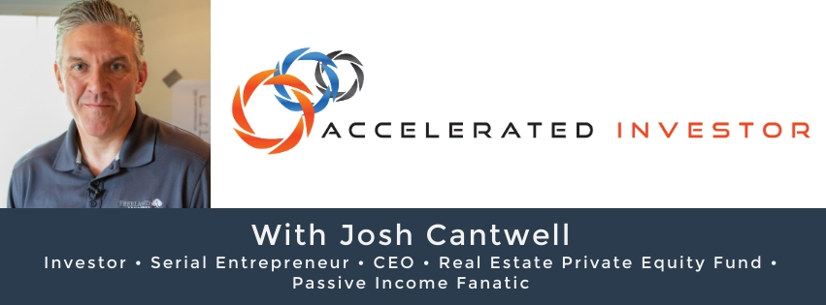






Connect With Josh
fb.com/groups/AcceleratedInvestor
fb.com/srecnow
AcceleratedInvestorPodcast.com
youtube.com/users/srecvideo
twitter.com/joshcantwell

