Slide 1
How to Accurately
Project Property Repairs
with
Josh Cantwell
& Ricardo Caldwell

Slide 2
1148 Whittlesay Lane, Rocky River, OH
Purchase Price: $195,000
Private Lender: $170,000
Josh’s Money: $110,000
Potential Private Lender #2: $100,000
ARV: $399,000 ($150-$175/foot)
Est. Net Profit: $84,000
All in for $275k + $9,900 interest + $30k in realtor
commissions & closing costs

Slide 3
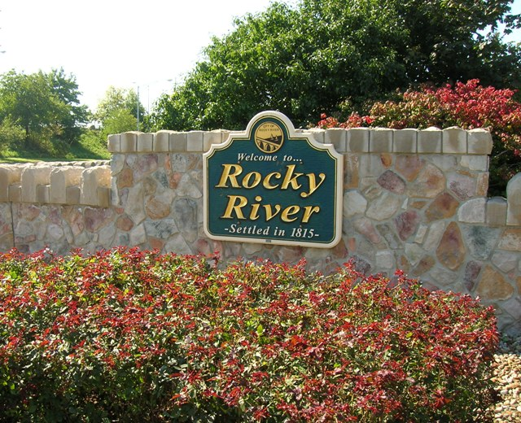
Rocky River, OH (44116)
Foreclosure Rate: .05%
Median Price Per Square Foot: $125
Housing Inventory:
Owned: 66%
Vacant: 8%
Rented: 26%
School Rating: Excellent
Crime Rating: 100% lower than the national average
Very walkable town, close to Lake Erie

Slide 4
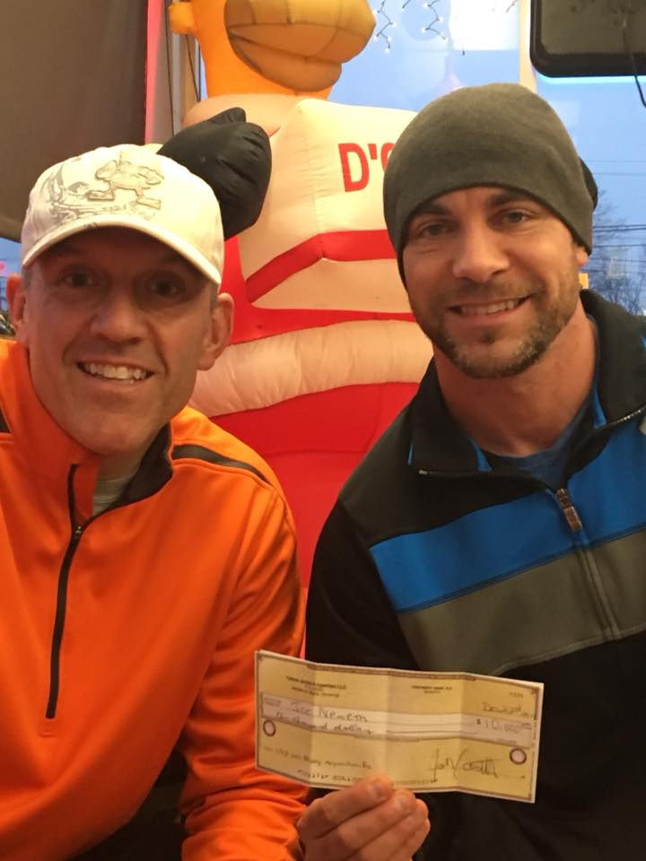
1148 Whittlesay Lane, Rocky River, OH
Whittlesay was originally found from wholesaler, under contract for $193k, trying to wholesale for $208k, but could not find a buyer.
We waited until wholesaler was out of contract and lost property for it to go back on the market for $205.
Counter-offered back and forth to meet in the middle for a Purchase Price of $195k
Paid $10,000 to Acquisitions Manager, Joe

Slide 5
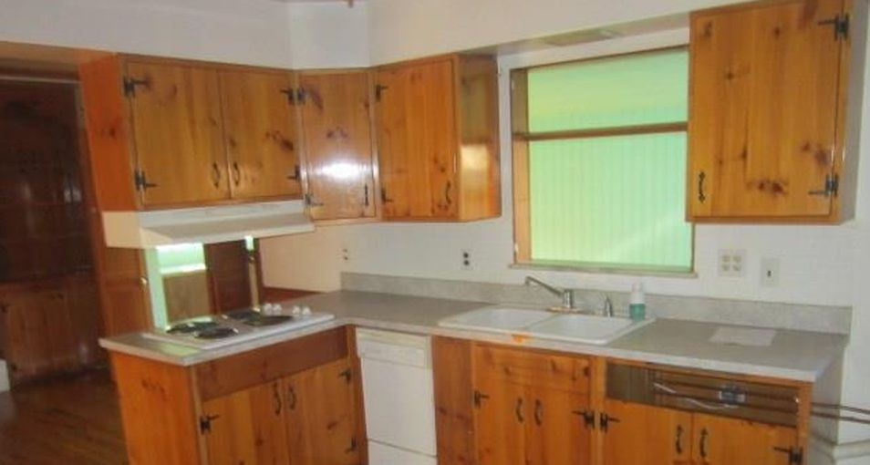
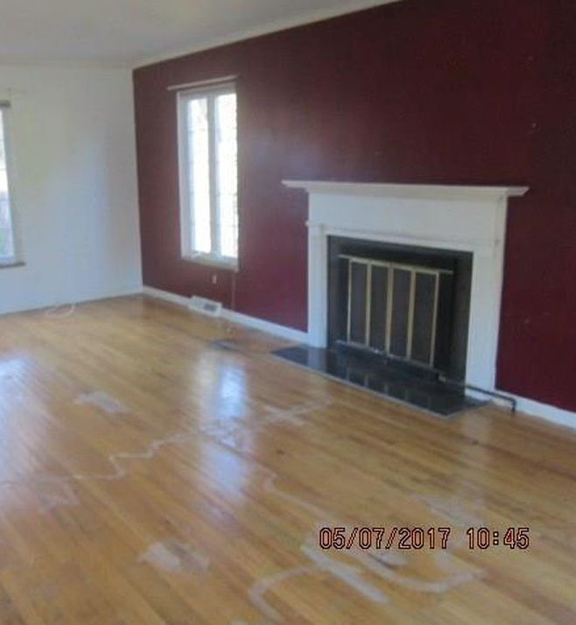
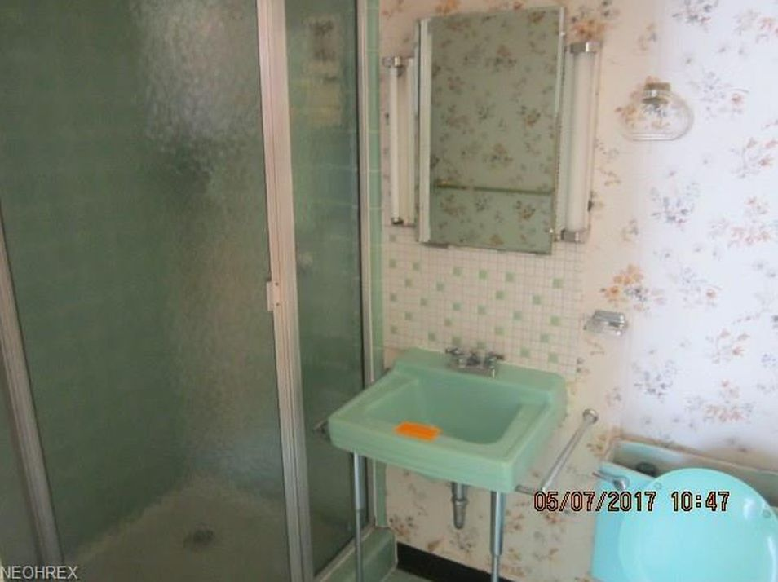
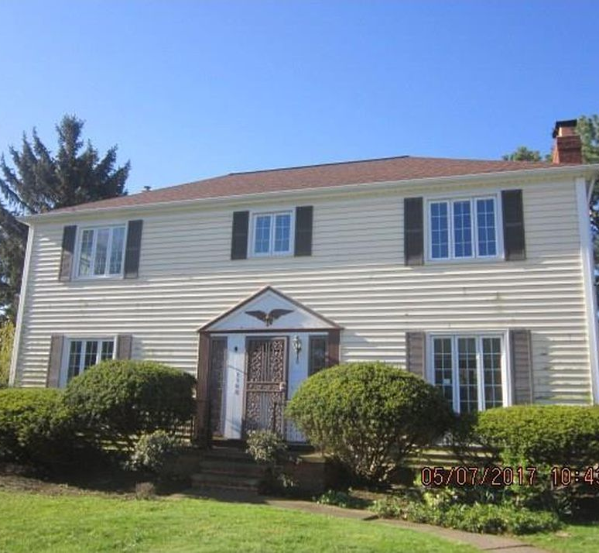
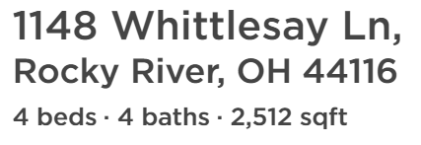

Slide 6
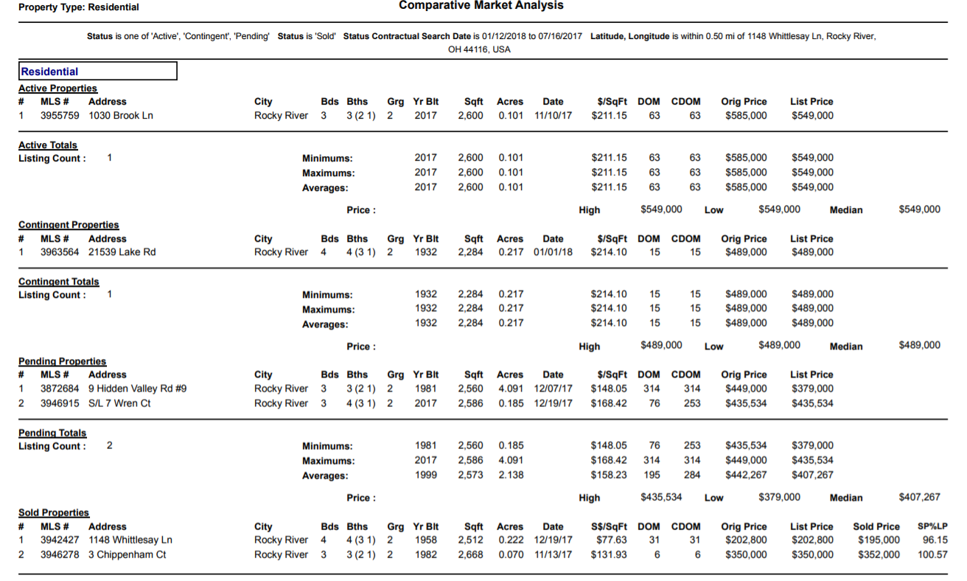

Slide 8
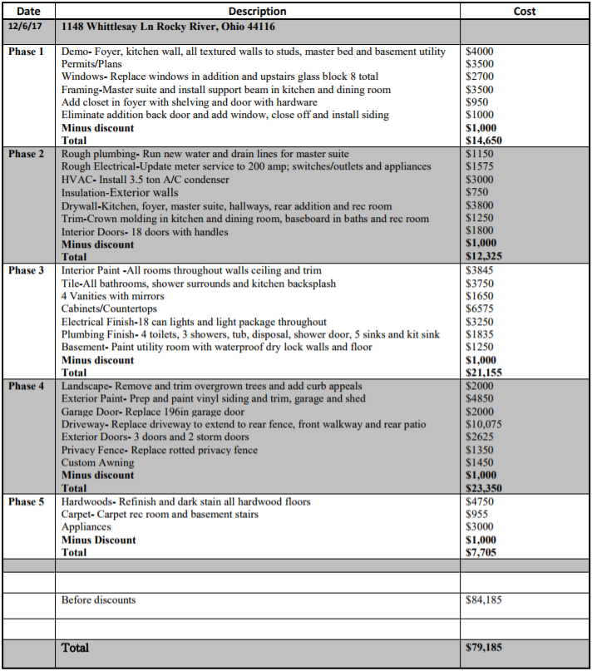
1148 Whittlesay Lane
Rehab Estimate

Slide 9
ASK ME ANYTHING?

