Slide 1
Build Wealth Today
With Double Digit Returns,
No Commissions & Predictable Results

Slide 2
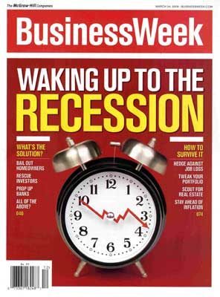
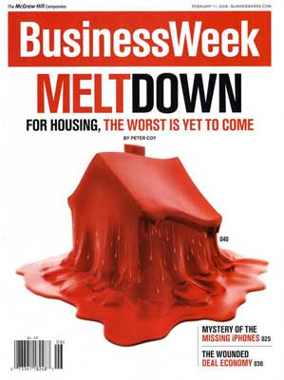

Investment Marketplace
Notes:
Have you been paying to the stock market?
Have you been paying attention real estate market?
What do you about your finances?

Slide 3
What Are Your Investment Objectives?
Security
CDs
Corporate Bonds
Government Bonds
Fixed Annuities
Higher returns
Stocks
Mutual Funds
Variable Annuities
Notes:
What are their objectives? What are they trying to accomplish? Are they investment savvy?
Do they want security with lower returns?
Do they want higher returns with lower security?
The only alternative investment that pays higher guaranteed returns with low/ no risk is tax liens?

Slide 4
What Are Your Investment Objectives
CDs
Corporate Bonds
Government Bonds
Fixed Annuities
Stocks
Mutual Funds
Variable Annuities
SECURITY
HIGHER RETURNS
4
Notes:
What are their objectives? What are they trying to accomplish? Are they investment savvy?
Do they want security with lower returns?
Do they want higher returns with lower security?
The only alternative investment that pays higher guaranteed returns with low/ no risk is tax liens?

Slide 5
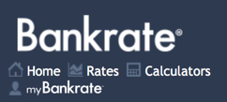
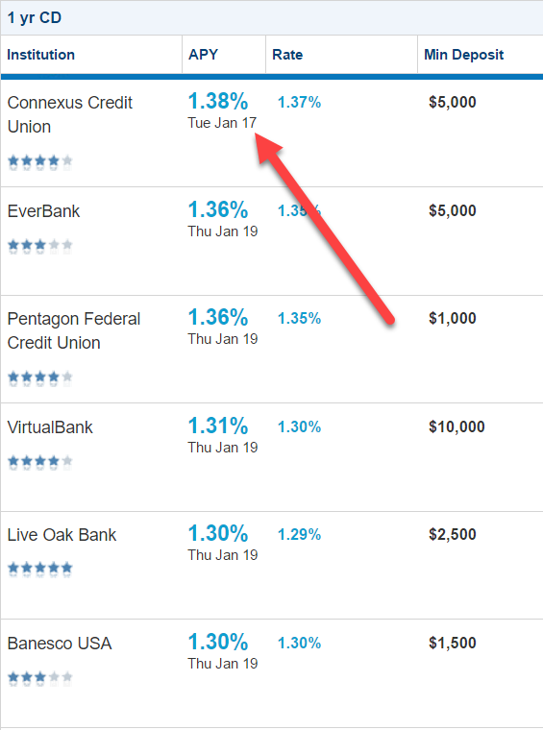
CD RATES 1.38% Return on Investment
Notes:
Okay, so let me explain, so if you went into Google right now and you ‘Googled’ CD rates, you’d find that CD’s are paying 1% okay?

Slide 6
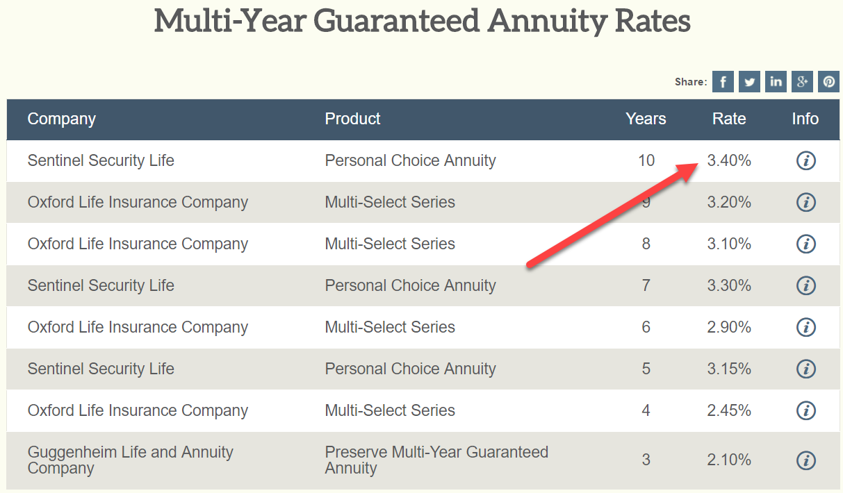
ANNUITY RATES 3.40% Return on Investment
Notes:
Okay, so let me explain, so if you went into Google right now and you ‘Googled’ CD rates, you’d find that CD’s are paying 1% okay?

Slide 7
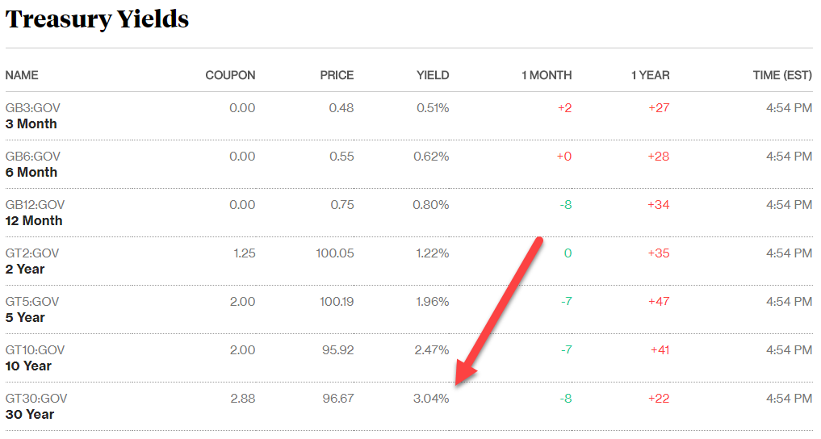
BOND RATES 3.04% Return on Investment
Notes:
Okay, so let me explain, so if you went into Google right now and you ‘Googled’ CD rates, you’d find that CD’s are paying 1% okay?

Slide 8
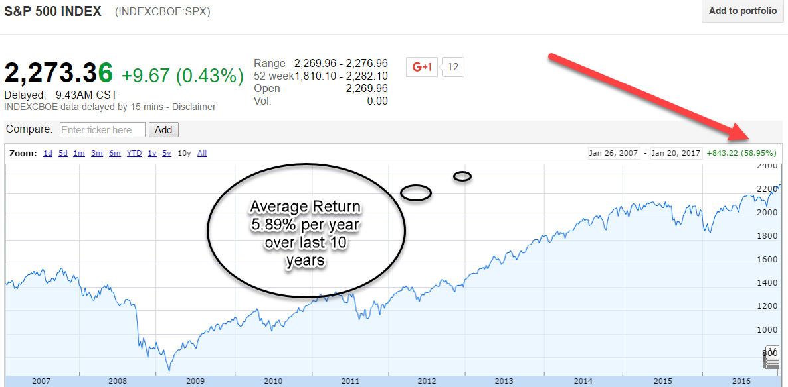
S&P 500: Last 10 Years: 5.89% Avg. ROI Per Year
Notes:
NEED NEW PIC OF GOOGLE S&P 500
And if you couldn’t live with those low interest rates, you could put your money in the stock market okay? But I don’t know about you; if you’ve been paying attention to the stock market lately, but the stock markets been getting hammered in 2014. Okay, it was down 300 point the other day, it’s down 200 points today; it was down 400 points last week. And so investors are scared, they are looking for somewhere to put their money. Okay, stock markets only average 8% over the last 10 years and so
And approximately 9% over the past 100 years.

Slide 9
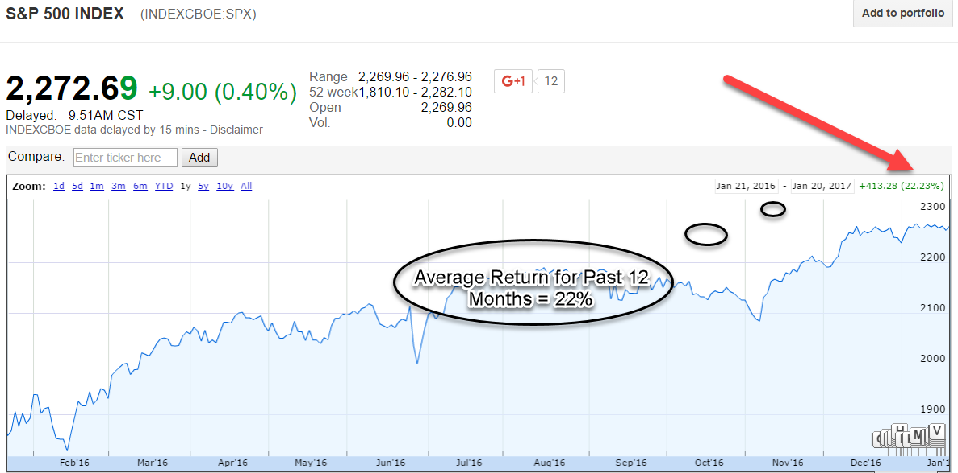
S&P 500: 22.23% Last 1 Year
Notes:
NEED NEW PIC OF GOOGLE S&P 500
And if you couldn’t live with those low interest rates, you could put your money in the stock market okay? But I don’t know about you; if you’ve been paying attention to the stock market lately, but the stock markets been getting hammered in 2014. Okay, it was down 300 point the other day, it’s down 200 points today; it was down 400 points last week. And so investors are scared, they are looking for somewhere to put their money. Okay, stock markets only average 8% over the last 10 years and so
And approximately 9% over the past 100 years.

Slide 10
SUMMARY: If you were a private investor, where would you rather invest?
OPTION “A” = NOT US
CD = 1%
Annuities = 4% or less
Bonds = 4% or less
Stock Market past 10 yrs = 5.89%
Stock Market past 100 yrs = 9%
Significant Volatility
No Control Over Investments
THE WEALTHY DON’T DO OPTION “A”
OPTION “B” = US
We pay 12% minimum
~OR~
15% of profit
Whichever is greater?
Predictable
Control over investments that you can see and touch
THE WEALTHY DO OPTION “B”
Notes:
So if you were an investor who had saved some money in your retirement accts like your 401k, IRA or pension
Where would you rather invest??
Option A or Option B

Slide 11

What is a Self Directed I.R.A?
A Self Directed IRA is an IRA where the owner is required to make their own Investment decisions.
Non- Traditional Assets: Like real estate, LLC’s, oil and gas, etc
Self Directed IRA custodians (Like The iPlan Group who I use) set up real estate investments inside of an IRA.
Any 401k, IRA, ROTH IRA, SEP IRA or HSA acct owner can make investments like real estate in those accts
Sample Investments
Note (I.O.U) w/ Mortgage
Buy stock in a company

Slide 12
3 Step Process
Set Up A Self Directed IRA Account
Fund The Account
Rollover = from 401k or 203b
Transfer = from another IRA
Make An Investment: (IE: Note and Mortgage)

Slide 13
$500,000 Mutual Fund Investment
American Funds = Small Cap World
Expense ratio = %1.09 (paid to the fund manager)
@ 10% = $50,000 Profit / ROI
@ 8.91% = $44,550 Profit / ROI
“A” Share Commission
(paid to the financial advisor who sells this mutual fund to their client)
$500,000 = 2% (breakpoint) = $10,000
$500,000 - $10,000 = $490,000 - $5,341 (%1.09 exp ratio) = $484,659 left (zero ROI)
$15,341 dollars in FEES for American Funds

Slide 14
Share Classes
Class “A” Shares – up front commission
Class “B” Shares – back end commission & higher expense ratio
Class “C” Shares – small annual commission & highest expense ratio

Slide 15
“LOAD” / “NO LOAD”
Load = Commission
No Load Fund = No Commissions
Paying a money manager = charge a money management fee
EX: Sell no load funds BUT charge 1% money management fee + 1% expense ratio

Slide 16
Variable Annuities
Act Very Similar A Mutual Fund
BUT
Access To 40 Funds Within The Annuity
Transfer From Fund To Fund With No Expense
3% Commission Up Front
AND
2% Exp Ratio Per Year Every Year

Slide 17
Our Mission Statement
To Provide Our Investors Double Digit Investment Returns By Matching Our Knowledge And Acquisition Of Undervalued Real Estate Assets With Investors Looking For Investment Alternatives And Double Digit Returns.

Slide 18
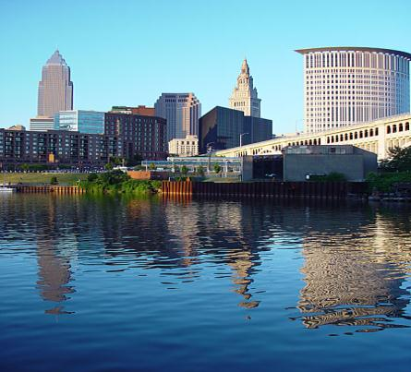
Company Overview
Millennium Capital Investments
A real estate investment firm created to purchase, manage and sell single, multi-family and commercial dwellings primarily in the Cleveland, Ohio area.

Slide 19
One and Only Goal
To Significantly Increase The
Wealth Of Our Private Investors With
Double-digit Returns Plus
Upside Bonus Potential .

Slide 20
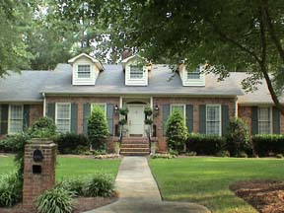
How We Acquire Properties
Private Individuals.
Realtors.
Pre-Foreclosures.
Foreclosures & REOs.

Slide 21
Testimonial
ACTUAL LETTER
“Over the last 6 years, while everyone else lost money, especially in 2008, I’ve been earning 10% EVERY SINGLE YEAR. I’m so glad I got involved with you when I did. It’s meant tens of thousands in interest I would have lost in the market or never earned in CD’s. ”
Cindy Heilman
Brunswick, Ohio

Slide 22
Testimonial
ACTUAL LETTER
“When we looked at our statements we could never tell if we were making money or loosing money. It just went up and down every month with no real progress. Plus our advisor never called us to make adjustments. Now I know we are making real progress towards our financial goals. 10% or more every month! You can’t beat it!”
Mike and Mary Tucciarone
Brunswick, Ohio

Slide 23
Testimonial
ACTUAL LETTER
“You were like an answer to our prayers. You always had our personal needs in mind. We felt very comfortable putting our home in your hands. Thank you again for helping us. ”
Your friends,
Rev. Willie and Cathi G.
Medina, Ohio

Slide 24

Some of our CURRENT DEALS!
1966 Marwell Ave. $65,000 Profit (SOLD)
364 Southwest Dr. $52,000 Profit (SOLD)
3665 Brookside Dr. $47,000 Profit (SOLD)
6415 Miller Rd. $43,000 Profit (SOLD)
2227 7th St. $35,000 Profit (SOLD)
1300 Idlewood Ave $18,000 Profit (SOLD)
26930 Oxford Ave. $21,000 Profit (SOLD)
2477 W 5th St. $43,000 Profit (SOLD)
1546 Galaxy Dr. $30,000 Profit (SOLD)
6709 Amsel Ave. $23,000 Profit (SOLD)
5636 Fairland Ave. $15,000 Profit (SOLD)
8674 Greenmeadow $30,000 Profit (SOLD)
2179 Pamer Ave. $25,000 Profit (SOLD)
770 Dunbar Rd. $31,000 Profit (SOLD)
1355 Keystone Dr. $21,000 Profit (SOLD)
145 Huffman Rd. $30,000 Profit (SOLD)
5309 Lindford Ave. $53,000 Profit (SOLD)
2713 Massillon Rd. $32,000 Profit (SOLD)
951 Wall Dr. $26,000 Profit (SOLD)
38 Edgewood Dr. $18,000 Profit (SOLD)

Slide 25
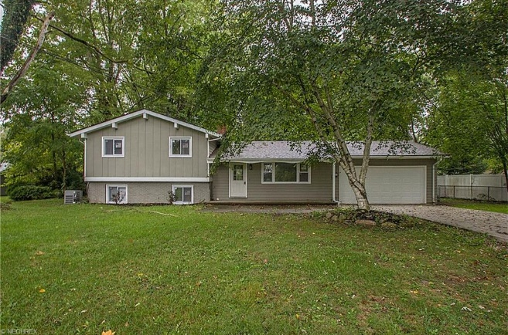
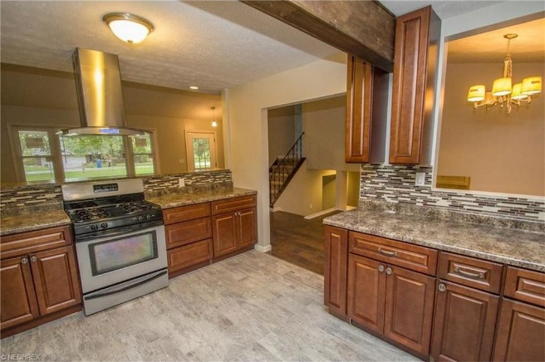

CASE STUDY 16004 Briarwood Drive Columbia Station, OH
Purchase Price $96,000
Improvements $44,000
All in For $140,000
Private Money $140,000
SOLD $192,500
Net Profit After ALL COSTS $35,000
Private Lender Profits: 12% return = $10k
Notes:
So this is Homestead, okay. Now keep in mind the five step formula. So we get the funding handed over to you is number one. We got $79,000 of funding. Number two we chose the best deal on a doorstep; this was a bank foreclosure; we bought it for 41,500. We got $37,000 cash back at closing, we outsourced the improvements; we put $3400 in our pocket when we bought it. Okay, so you’re going to get paid when you buy. We had the realtor sell the house for us, and they sold it for us for 121 we made 38 Grand; okay.

Slide 26
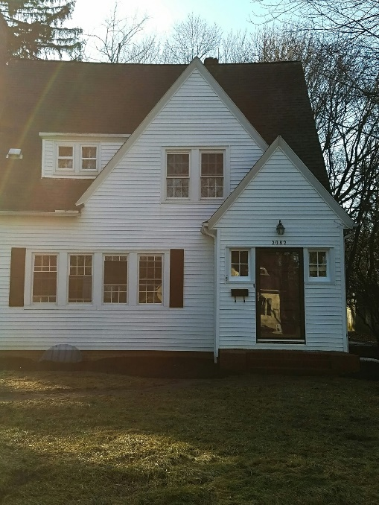
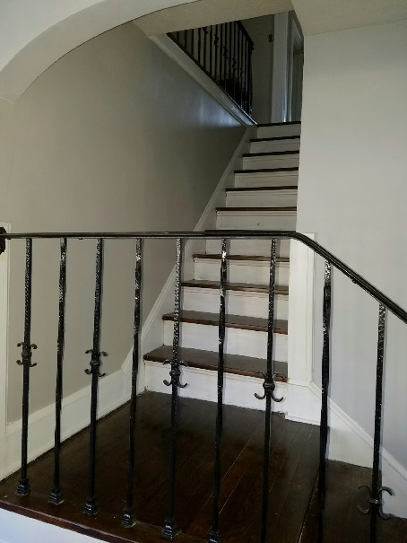
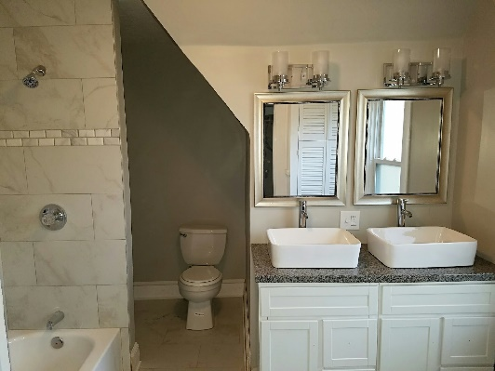
CASE STUDY: 2082 Braewick Drive Fairlawn, OH
Purchase Price $92,000
Improvements $51,000
All in For $143,000
Private Money $145,000
ARV/List Price $195,000
Gross Profit $50,000
Net Profit After ALL COSTS $35,000
**All Case Studies Closed And Profit Made In Past 24 Months
Notes:
Okay, so guys let’s start with one of my latest and most recent big profit deals, okay, and then you can see how these deals come together and then you can decide if you want to do this for yourself, okay. So, this is Iota Avenue, okay. When your screen flips – there it goes, 2312 Iota Avenue. This is a deal that I just flipped, we made 38,000 dollars profit total, I gave a portion of the money to my private investor, I gave him 5,700 dollars and we made 32,000 dollars, $32,549.24. Now, I did this deal part time, I only had about four hours into the deal, I didn’t use any of my own money, okay. I would have had to do eight little wholesale deals at four thousand each to make the same kind of money, okay. So that’s what’s going to happen for you.
Now, how did the deal come together? Well, I found a deal – this deal on Iota Avenue in Cuyahoga Falls so, guys just let your eyes follow my mouse – Iota Avenue in Cuyahoga Falls, we paid 53,000 for it, when we bought it we had someone give us 86,000 of what’s called private money, that’s the funding that we got. Now, out of the 86, 000, 53 went towards the purchase price and at closing the title company called us up and said, “Hey Josh, we only needed 53,000 but your investor sent us 86,000, what do you want us to do with the other 33 grand?” I said, “Well, just send it back to my checking account.” They said, “Okay, cool.” And now I was fully funded. You are going to be fully funded for insurance, utilities and any repairs that you want. And then I took 2,500 bucks and stuffed that into my own saving account. So, I got 2,500 dollars upfront – okay, follow my mouse – 2,500 dollars upfront plus 32, 549 dollars later. So, with my system, with my training you’re going to get paid upfront and down the road, two three four months from now, you get paid upfront and later, okay. So, I don’t know about you guys but I like to get paid and I like to get paid upfront and I like to get paid down the road.

Slide 27
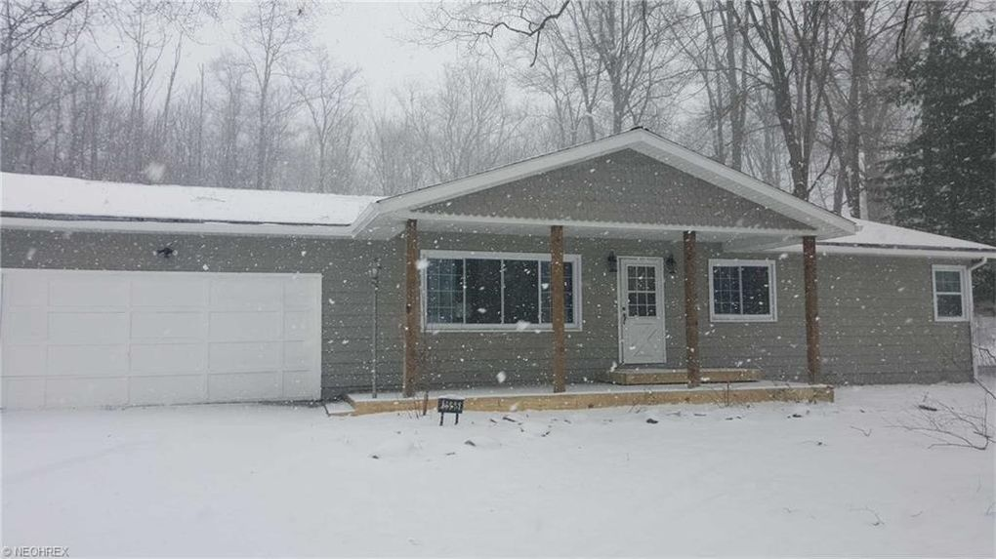
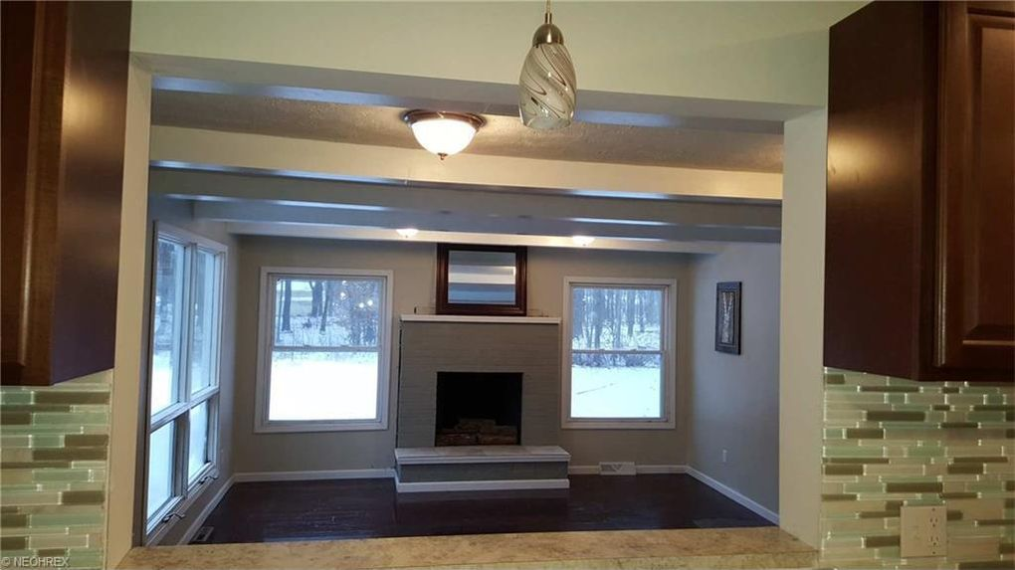
CASE STUDY 3665 Brookside Drive Norton, OH
Purchase Price $63,000
Improvements $45,000
All in For $108,000
Private Money $110,000
SOLD $172,925
Net Profit After ALL COSTS $42,000
Private Lender Profits: 12% interest = $9k
Notes:
1297 Steve same deal. Remember step number one is to get the funding handed over to you. Which we did, we got $90,000 of private money, okay. Now when I say private money what does that mean? Private money means, this is not a bank loan; this is not a hard money loan, this is not a line of credit. This is an individual who has some money, and they thought it was a better use of their money to give their money to you instead of put the money in the stock market. Okay?

Slide 28
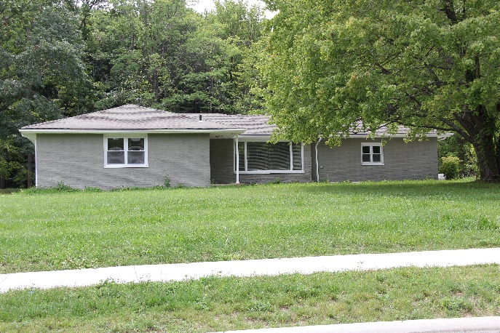
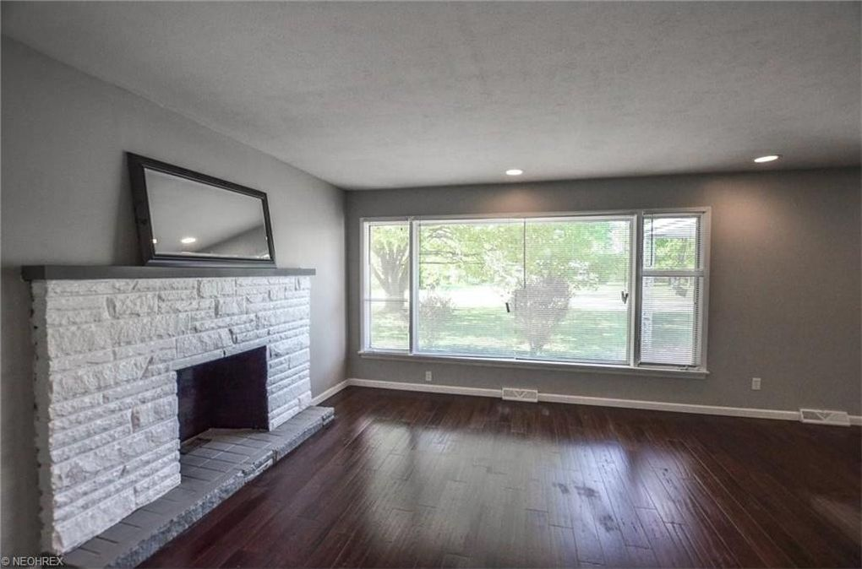
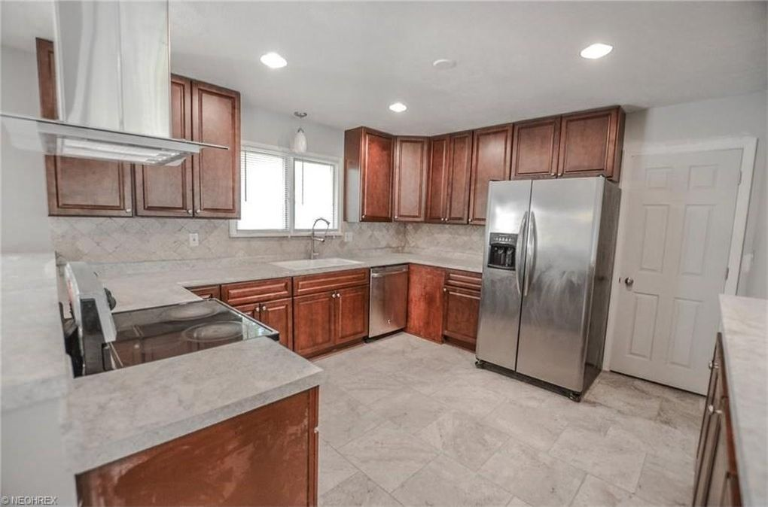
CASE STUDY 1966 Marwell Avenue
Hudson, OH
Purchase Price $65,000
Improvements $55,000
All in For $120,000
Private Money $122,000
SOLD $215,000
Gross Profits $80,000
Net Profit After ALL COSTS $55,000
Private Lender Profits: 12% interest = $13k

Slide 29

Invest in Northeast Ohio
• The Cleveland-Akron area is made up of 8 major counties and is the 15th largest consumer market in the U.S. with approximately 2,950,000 residents.
• Nearly 35% of Ohio’s population is within Cleveland-Akron’s area of dominant influence.
• Over $1 Billion in residential and commercial development is planned for greater Cleveland over the next 5 years. “Flats renovation, Euclid Corridor Project, Steel Yard Commons, Downtown condo development, East 4th Street Project.”

Slide 30
Certified Borrowers Work Hard So You Can Relax
Locate potential properties.
Perform property analysis and due diligence.
Process and evaluate foreclosures from “Legal News.”
Monitor property’s foreclosure proceedings at courthouse and through media.
Address Realtor questions.
Interface with Equity Trust Co.
Provide presentations to investors.
Negotiate offers.
Coordinate and oversee inspections.
Coordinate closings.
Research marketplace.
Perform marketplace analysis.
Develop marketing plan.
Coordinate title searches.
Arrange and oversee inspections.
Review settlements for accuracy.
Inspect properties on an on-going basis to ensure tenants adhere to lease agreement.

Slide 31
Certified Borrowers Work Hard So You Can Relax
Procure tenants for rentals and lease-purchases.
Screen tenants for credit worthiness, employment and rental history.
Create ads and signs for advertising available properties.
Put out lock boxes and signs.
Obtain constant training through Real Estate Investment Assoc. of Cleveland and National Real Estate Investing Association.
Manage database.
Call lenders weekly.
Interface with insurance company.
Schedule showings.
Hold open houses.
Coordinate and monitor property renovations.
Negotiate with subcontractors.
Monitor property renovation budgets.
Negotiate with homeowners.
Prospect for new clients.
Collect monthly rentals.

Slide 32
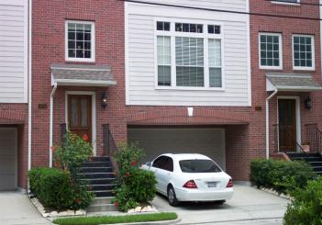
Program Guidelines
Each loan gets a mortgage.
$50,000 and above, you typically get a 1st mortgage.
$10,000 to $50,000, you typically get a 2nd mortgage.

Slide 33
Investor Payments
Annually.
~OR~
Interest accrues monthly – full payment of principal and interest when property is sold.
You pay no transaction fees or closing costs!

Slide 34
Early CD Withdrawal
A bank’s average penalty on a $50,000 CD is $750 (6 months interest @ 3%).
Strategic Accelerated Fund may pay your withdrawal penalty.

Slide 35
IRA Eligible
Individual Retirement Accounts qualify, including Roth IRAs.
Allows you to self-direct your investments in real estate.
3rd Party Administrators.
iPlan Group
(Westlake, Ohio)
Equity Trust Company
(Elyria, Ohio)

Slide 36
Passive Investor Profile
Want to increase your R.O.I.
Want some collateral to protect investment capital.
Have liquid assets ($50k+) available to invest for 1 - 5+ year term.
Savings accounts & CD’s
Mutual Funds and Stocks
IRA

Slide 37

Investment Alternatives
Transition to a secured investment.
Collateral-based.
Fixed returns.
Better protection of
principal.

Slide 38
What Do Smart Banks Know About Investing? Plenty!
Banks lend heavily in Real Estate.
They take in money on CDs (ex. 2%).
Then loan the money out at a higher rate of interest to other people to buy houses (ex. 5%).
This is called “Arbitrage.”
You can be the bank.

Slide 39
Building Wealth By Becoming “The Bank”
Private Lender Program
No hassles, no fees.
Fixed double-digit returns plus points
You determine your levels of risk.
Profitability - Safety - Security.

Slide 40
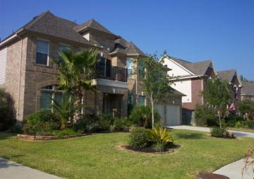
Scenario #1: “Short Term Double-Digit Interest”
Our company locates a property.
Our company purchases the property at 40-50% of its real value.
Private individual lends us money via wire transfer to escrow agent.
Investor lends from account they control.
Money goes to title agent’s escrow account.
The private individual receives documents (note and mortgage) to secure investment at formal closing.

Slide 41
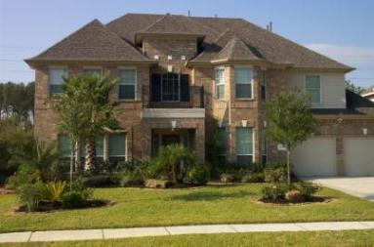
Private Lender Quick-Turn Program Overview
Private funds allow us to purchase at a discount quickly.
We have a formal closing with a HUD1 settlement statement.
Title Insurance to protect all parties.
We then quickly resell the property using 7 different strategies.
The private lender’s money is returned to them with interest and/or profits.

Slide 42

Scenario #2: “Long Term Interest”
Our company locates a property.
Our company purchases the property.
Private individual lends money via transfer to escrow agent.
They receive documents to secure investment at formal closing.
Our company finds a tenant-buyer.
Our company collects the rent from tenant buyer which covers payment to private lender plus other expenses plus monthly profit.
Our company writes a check for interest payment to private lender quarterly or annually.

Slide 43
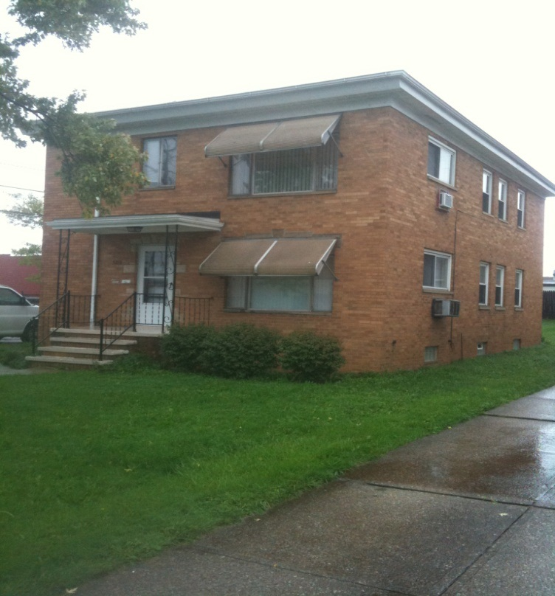
Program Guidelines
Each loan is secured by a note.
A mortgage is recorded in public record to secure the note.
We typically need $50,000 - $500,000 for quick-turn loans.

Slide 44

Protection of Principal
#1 Rule: Money borrowed is no higher than 70% loan-to-value; after repair value.
We then build in more equity by renovating the property.
Independent appraisals done upon lender’s request.
Because we don’t over-leverage the property, you get additional security.

Slide 45
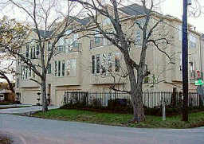
In the Event Something Happens to a Key Owner
We will continue on in business thru our strategic partners and family members.
Single family homes are easier to sell/liquidate.
Properties can be sold if necessary.

Slide 46



Give Yourself the Gift of Time

Slide 47

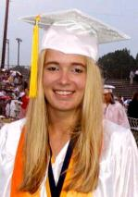
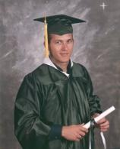

Your Quality of Life Is Important
Peace of mind for us in retirement is priceless.
Thanks, Mom and Dad, for the gift of education.
We now enjoy a more relaxed lifestyle.

Slide 48
The Next Step?
We will answer any questions you have.
Now that you know how you can earn double-digit returns on your investments…
Sign up today for a private meeting.
Also, do you know someone else who may want to earn double-digit returns?
Join our team of Private Lenders

Slide 49
The Strategic Family Of Companies Strategic Real Estate Coach Freeland Ventures Millennium Capital Investments Yellow Jacket Properties
Private Investing
855-477-8855
support@freelandventures.com
www.freelandventures.com
www.strategicrealestatecoach.com
Investing Solutions

