Slide 1

We’ll begin in just a Minute...
Feel free to type in the chat box your questions on Virtual Wholesaling

Slide 2

WARNING:
Your Beliefs about What is TRULY Possible in the World of Wholesaling is about to
Be DESTROYED!
This Presentation is going to BLOW your MIND!

Slide 3

What I am going to be teaching you today!
How to create a Consistent $5,000 to $10,00 Per month or more Virtual Wholesaling business.
Learn how to get others to do 90% of the work for you.
How to automate everything and why you should be focusing on Growing your business
Learn from some of my Biggest Mistakes
I’ll Walk you step by step through how you can start doing this in the next few weeks and will walk you step by step through my entire process.
and much much more….

Slide 4

What does Creating an Automated Virtual Wholesaling Business mean to you?
Creating a business with a team around you where you coordinate everything and your team flips all of the houses for you

Slide 5
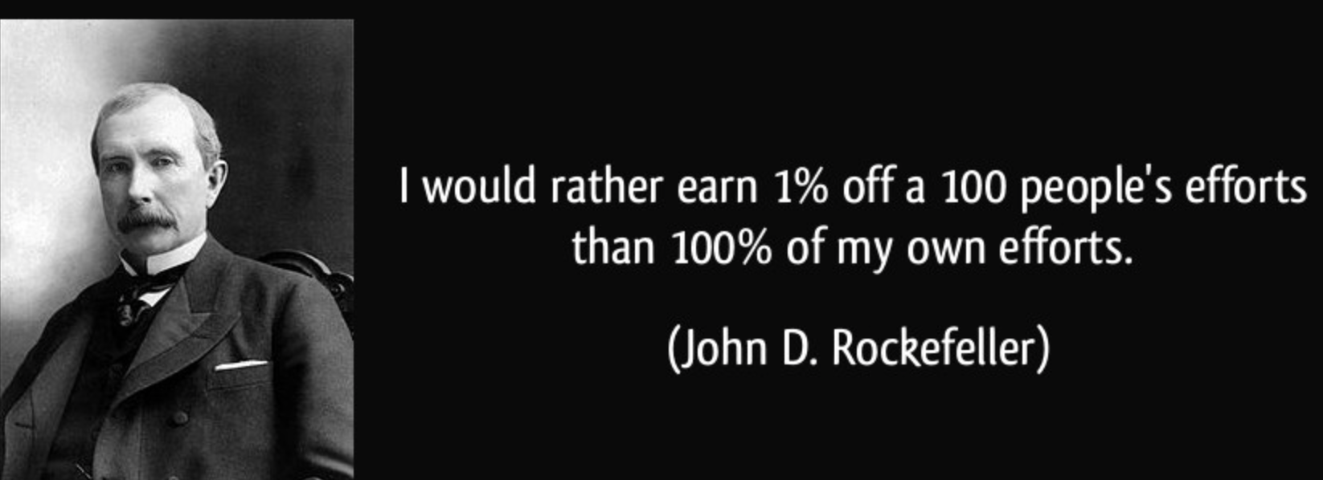
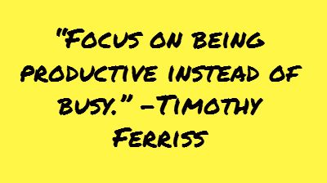

Slide 6
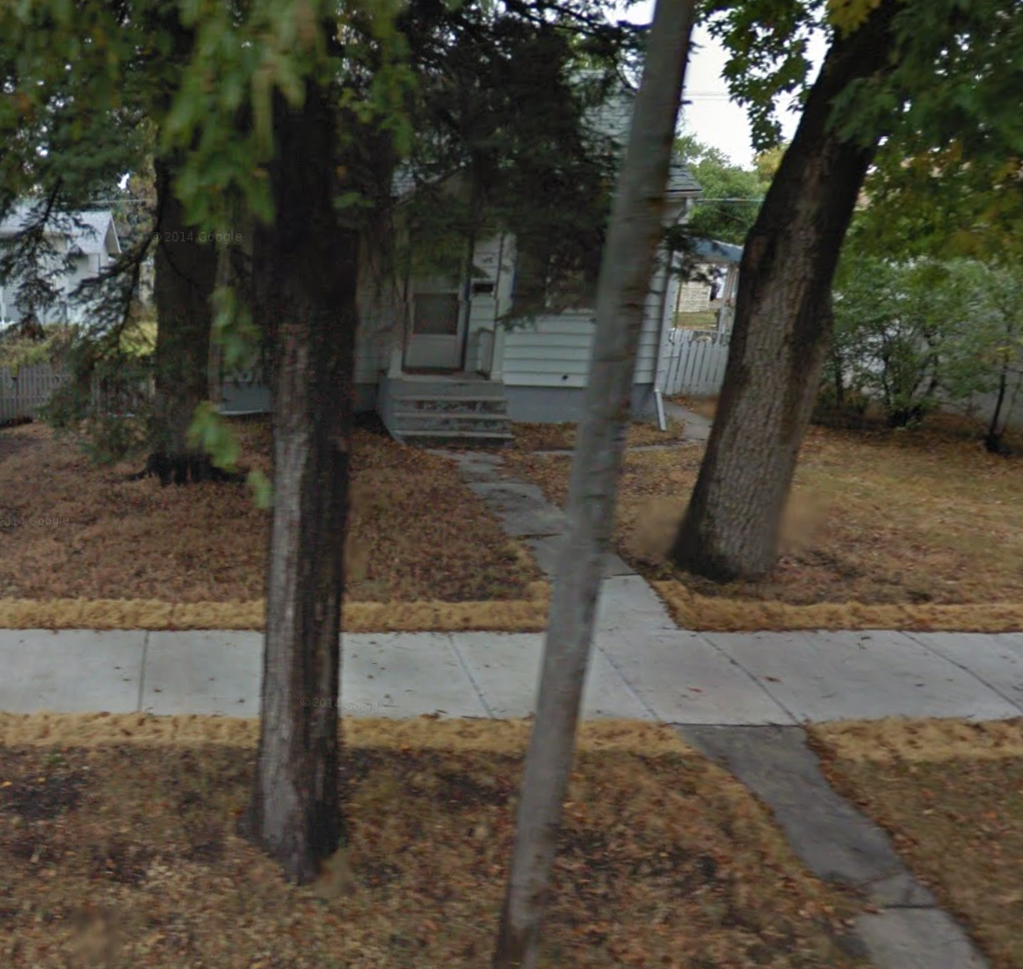
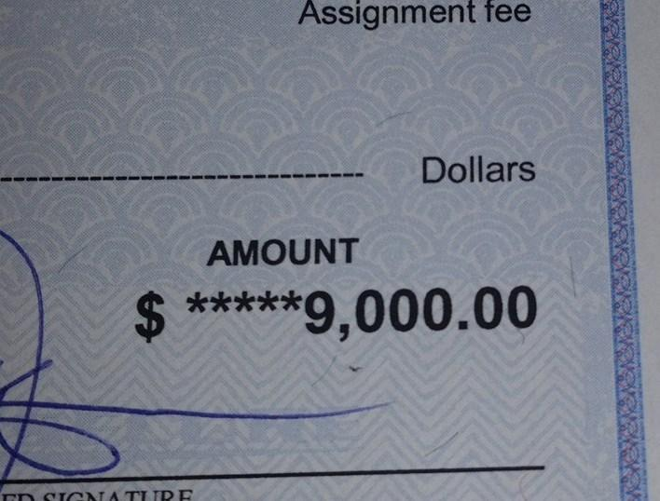
What does a Virtual Deal Look Like?
$9,000 Assignment Fee
(Contract for $26,000 And sold for $35,000)
Worked 45 Mins, Acquisitions Manager Did around 2 hours of work!

Slide 7
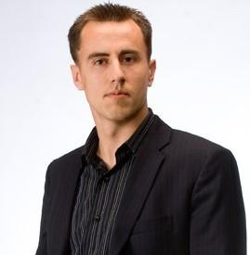
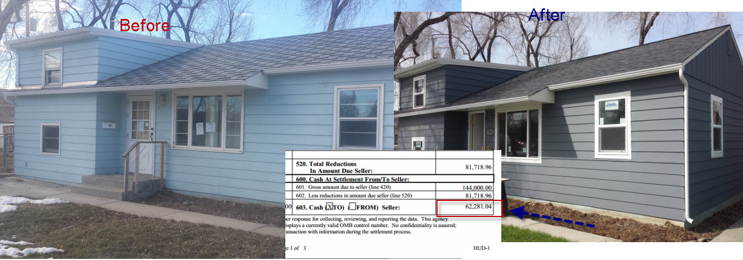

Who am I?
Started in 2009
Grew up in a Town where the cows outnumber people
Been involved in over 100 real estate transactions
Did 15 Rehab projects in 2014
Family owns over 100 rentals

Slide 8
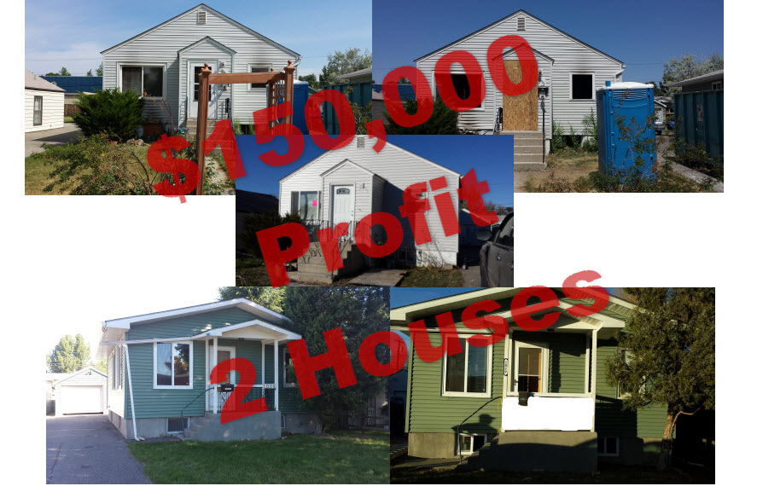
$150,000 in 1 Month

Slide 9
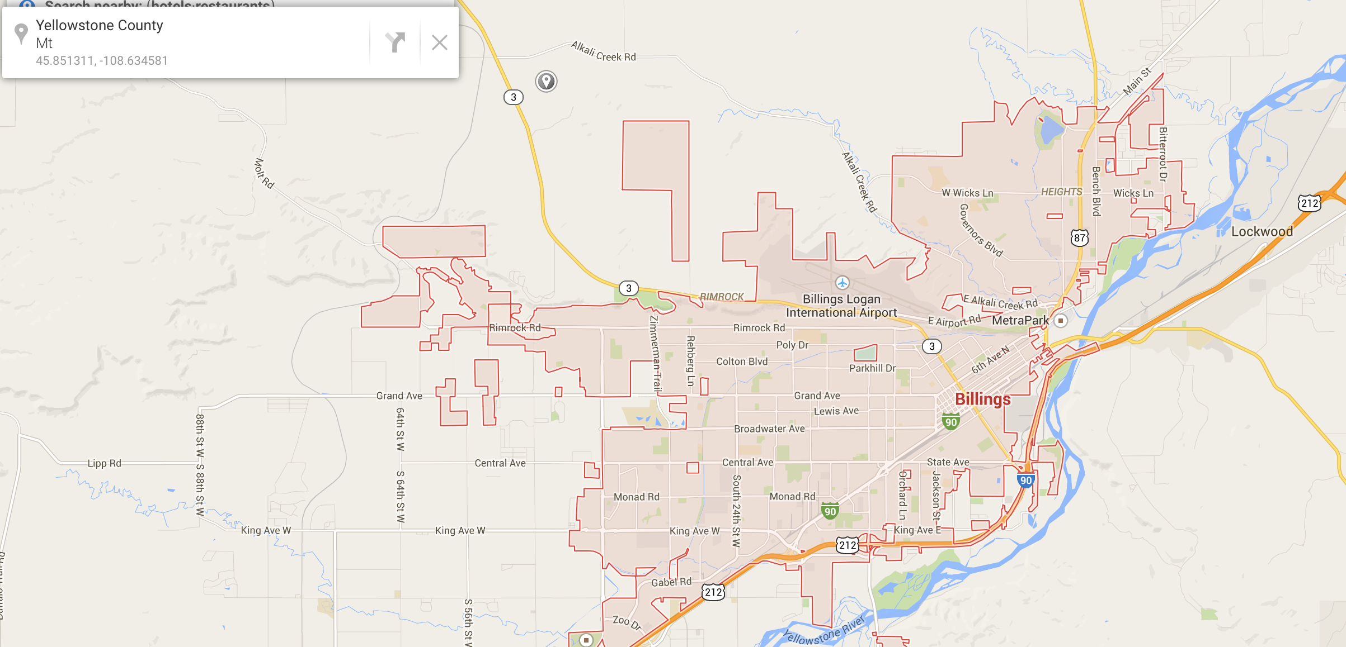
Why I Ventured out to Virtual Deals?
Total Population 110,000 in the city
and 160,000 in our county
You can only do so many deals per year in a small market

Slide 10

Why my Business has Shifted?
TIME and FREEDOM
Average Time spent on a Rehab 5 to 6 Months working at least 80 hours
Getting Material, Managing contractors, Hiring, firing, selling a house, etc
Average profit around $30,000
$30,000 in profit/80 hours is $375 per hour
Average Virtual Wholesale Deal $7,000 Gross profit ($3,000 net)
Average time worked per wholesale deal 3 Hours
$3,000/3 hours = $1,000 per hour
You can do 20 +++ X the deals in the same time as 1 rehab
3 Hours x 20 = 60 hours and over $60,000 in profit

Slide 11
Why is Virtual Wholesaling Easier than Wholesaling houses in your own market?
TIME and Freedom
Regular wholesale deal average profit $7,000, Working al teat 20 hours doing everything yourself.
$7,000/20 hours is around $350 per hour
Our Virtual Deals remember are $1,000 per hour
You can do twice as many deals and work LESS

Slide 12
Before We get started with the process Lets talk about YOU!
Lets Write down your personal goals right now!
What City do you currently live in? What is the Population?
Example: Billings, 160,000
What do you need every month to replace your current income? $3,000, $5,000, $10,000 or more? (Write it down) What do you currently make at your JOB? Example $4,000
How much do you want to make in income this year? ($40,000, $50,000, $100,000 or more)
Example $150,000 (around $12,500 per month)

Slide 13
Continued...
How much Money do you have extra that you can put towards starting a real estate wholesaling business? ($0, $250, $500, $1,000, or more) Example: I have can afford or save $1,000
How many hours per week can you dedicate towards reaching your goals? Example: 20 Hours
What is your end goal with real estate investing? (make enough to retire?, create a business?, generate consistent monthly income?, Build Capital to Buy Rentals? other?)
Build Capital to buy 20 free and clear Rentals Generating $10,000 a month passive income
Example: Wholesaling business that generates $20,000 per month
etc. Whatever your goal is write it down no matter how BIG or Crazy

Slide 14
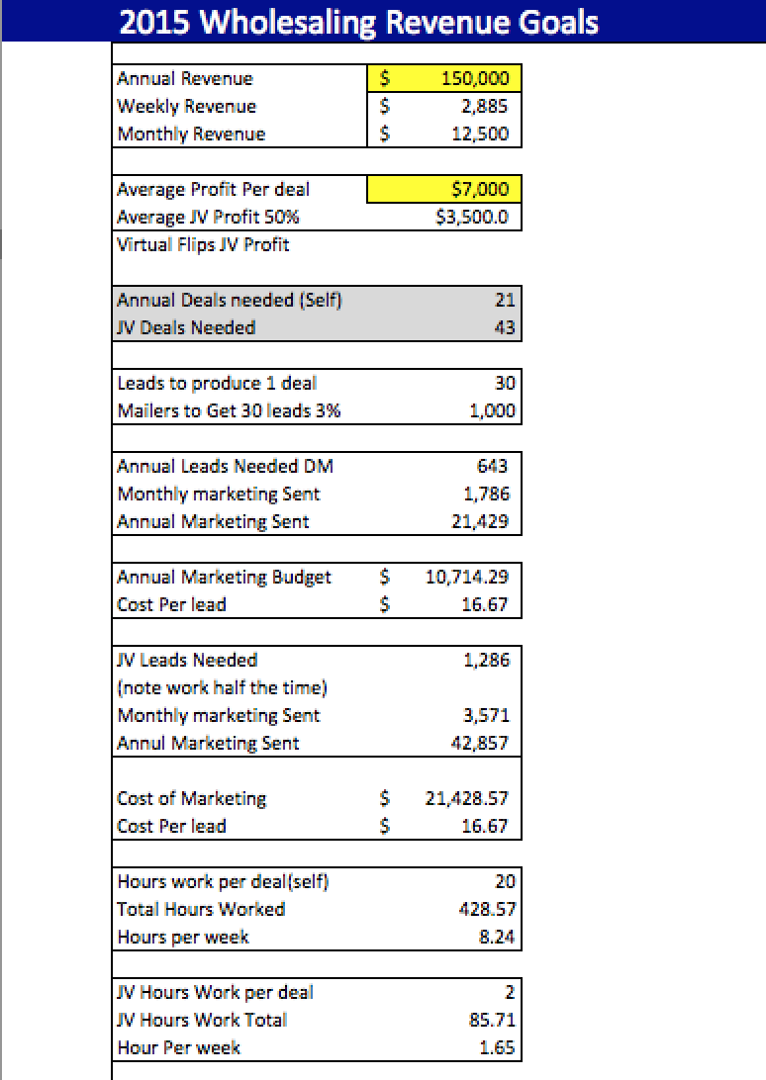
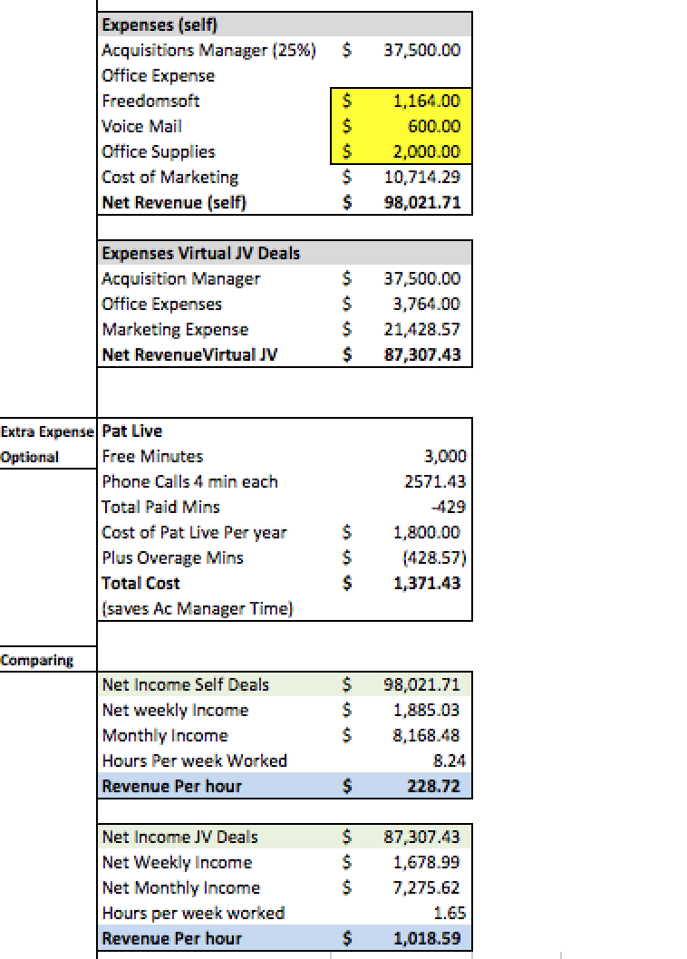
Now that we have our End Goal in Mind How do we Accomplish it?
You will have access to this Spreadsheet

Slide 15
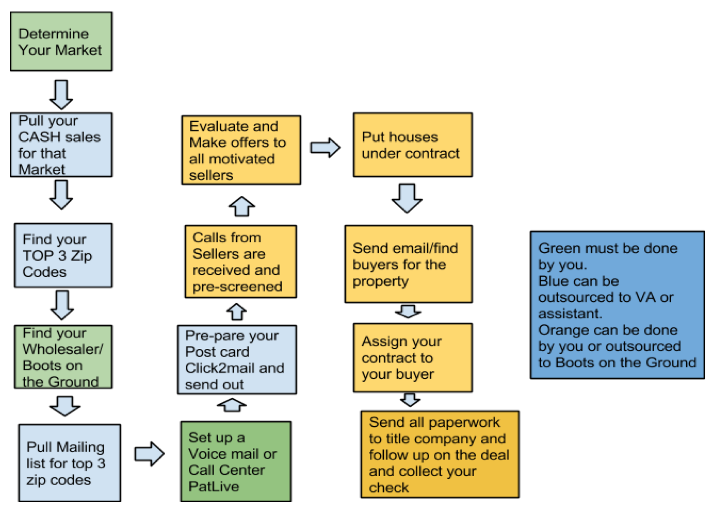
Virtual Wholesaling Process
Get out a Pen and Paper and take notes

Slide 16
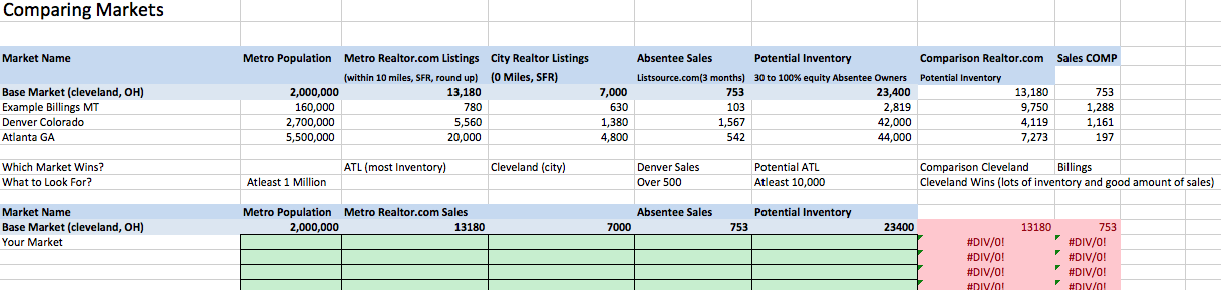
Step # 1 Finding a Wholesaling City
NOT all Cities are Created Equally!
Some will be Awesome for wholesaling while others will be a waste of your time.

Slide 17
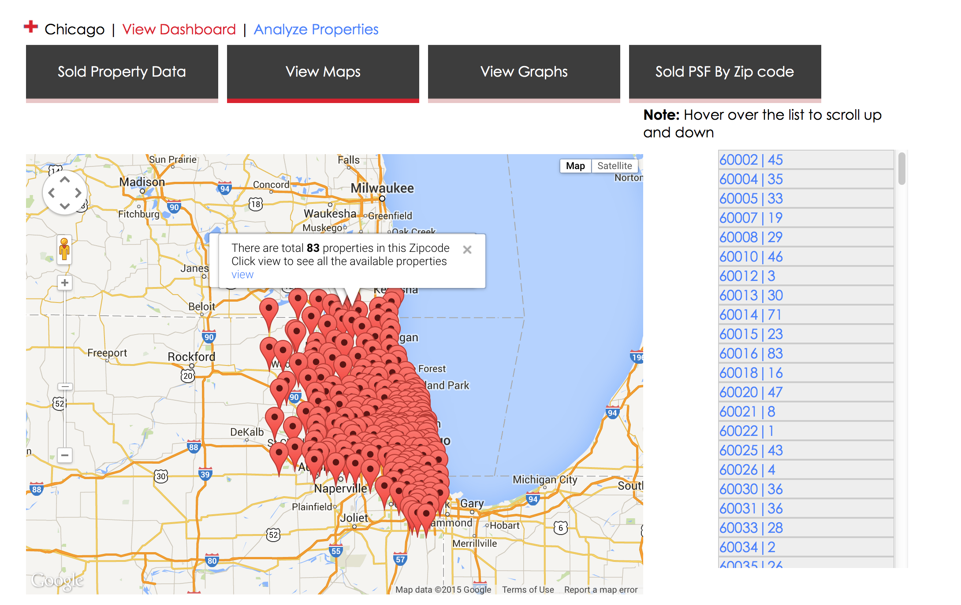
Step # 1.5A FINDING the HOT Areas
Once we pick a City we Dive DEEP!

Slide 18

What Happens when you do not DO market research correctly?
Waste Money
Send Mailers to Areas NO ONE wants to buy in.
Example: Did a campaign and sent 1,500 postcards to a BAD area. Received over 300 phone calls and 0 Deals. Waste of time and money.

Slide 19
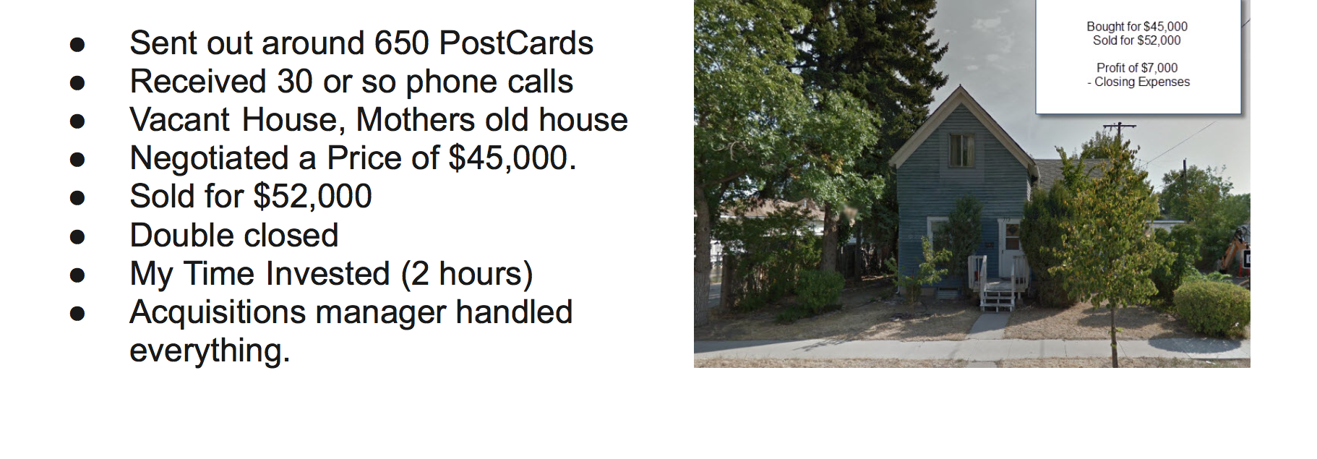
When You Know where the HOT areas are you life gets easy

Slide 20

Step # 2 Building a Team
You Need Boots On the Ground
Why Working with Experienced Wholesalers makes your life easier!
Who you need?
Wholesaler (most important)
Title company & closing attorney
Realtor

Slide 21
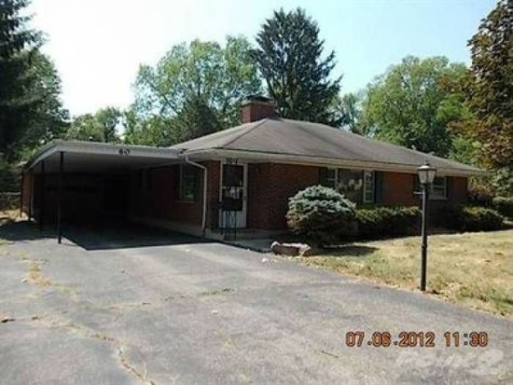
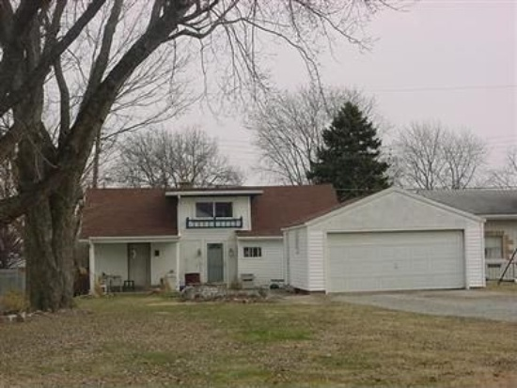
My $2,000 Blunder (dont make my mistake)

Slide 22
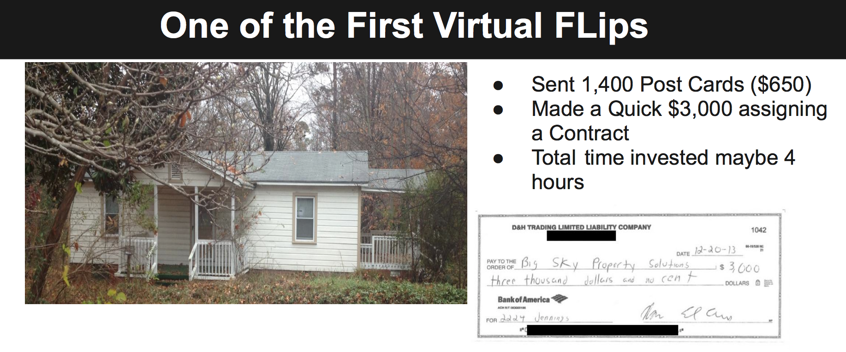
QUICK Profit

Slide 23

I run My Business from just my laptop and have a team that does 90% of
the work for me!

Slide 24
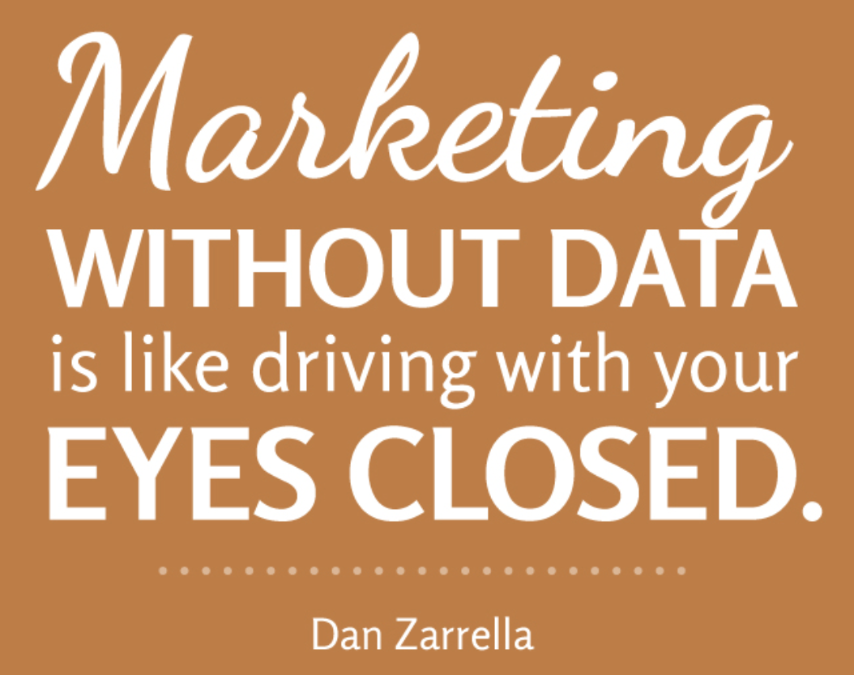
Step # 3 Marketing & Finding Deals
The Lifeblood of your Business
Marketing = Leads =Deals =$$
Your Goal Should be to become an Expert
Focus on the areas with HIGH cash sales, and Good potential Inventory!

Slide 25

GO into Markets where its easy to find deals!
Scale your Business & Scale your Marketing!
Once you HIT a ceiling create the same process in a new market this is why we moved from our market we hit the CEILING!

Slide 26
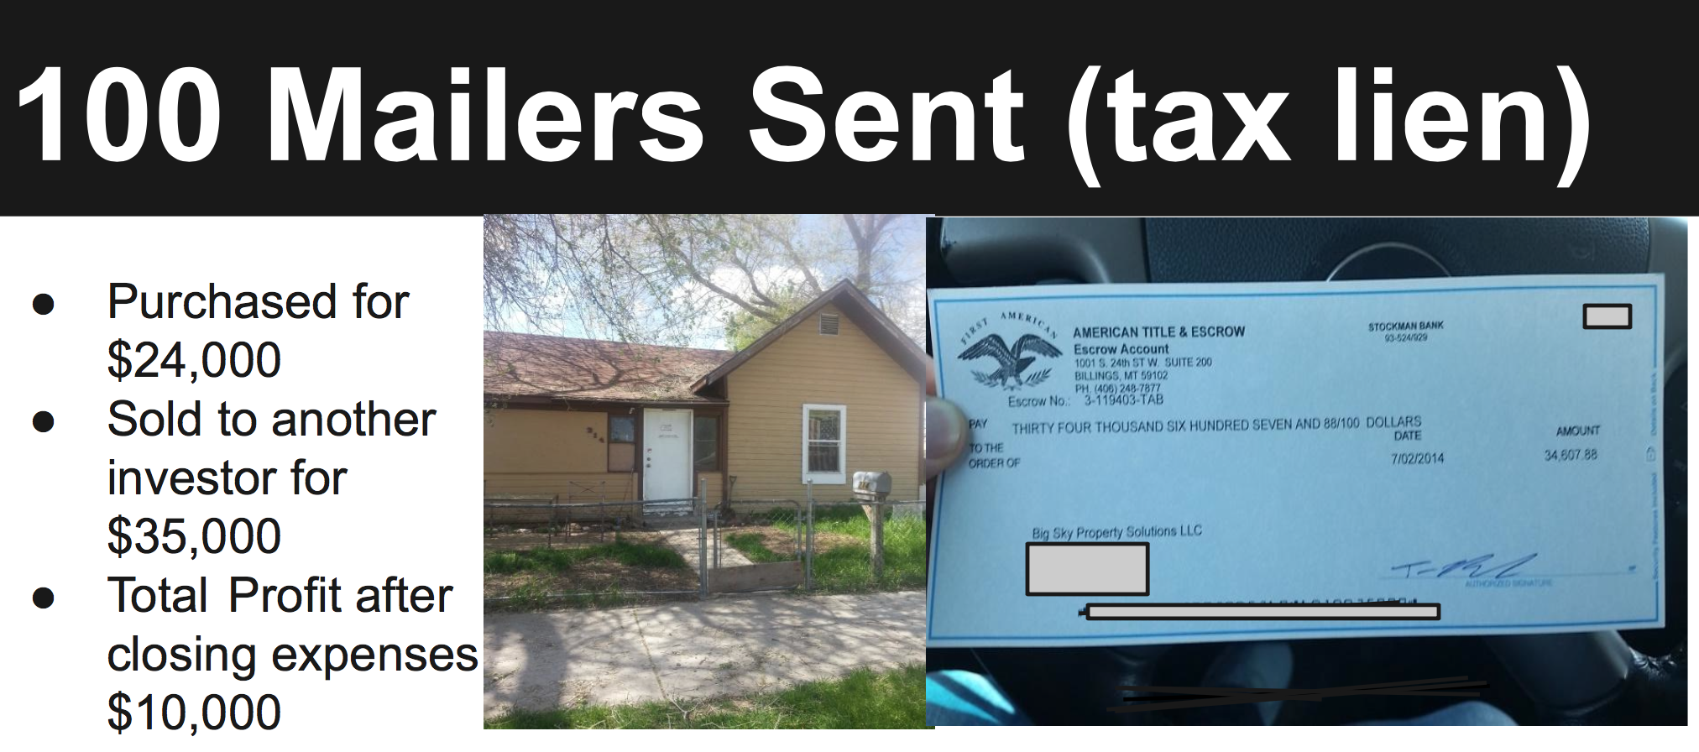

Slide 27
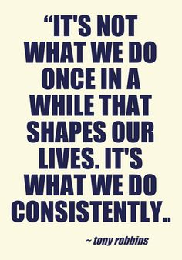


The Key is to Repeat this Process every week or month and Create a System

Slide 28

Step # 4
Pre-Screening and Evaluating
Marketing out and Calls Coming IN!
Pre-Screen using a Lead Sheet
I OUTSOURCE THIS to PATLIVE!
Evaluating is OUT Sourced
My Process takes 7 minutes
From there we Make our Offer
WE make offers on ALL leads

Slide 29
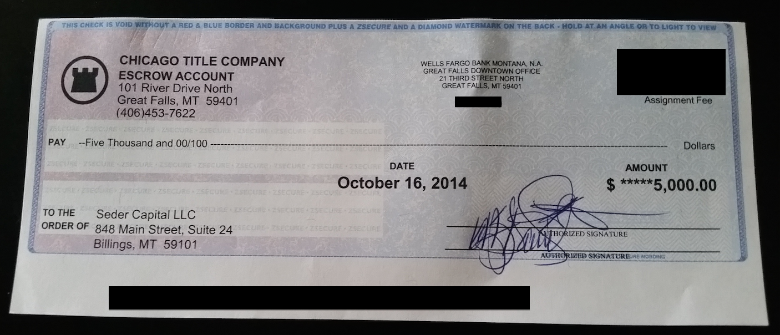
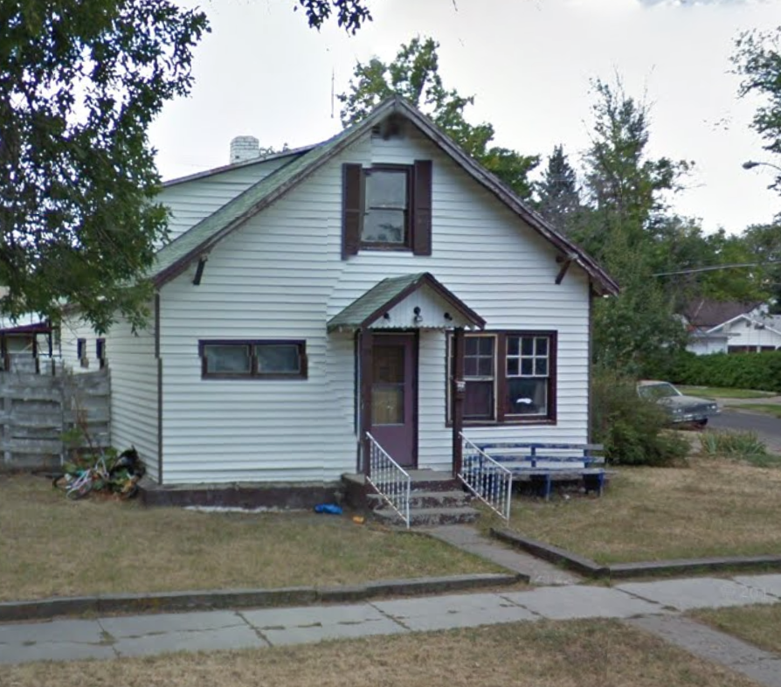
Another Quick Wholesale Deal!

Slide 30
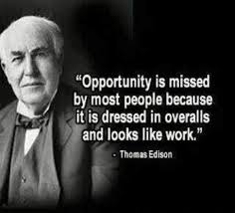
Are you starting to see the opportunity?
I have yet to work more than 3 Hours on a Virtual Wholesale Deal I have DONE
It DOES take work in the beginning, this is not a push button anything!

Slide 31
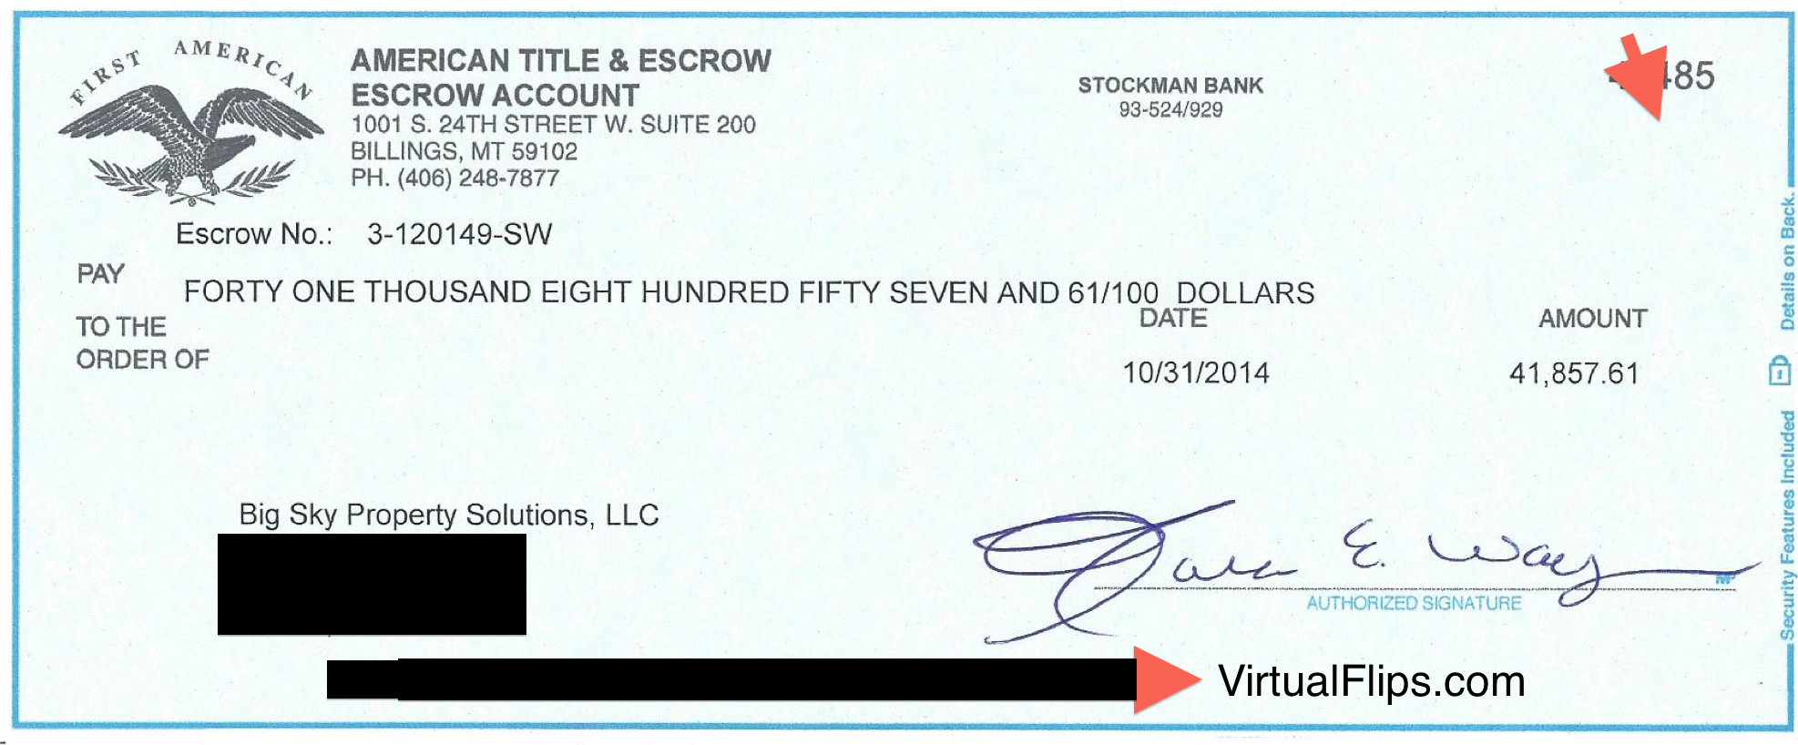
KNOWING what Buyers Want Saves you!

Slide 32
Step # 6 Closing the Deal ($$$ Time)
Everything is submitted to the title company and all you have to do is sit back and wait for your check!
Your Wholesaler should handle coordinating with the seller and buyer to make sure everything goes smoothly!

Slide 33

Step # 5 Finding Buyers
How do I do this without ever having a buyers list?
Leverage Experienced Wholesalers
What if the Wholesaler Can not find a Buyer?
Use a Proven Buyer Marketing process
#1 We have all of the cash sales for the area

Slide 34
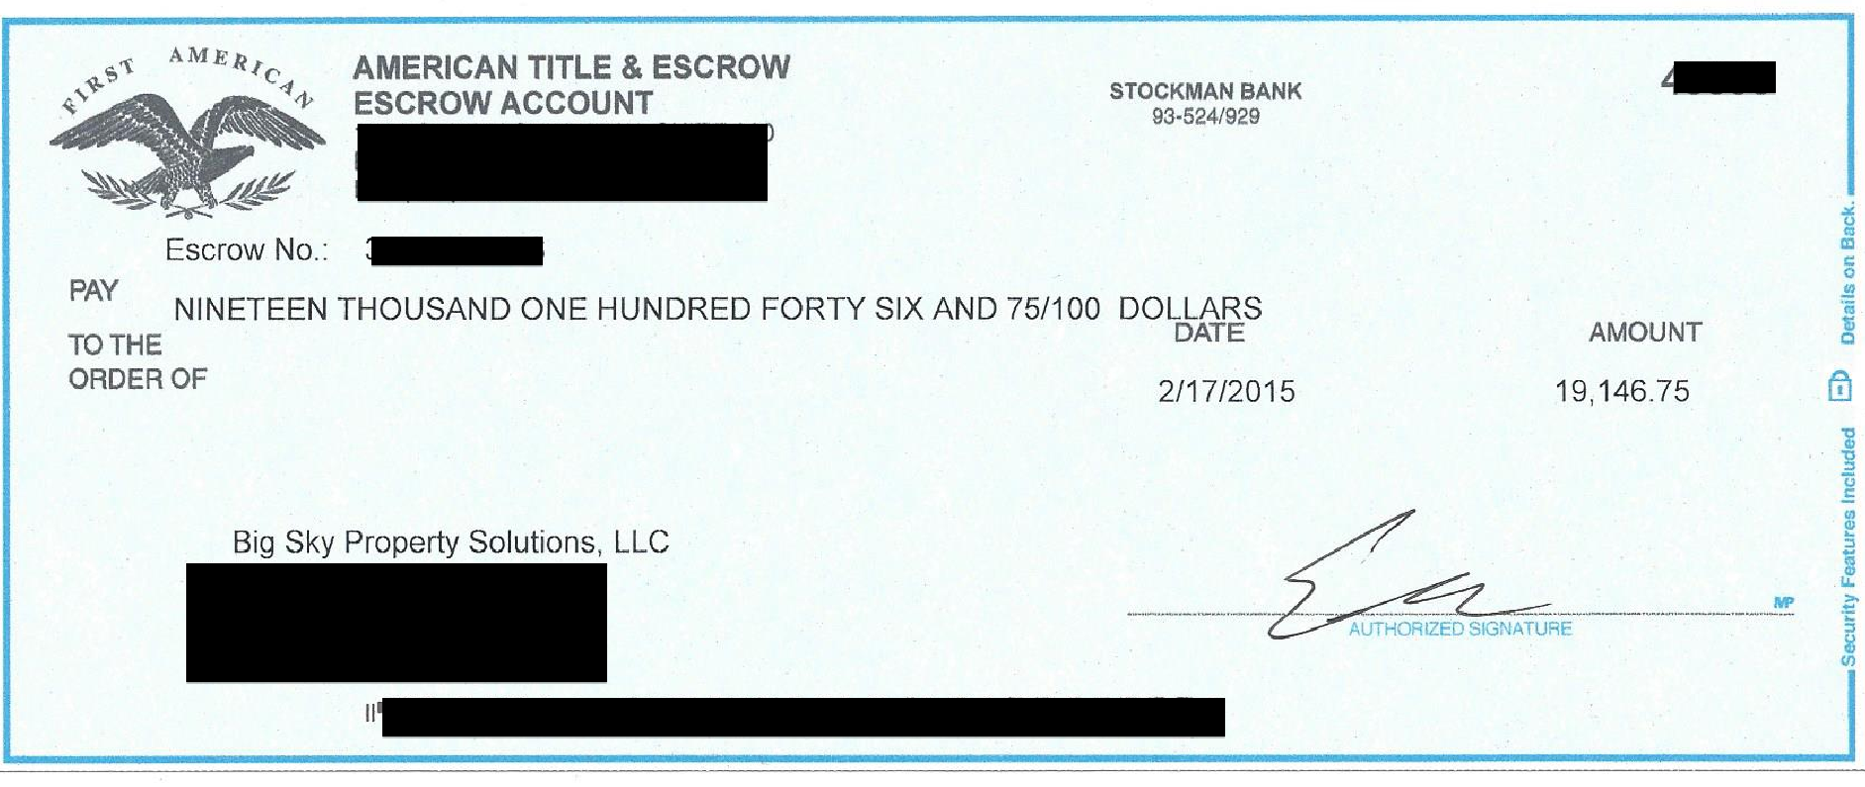
Are you Interested in How you can make Almost $20,000 on a wholesale deal?

Slide 35

Step # 7: Tweak, Automate and Repeat
Ask yourself what worked?
Write it Down
What did I struggle with?
Test something new
What took the MOST amount of time?
Figure out how to
Repeat the process with your improvements

Slide 36

If you can build a team around you that does 90% of the work for you Would you do it?

Slide 37

How do you create a System?
Document Every Step of your Business
Do everything yourself in the beginning so you can easily teach someone!
Create a Proven Plan for success
Trial and Error

Slide 38

Lets Recap our Process

Slide 39
Questions?

